Slide 1
EDU-1
Professional Certification Program

Slide 2
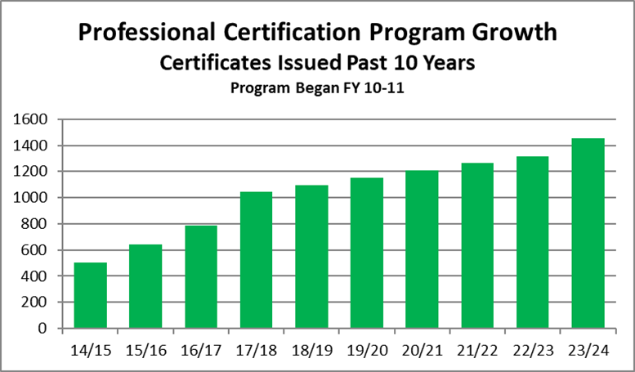
Professional Certifications
 | FY 14-15 | FY 15-16 | FY 16-17 | FY 17-18 | FY 18-19 | FY 19-20 | FY 20-21 | FY 21-22 | FY 22-23 | FY 23-24
Certificates Awarded | 198 | 140 | 142 | 257 | 53 | 56 | 60 | 56 | 48 | 158
Cumulative | 503 | 643 | 785 | 1042 | 1095 | 1151 | 1211 | 1268 | 1316 | 1474
2025 PDC Interim Report

Slide 3
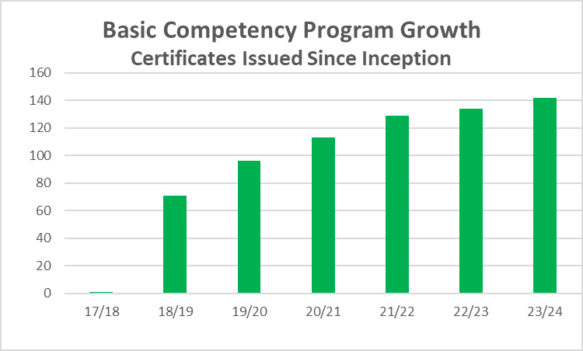
Basic Competency Certifications
 | FY 17-18 | FY 18-19 | FY 19-20 | FY 20-21 | FY 21-22 | FY 22-23 | FY 23-24 | All FYs
Basic - Weighing | 1 | 30 | 11 | 12 | 9 | 2 | 4 | 73
Basic - Measuring | 0 | 40 | 14 | 5 | 7 | 3 | 4 | 69
2025 PDC Interim Report

Slide 4
High Utilization States – Professional Certificates
State | Certificates | State | Certificates
Minnesota | 233 | Arizona | 41
Louisiana | 177 | Nebraska | 33
Missouri | 143 | Nevada | 29
Wisconsin | 101 | Maine | 27
Maryland | 87 | New Mexico | 25
Virginia | 81 | New York | 19
Alaska | 64 | Colorado | 19
Mississippi | 56 | Connecticut | 15
North Carolina | 56 | Private | 15
Washington | 50 | Ohio | 14
Kansas | 46 | Montana | 14
California | 41 | Indiana | 13
2025 PDC Interim Report

Slide 5
Professional Certifications - Devices
FY | 14-15 | 15-16 | 16-17 | 17-18 | 18-19 | 19-20 | 20-21 | 21-22 | 22-23 | 23-24 | Total
Small Capacity | 47 | 22 | 26 | 67 | 11 | 8 | 11 | 5 | 6 | 25 | 230
Medium Capacity | 30 | 18 | 28 | 36 | 3 | 3 | 0 | 2 | 5 | 18 | 143
Large Capacity | 11 | 20 | 25 | 18 | 2 | 5 | 2 | 3 | 2 | 7 | 95
Precision Scales |  |  |  |  |  |  | 3 | 4 | 1 | 12 | 20
Retail Motor Fuel | 65 | 43 | 35 | 56 | 20 | 17 | 12 | 14 | 16 | 36 | 314
Vehicle-Tank Meters | 20 | 18 | 14 | 24 | 7 | 2 | 2 | 4 | 2 | 16 | 109
LPG and Anhydrous |  |  |  |  |  |  | 0 | 1 | 0 | 1 | 2
Total | 173 | 121 | 128 | 201 | 43 | 35 | 30 | 33 | 32 | 115 | 913
All values based on passed exams
2025 PDC Interim Report

Slide 6
Professional Certifications – Regulatory
FY | 14-15 | 15-16 | 16-17 | 17-18 | 18-19 | 19-20 | 20-21 | 21-22 | 22-23 | 23-24 | Total
Package Checking – Basic | 25 | 19 | 14 | 56 | 10 | 3 | 7 | 8 | 7 | 8 | 157
Price Verification |  |  |  |  |  | 19 | 23 | 15 | 7 | 14 | 78
Packaging and Labeling |  |  |  |  |  |  |  |  | 15 | 5 | 20
Method of Sale |  |  |  |  |  |  |  |  | 17 | 16 | 34
Total | 25 | 19 | 14 | 56 | 10 | 22 | 30 | 23 | 46 | 43 | 288
All values based on passed exams
2025 PDC Interim Report

Slide 7
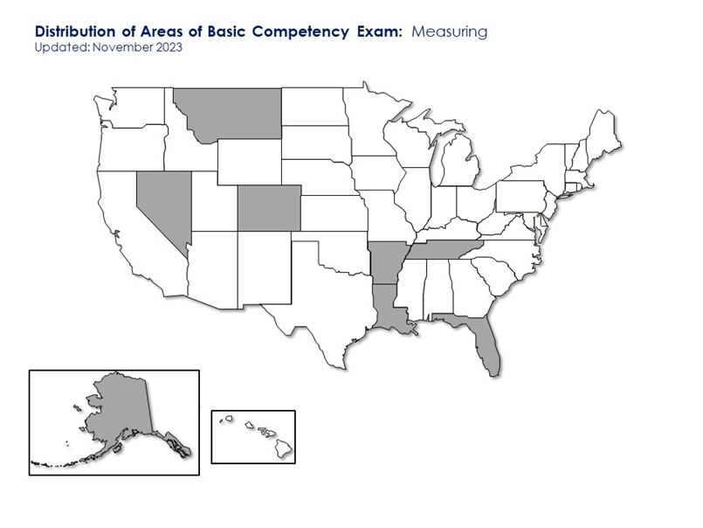
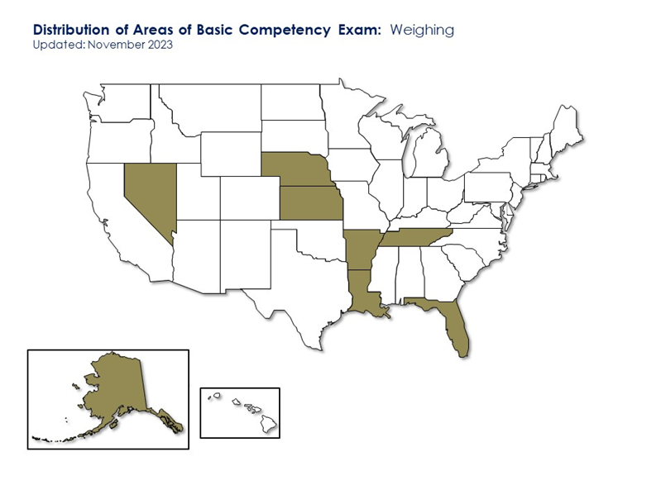
Basic Competency Certifications
 | FY 17-18 | FY 18-19 | FY 19-20 | FY 20-21 | FY 21-22 | FY22-23 | FY 23-24 | ALL FYs
Basic Measuring | 0 | 40 | 14 | 5 | 7 | 3 | 4 | 69
Basic Weighing | 1 | 30 | 11 | 12 | 9 | 2 | 4 | 73
Total | 1 | 70 | 25 | 17 | 16 | 5 | 8 | 142
2024 PDC Interim Report

Slide 8
Registered Service Agent Exam Program
Service Agent Exams
  Test at state facility or designated testing center
  Test results available immediately – certificate issued to test taker
  Feedback on results provided to all test takers
  Exams with passing scores posted on limited access test website
  NCWM hosts state regulatory exams
  Exams available now – Handbook 44, Small Scales, RMFD, Large Capacity Weighing, LPG and Anhydrous, Vehicle Tank Meters, State of Minnesota
Exam Type | NCWM Member | Non-Member | Virtual Proctoring
NCWM Technical Exam | $50 | $100 | $20
State Regulatory Exam | $20 | $50 | $20
2025 PDC Interim Report

Slide 9
Proctoring
Proctoring of all exams required
In-person and virtual proctoring available
  List of authorized in-person proctors on NCWM website
  Virtual proctoring through Test.com – no cost to members, $20 for RSA Exams
In-Person vs Virtual FY 23-24
 | In-person | Virtual
Professional Certification | 272 | 9
Basic Competency Certification | 35 | 1
2025 PDC Interim Report

Slide 10
Achievements and Plans
  Registered Service Agent – Five exams
    Large Capacity Weighing Systems Exam
    Vehicle Tank Meter Exam
    Retail Motor Fuel Dispensers
    LPG and Anhydrous Ammonia Liquid Metering Systems
    Electric Vehicle Fueling Systems
  Feedback provided for all exams
  State exams are available
    Minnesota, New Hampshire, Nebraska, Ohio, and Wisconsin
2024 PDC Interim Report

Slide 11
Achievements and Plans
Projects In Progress
  Professional Certification Exams
    Electric Vehicle Fueling – July 2025
    Retail Motor Fuel Dispensing Revision – September 2025
    Small Capacity Weighing Systems Revision – December 2025
Looking ahead
  Determine need for other exams
  Work with states for jurisdiction specific exams
  Provide support as needed
2024 PDC Interim Report

