Slide 1



Slide 2


Slide 3


Slide 4
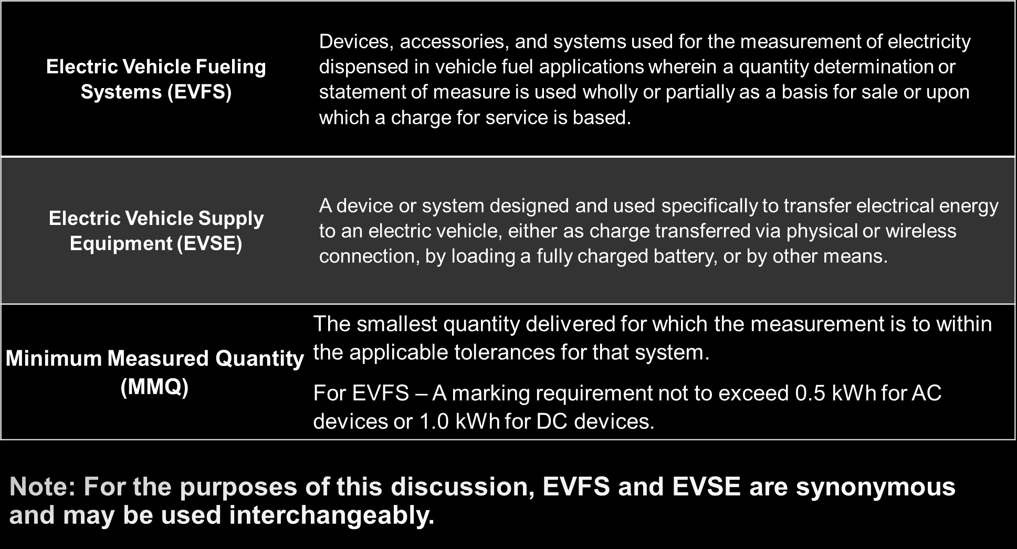

Slide 5


Slide 6


Slide 7
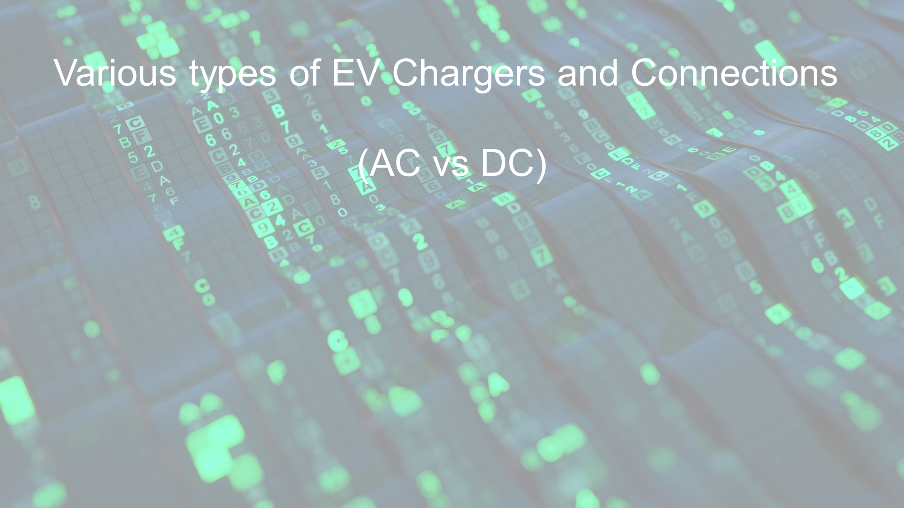

Slide 8
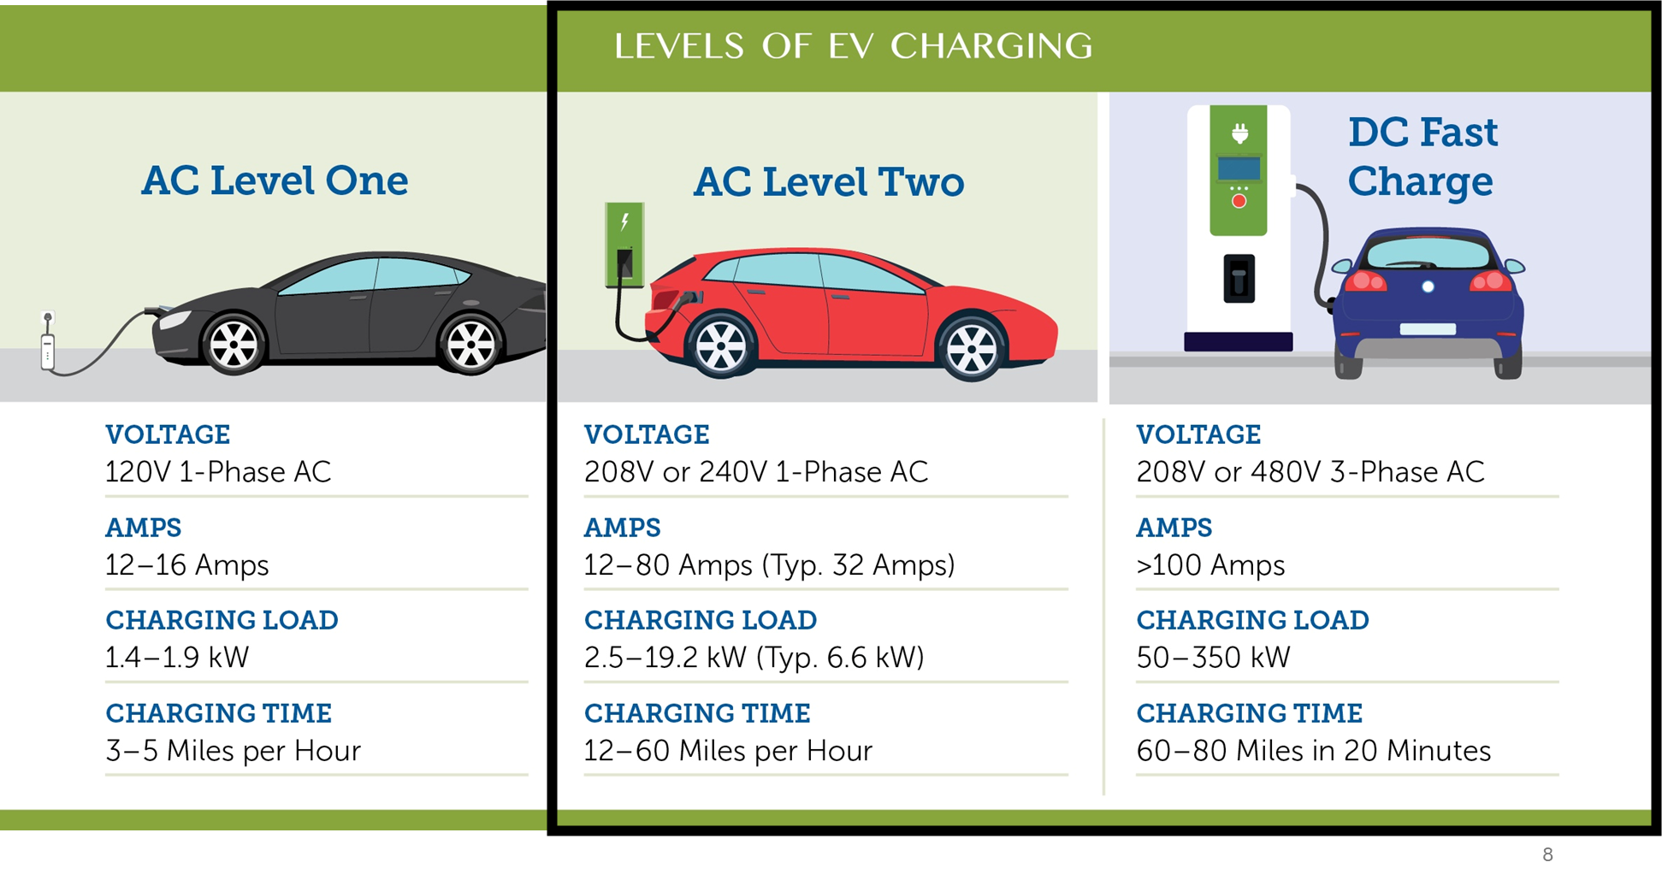

Slide 9
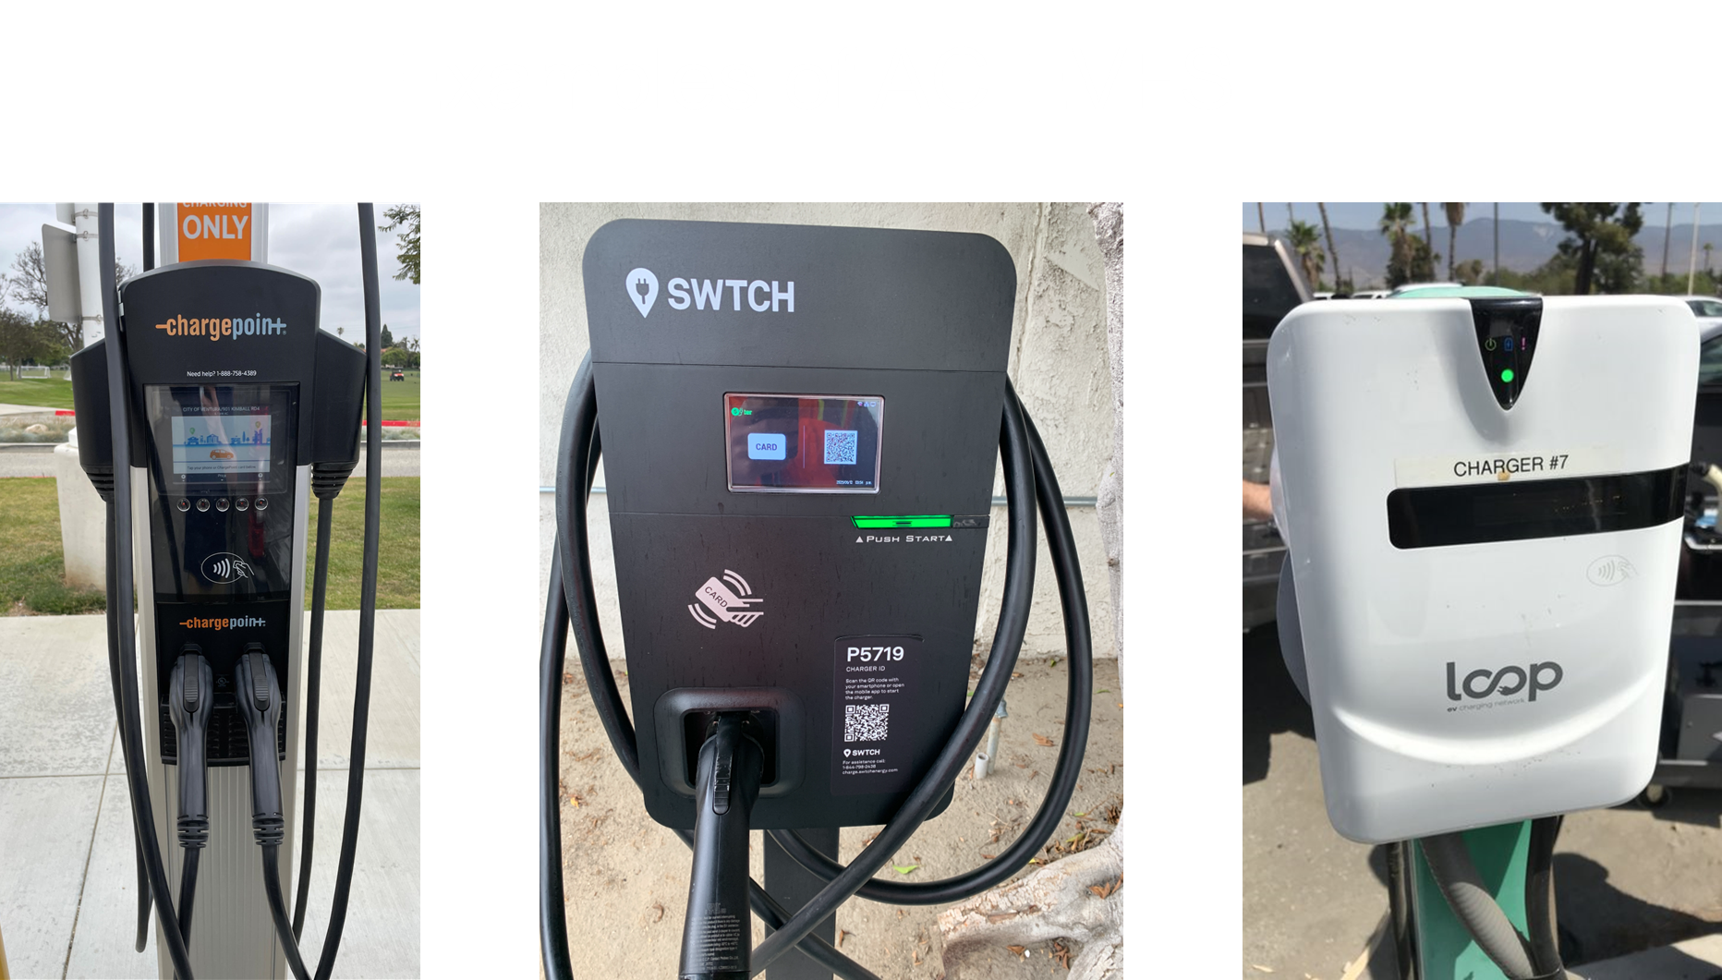

Slide 10
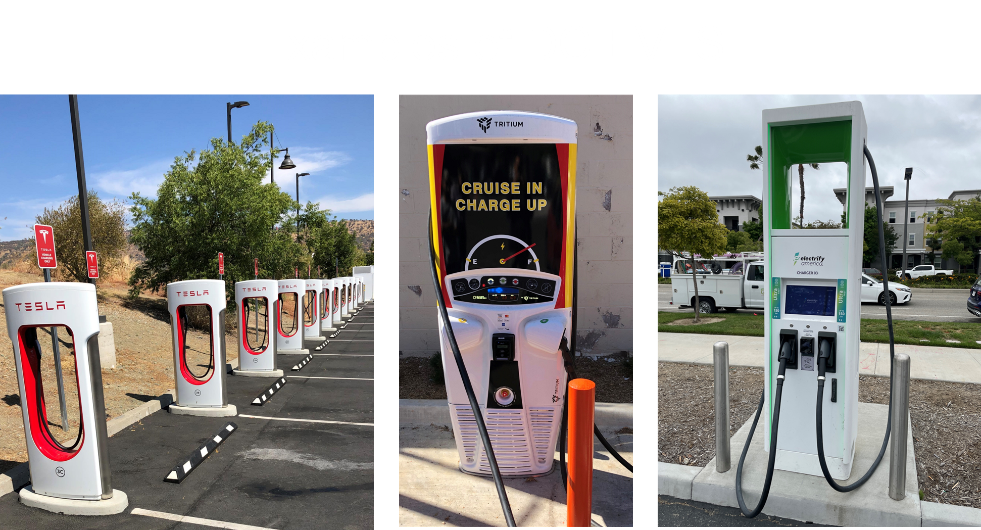

Slide 11
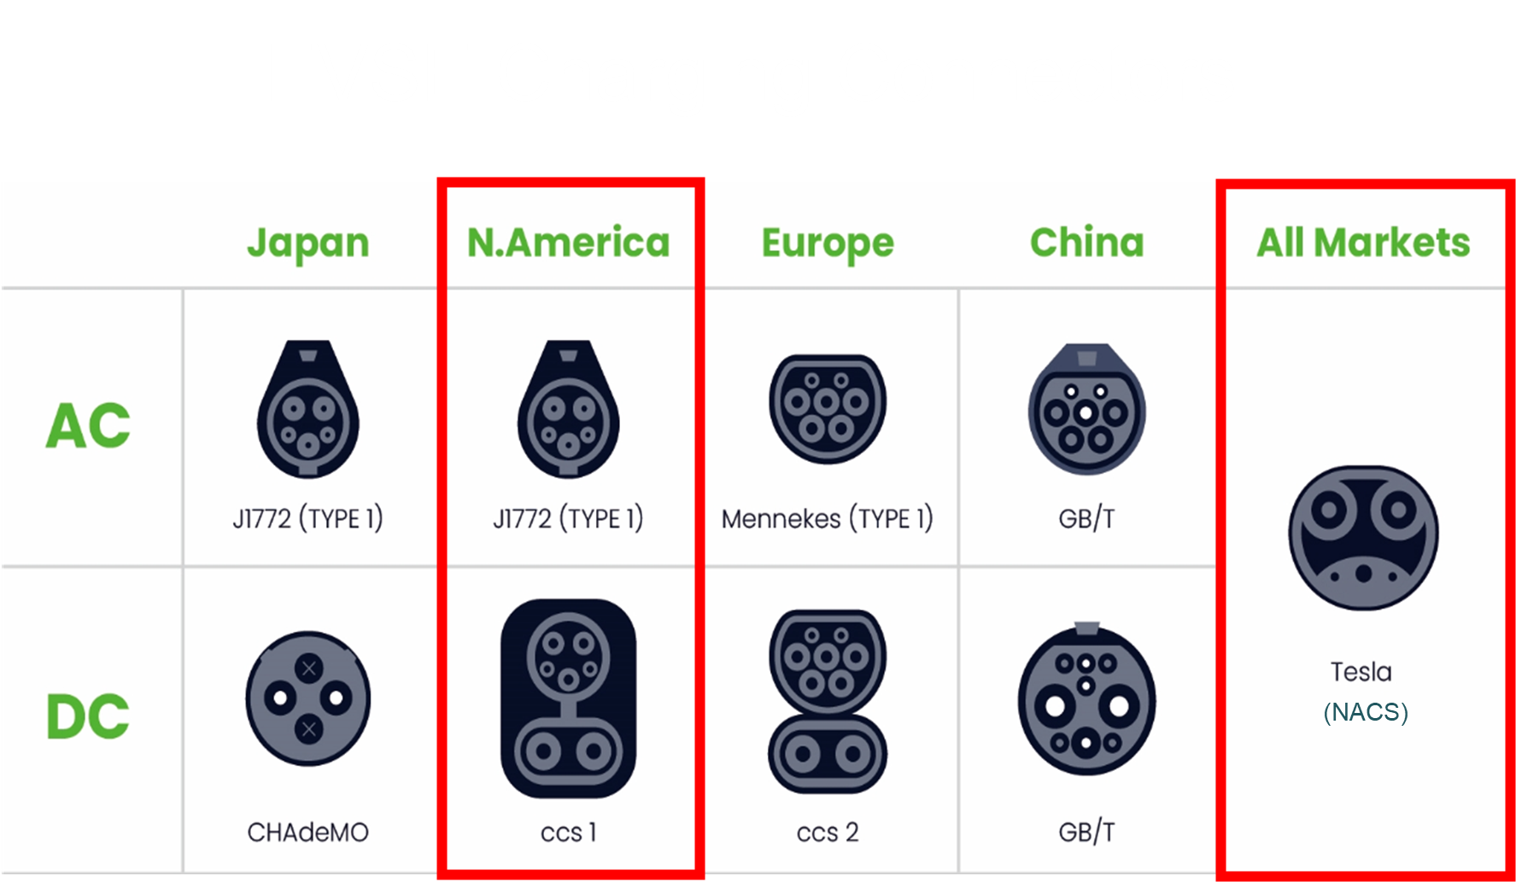

Slide 12
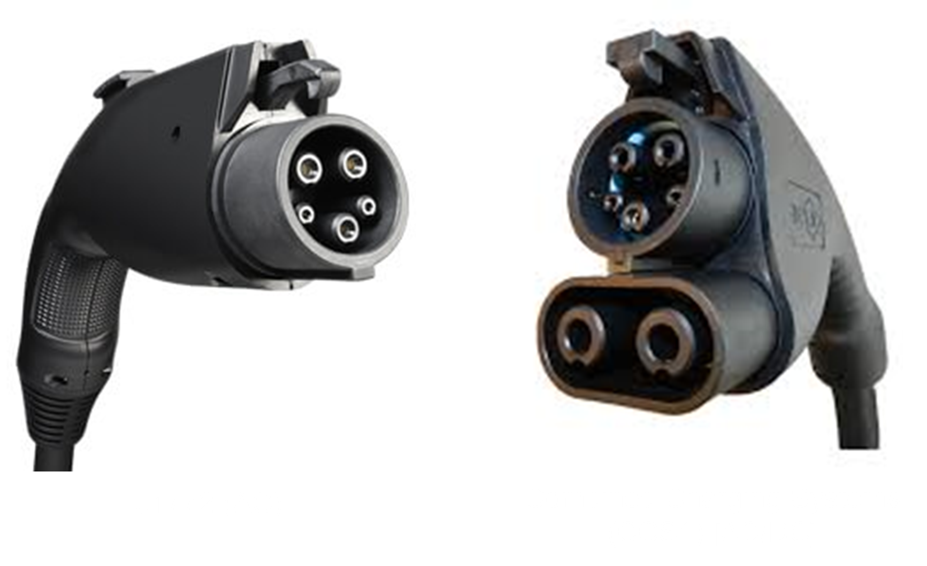

Slide 13
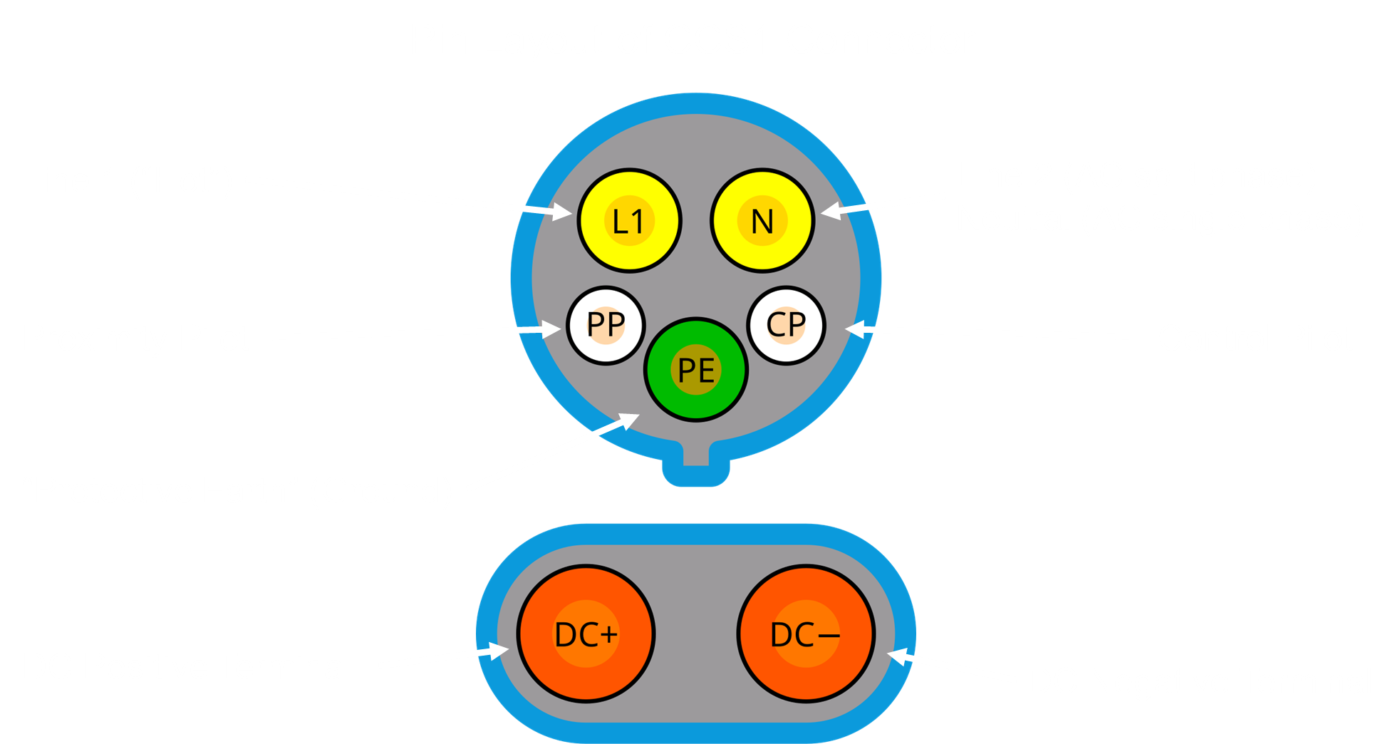

Slide 14
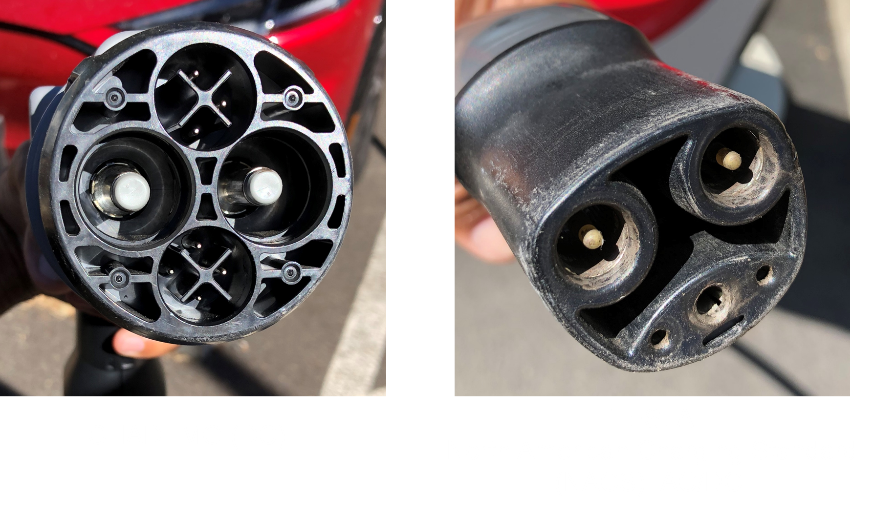

Slide 15
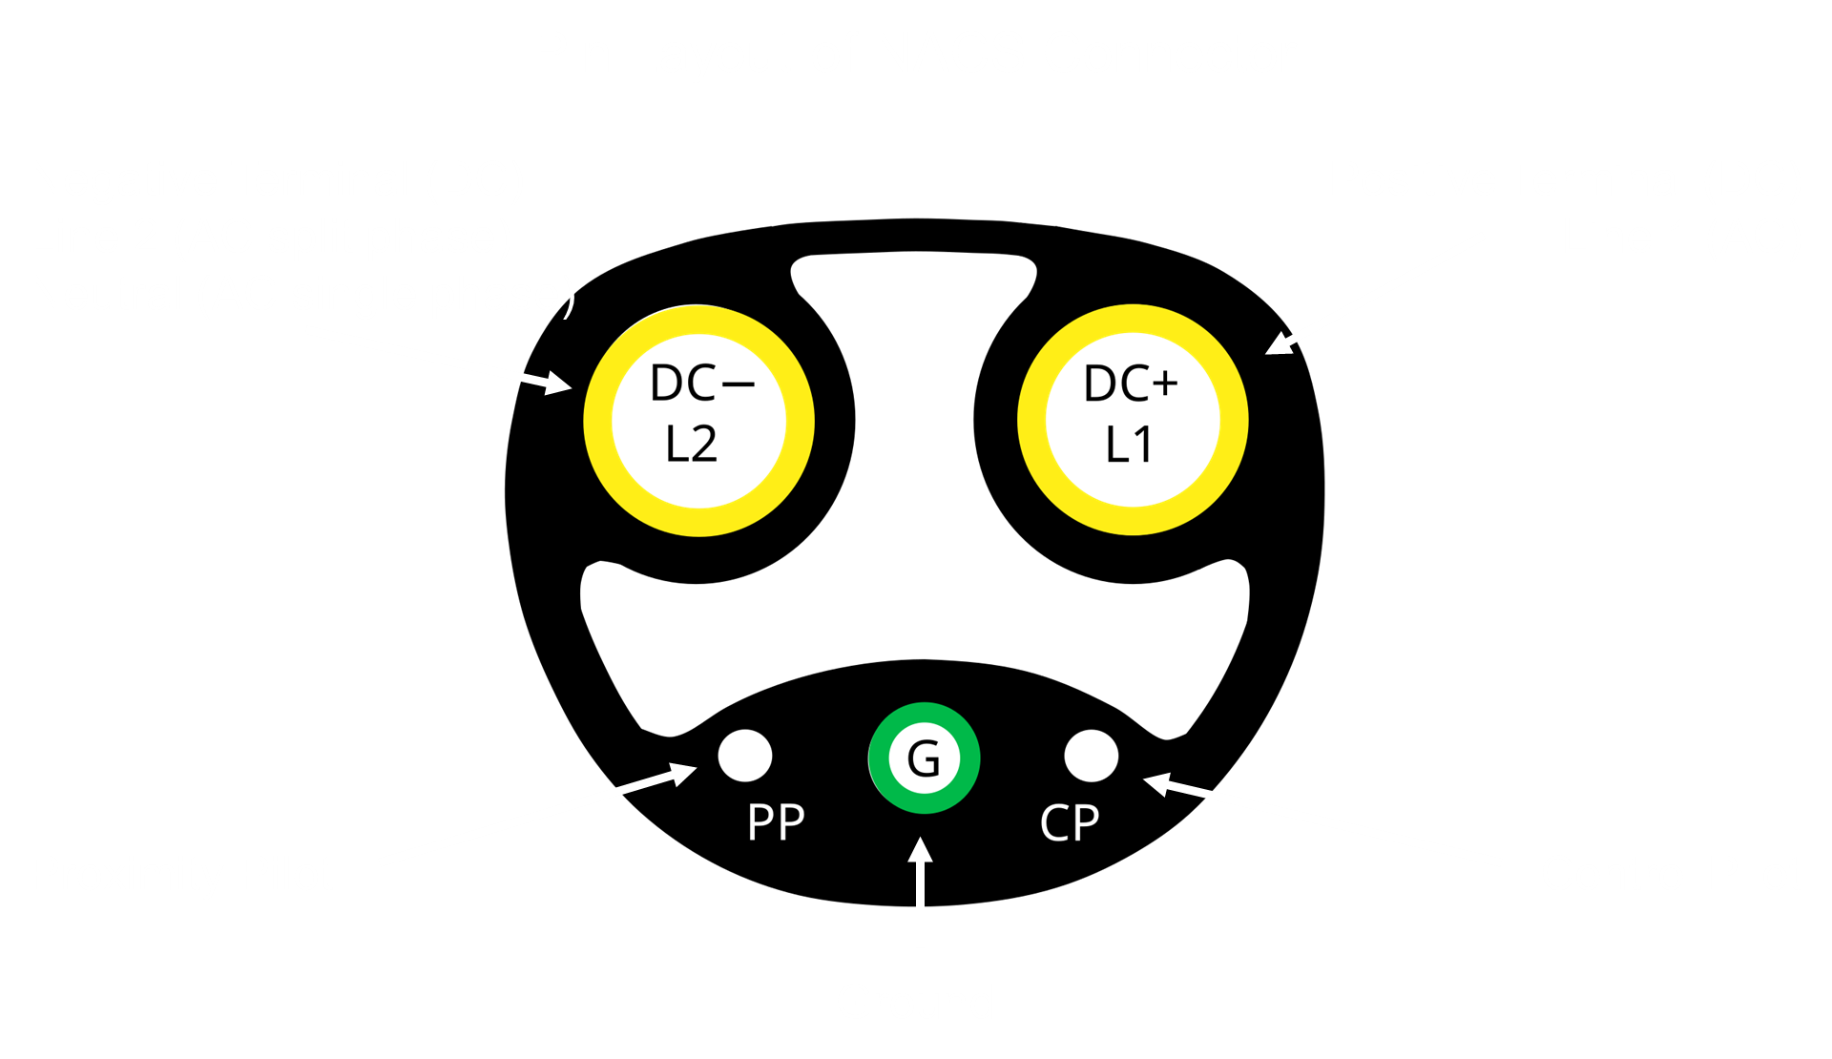

Slide 16
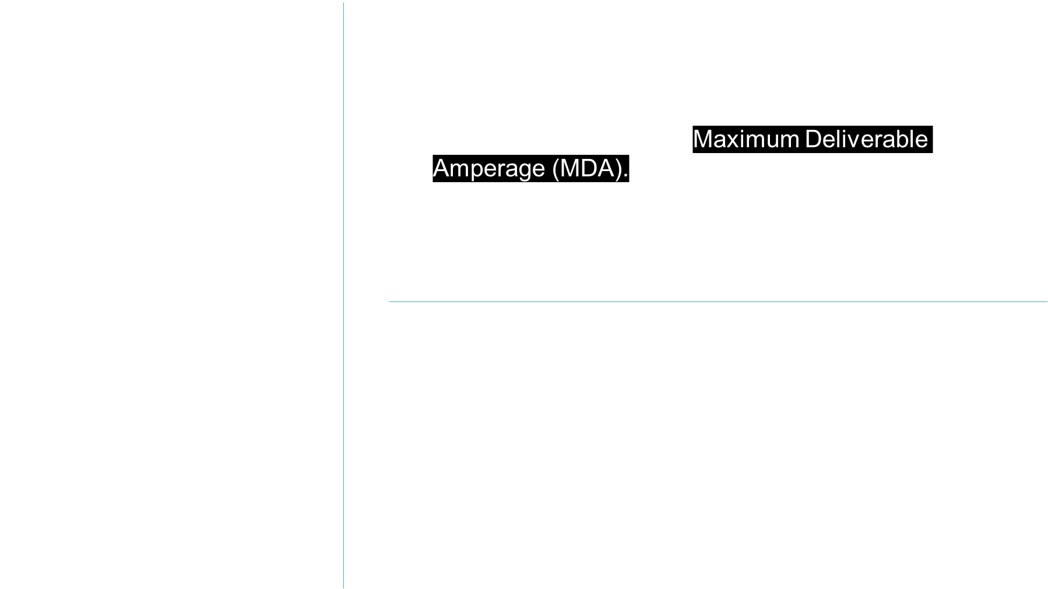

Slide 17


Slide 18
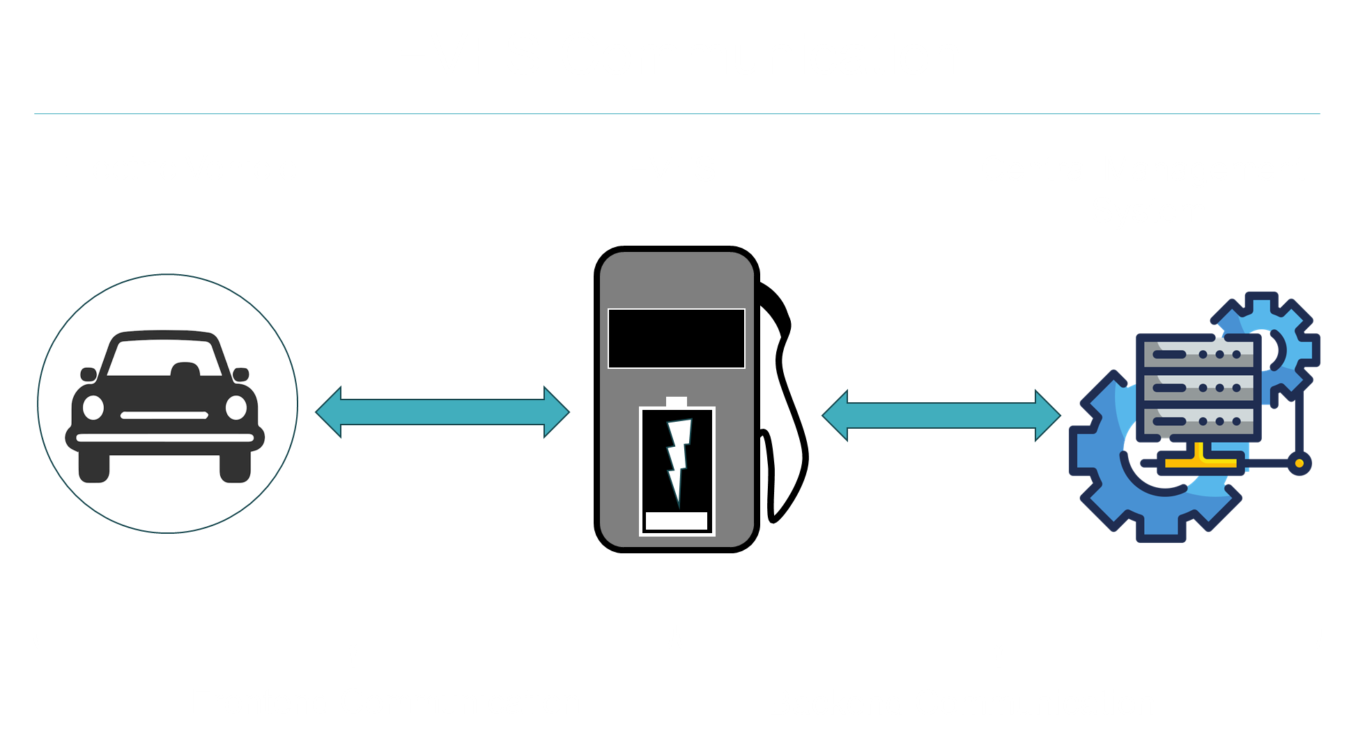

Slide 19
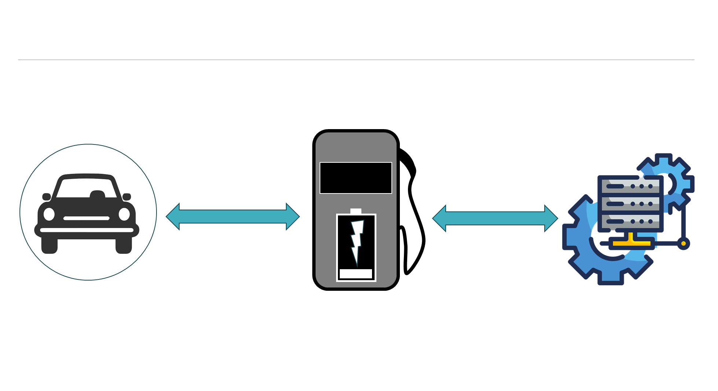

Slide 20
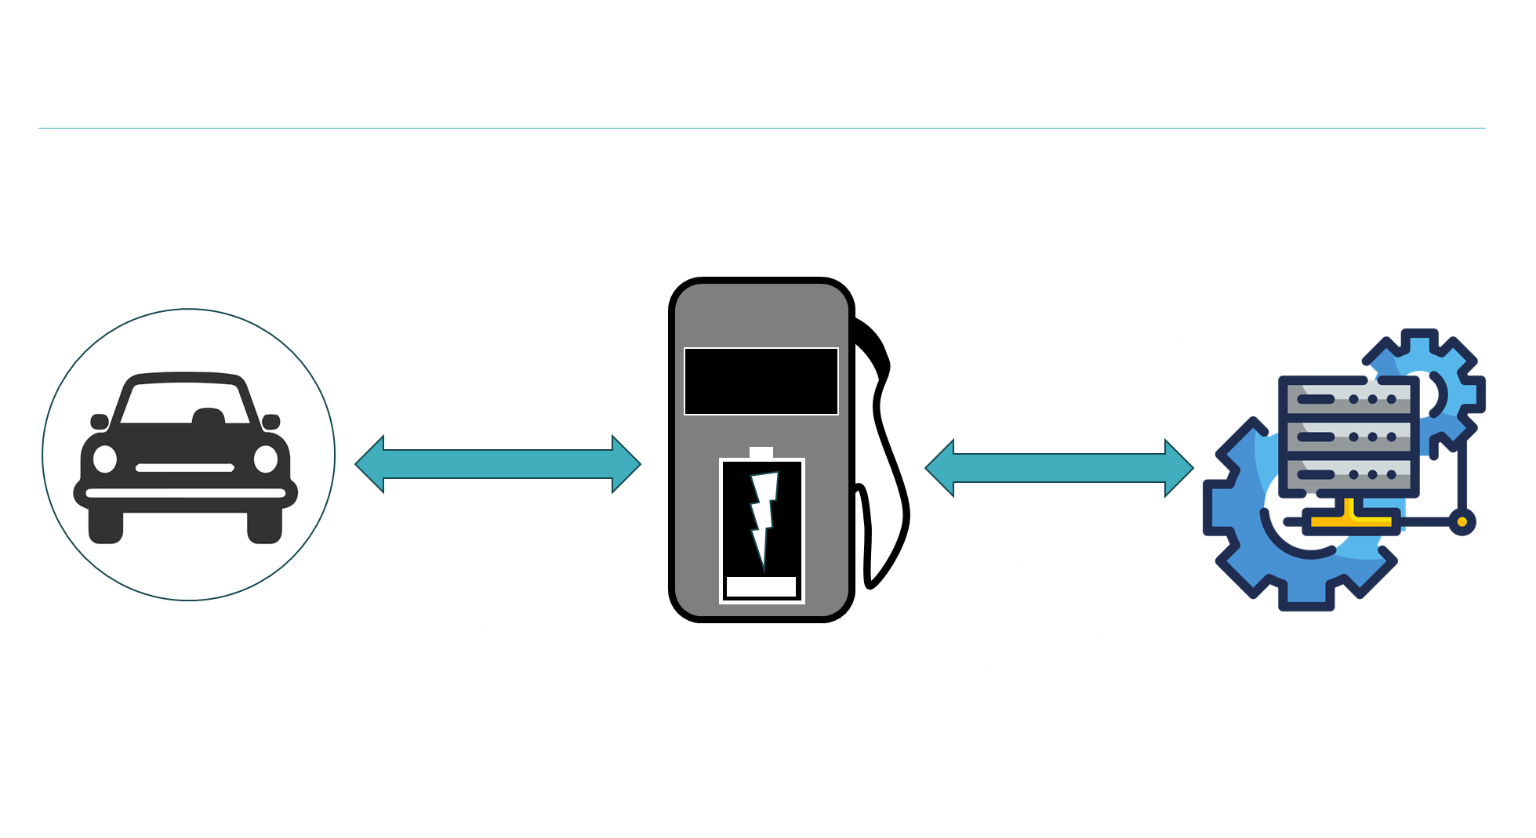
Notes:
Charger communication protocols and downfalls found. OCPP 1.6j communicating in a WH indication for both AC and DC.
When you plug a charging connector into a vehicle, two separate digital conversations occur with the charger sitting in between the two. The first conversation is between the vehicle and the charger, where the vehicle asks the charger for power and the charger must understand the request in order to deliver. This conversation tends to be guided either by ISO 15118, which was developed by the International Standardization Organization (ISO), or by DIN SPEC 70121, where DIN stands for the German Institute for Standardization, a non-profit organization serving as the national body for standardization. On the other side, the charger talks to the network operator to authorize payments, track the charging session, provide status updates to the driver’s phone app, and allow the operator to see any problems with the charging session. This communication process is typically guided by a protocol developed by the Open Charge Alliance (OCA) called Open Charge Point Protocol (OCPP).
OCPP 1.6j does not utilize TLS and generally requires no security or is password protected.

Slide 21
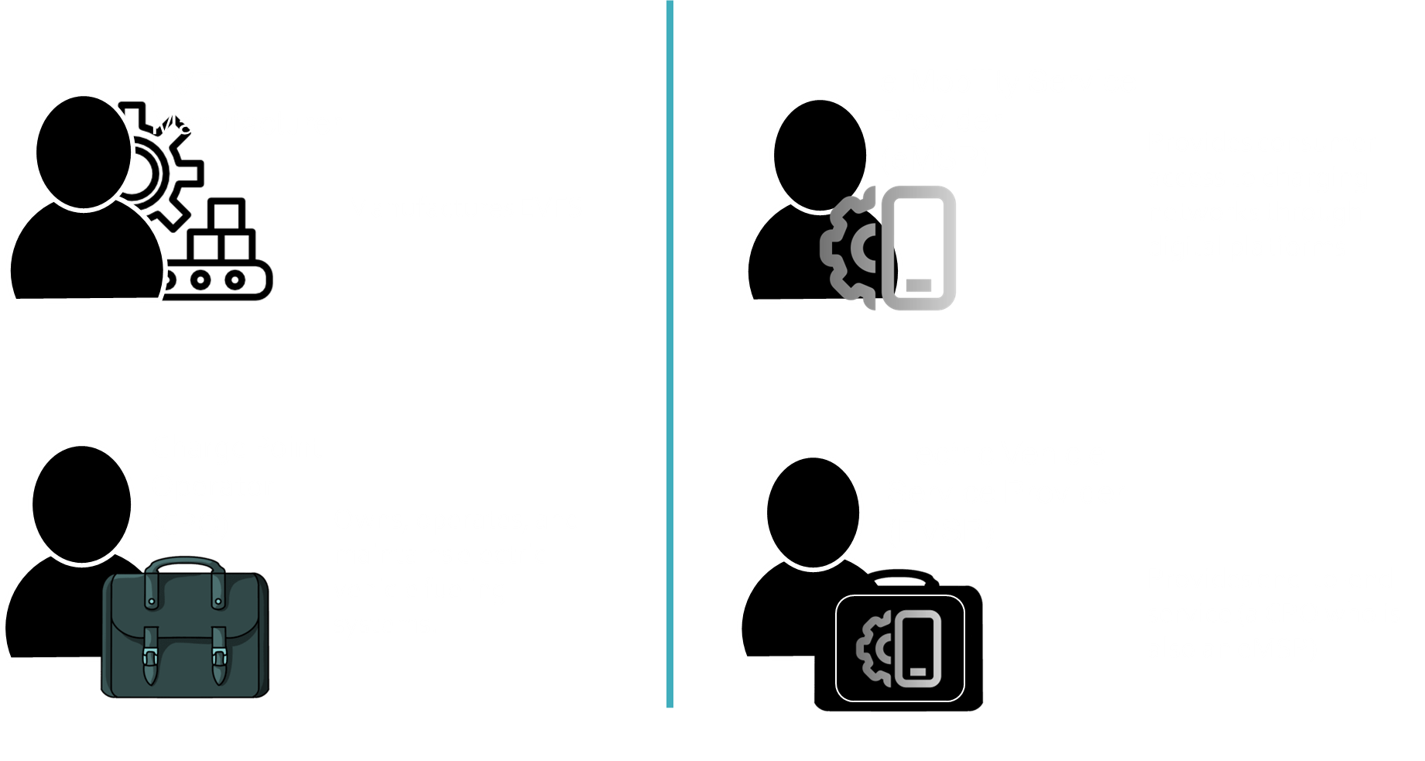

Slide 22


Slide 23
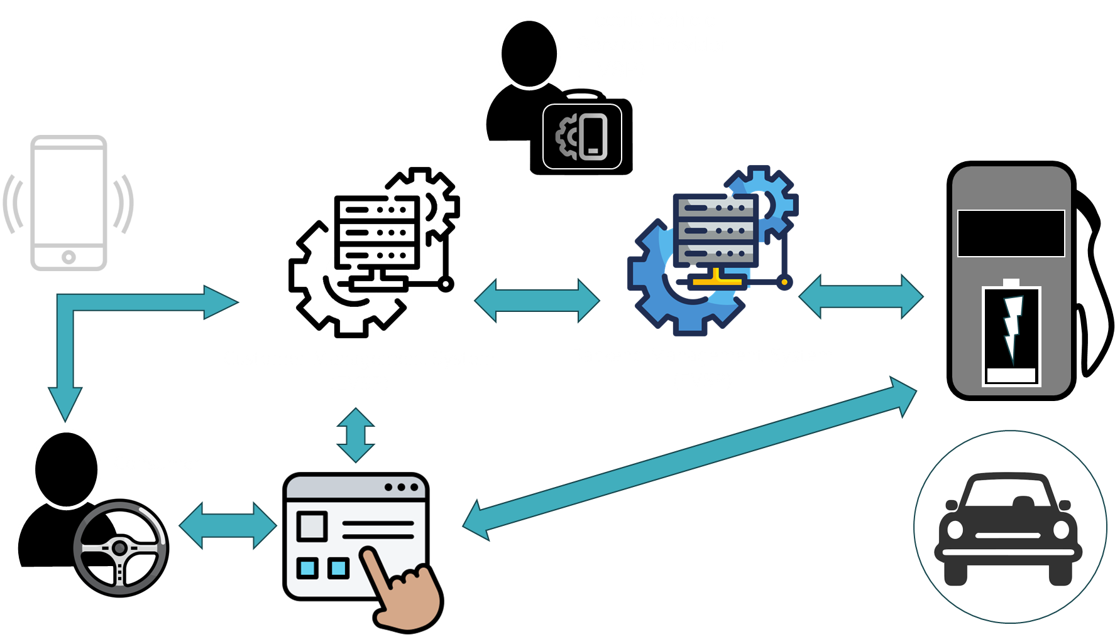

Slide 24
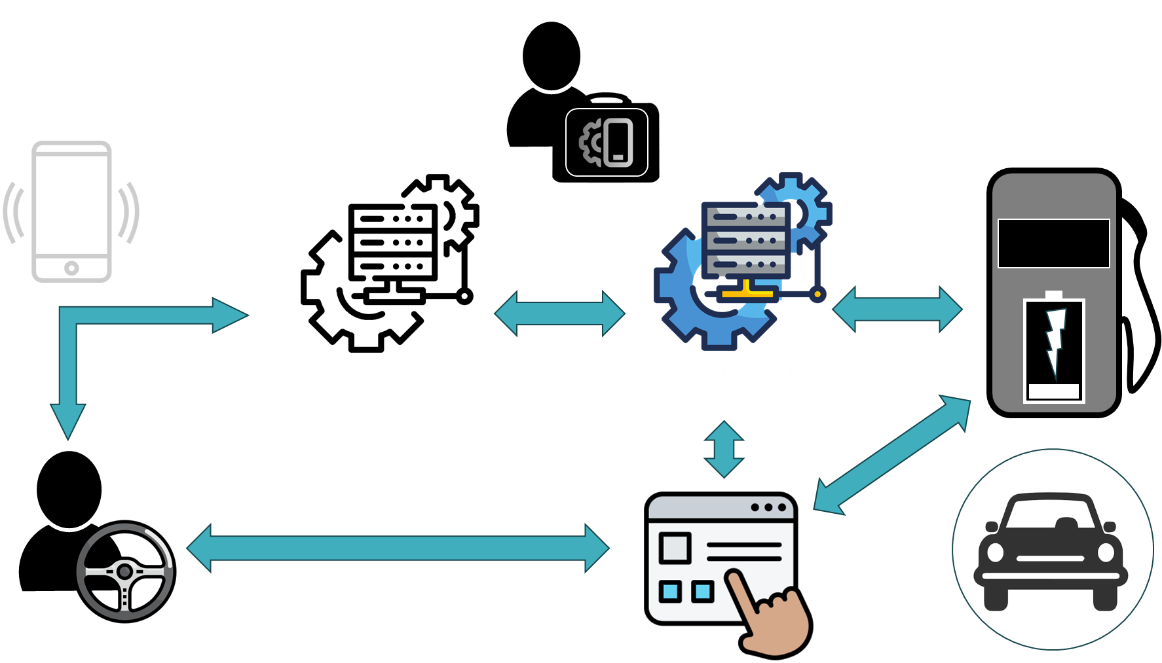

Slide 25
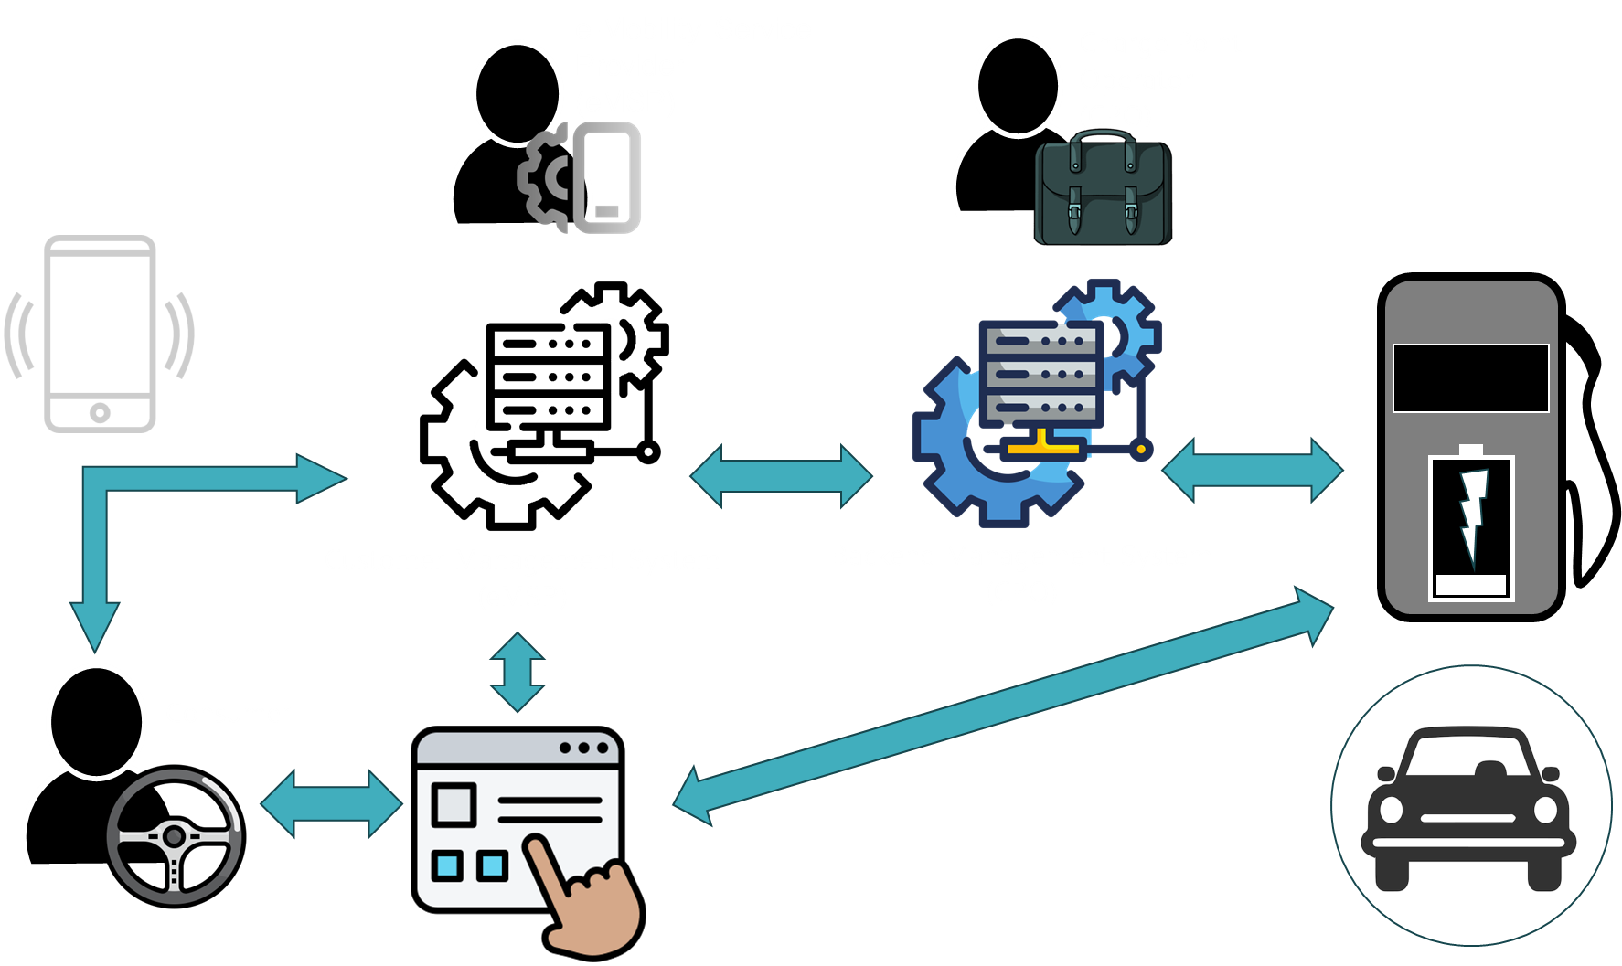

Slide 26
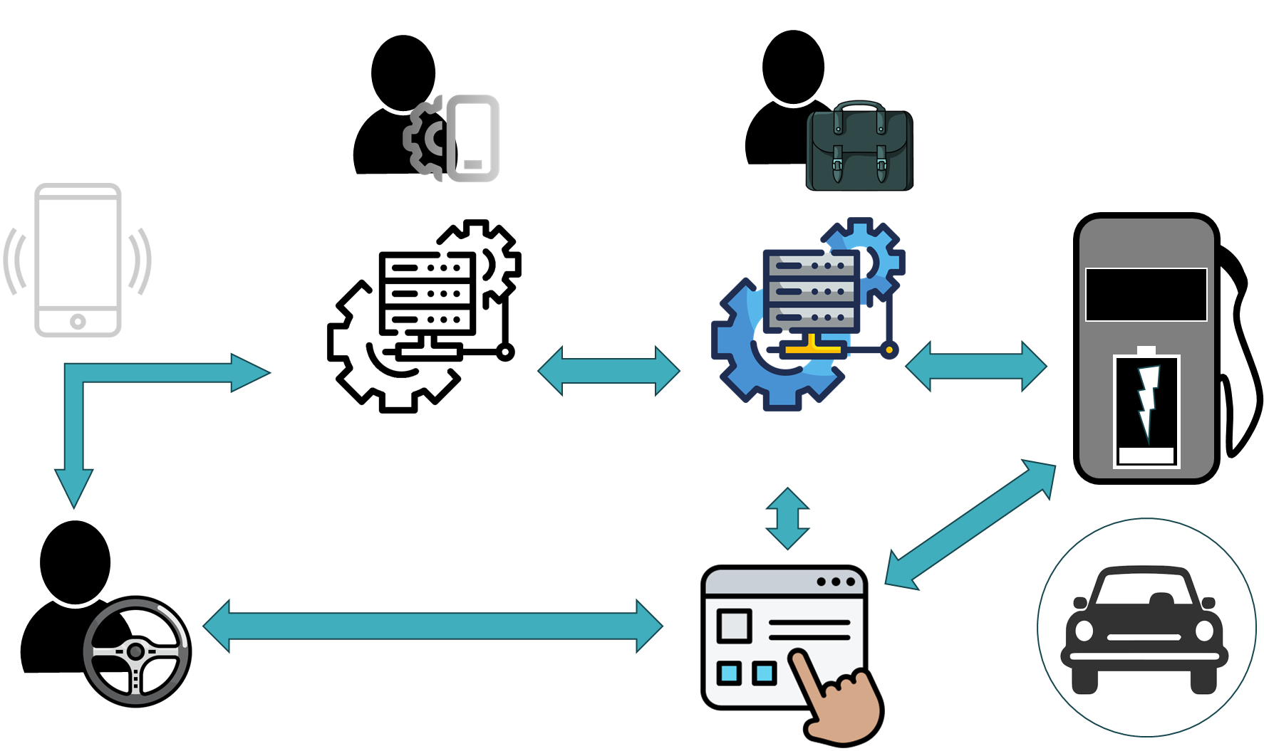

Slide 27
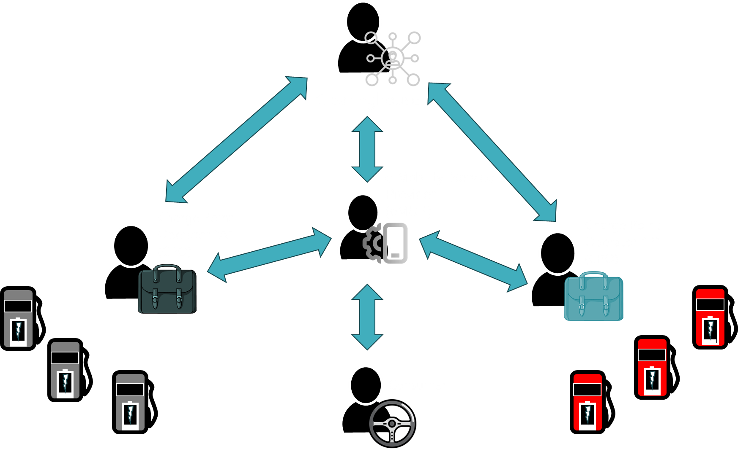

Slide 28
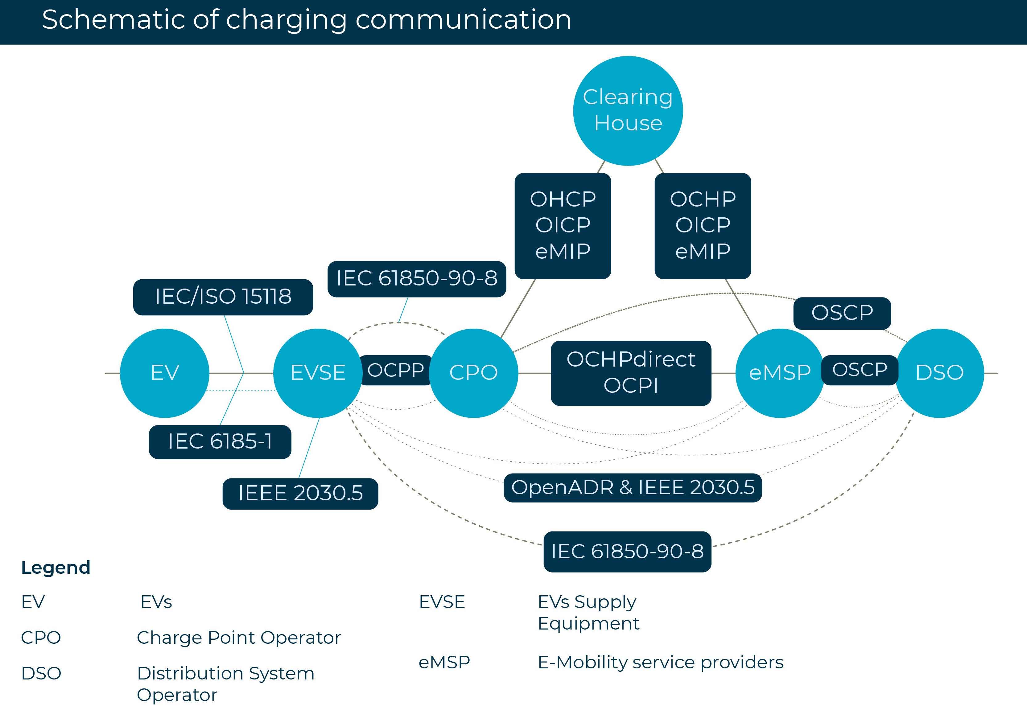

Slide 29
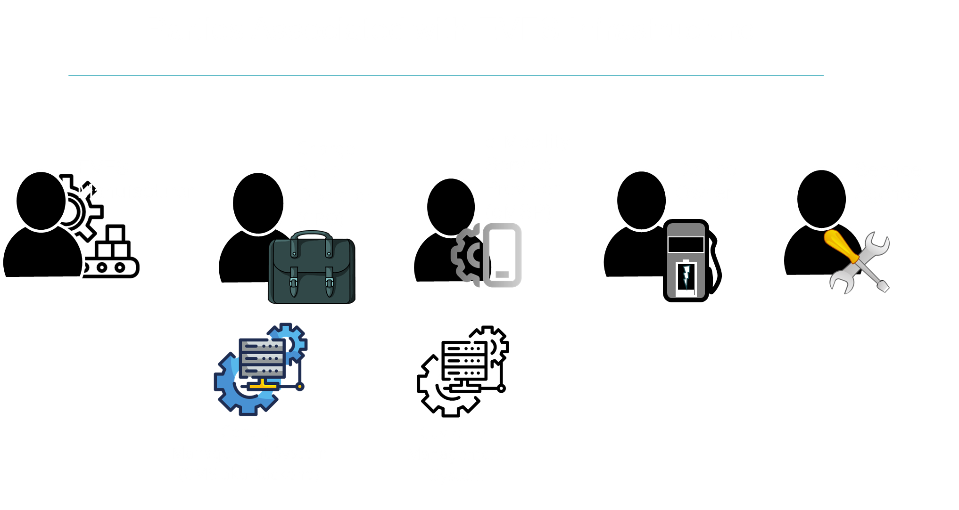

Slide 30
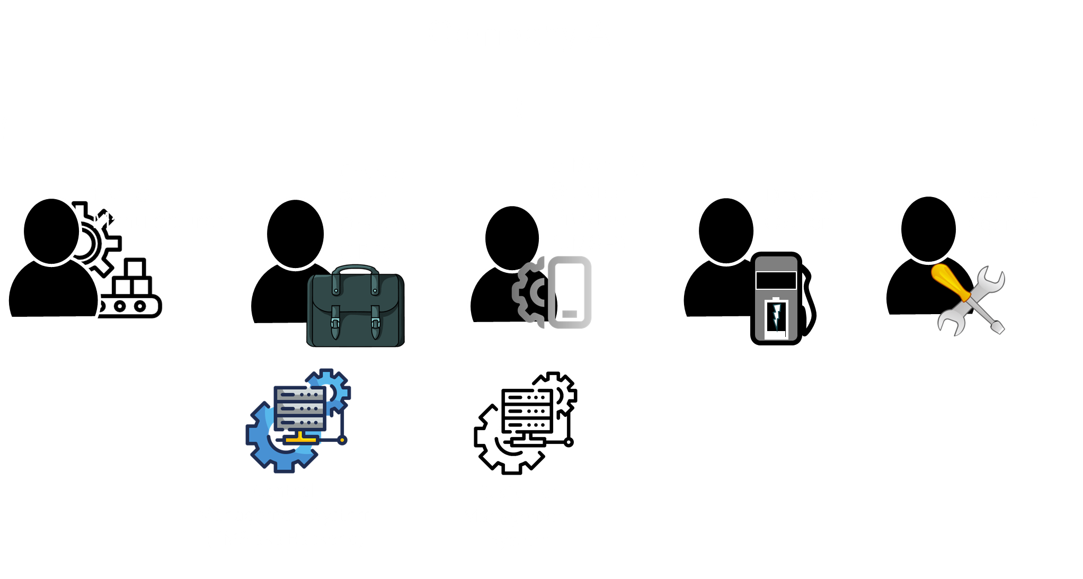

Slide 31


Slide 32


Slide 33
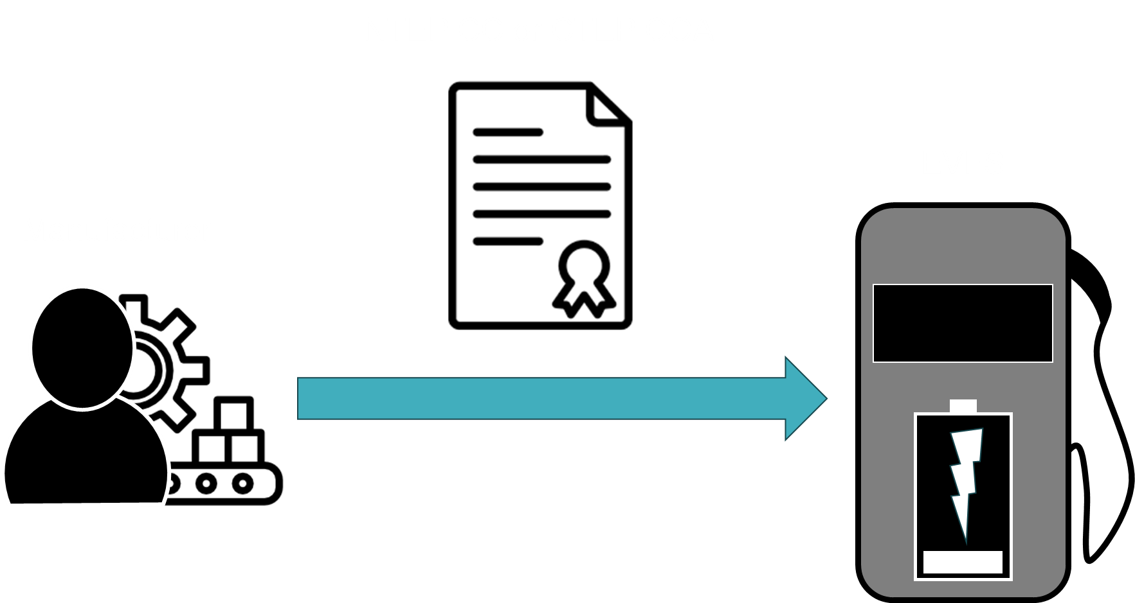

Slide 34
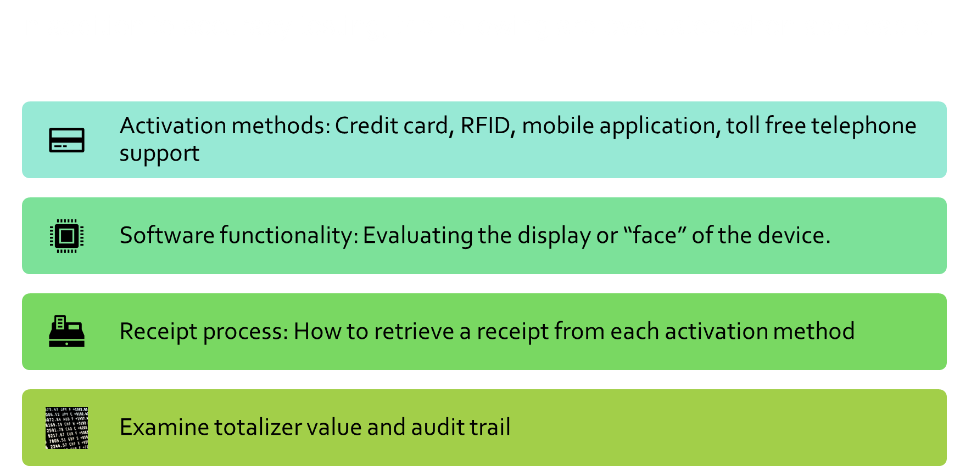
Notes:
Things to keep in mind while testing EVSE for type approval.
mobile application must have required markings.

Slide 35
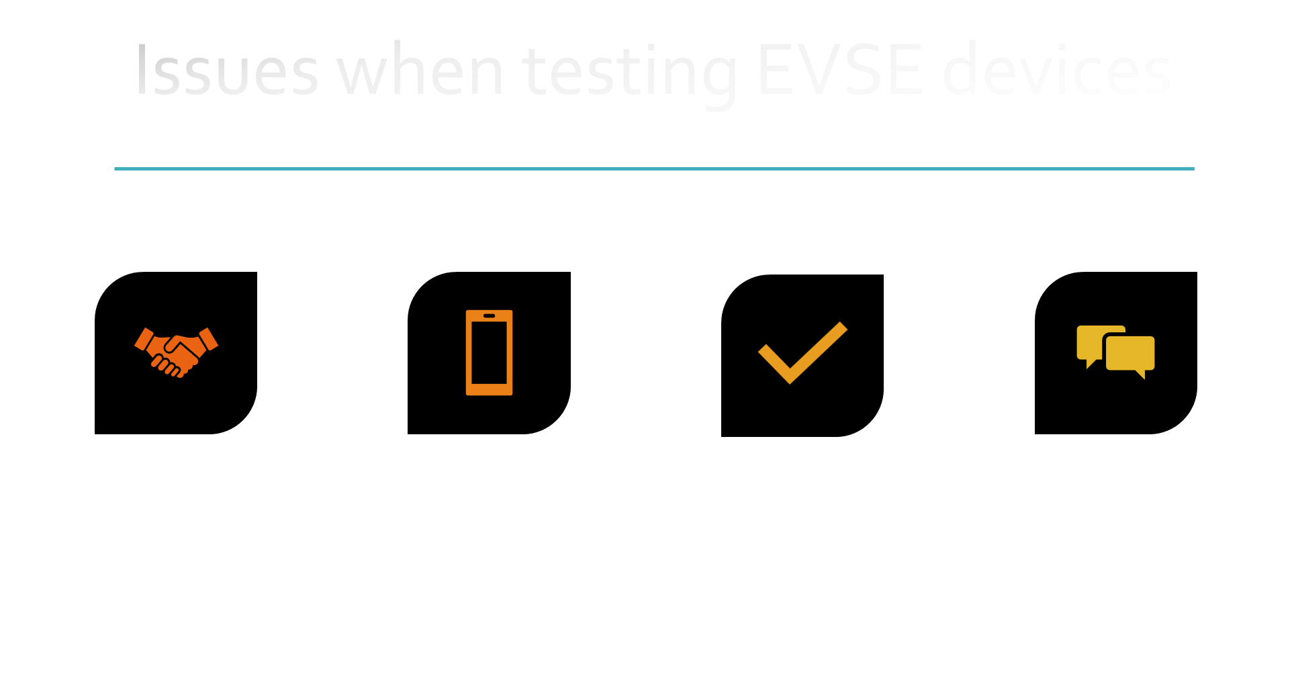
Notes:
Discuss the inability for some chargers to display the totalizer value during the initial type evaluation. Activation methods an issue for some devices in the field, especially if they are only RFID activated. Markings on HMI and receipt must match, agreement of indications. Discuss zero placeholder and power loss not shown on receipt. Some pitfalls I have seen is trying to list a disclaimer for power loss on every receipt. Requirement to display on receipt that the session was ended due to power loss.
ISO 15118 communication errors with tesco, TESCO and TESLA communication errors. Possibly more to come.

Slide 36
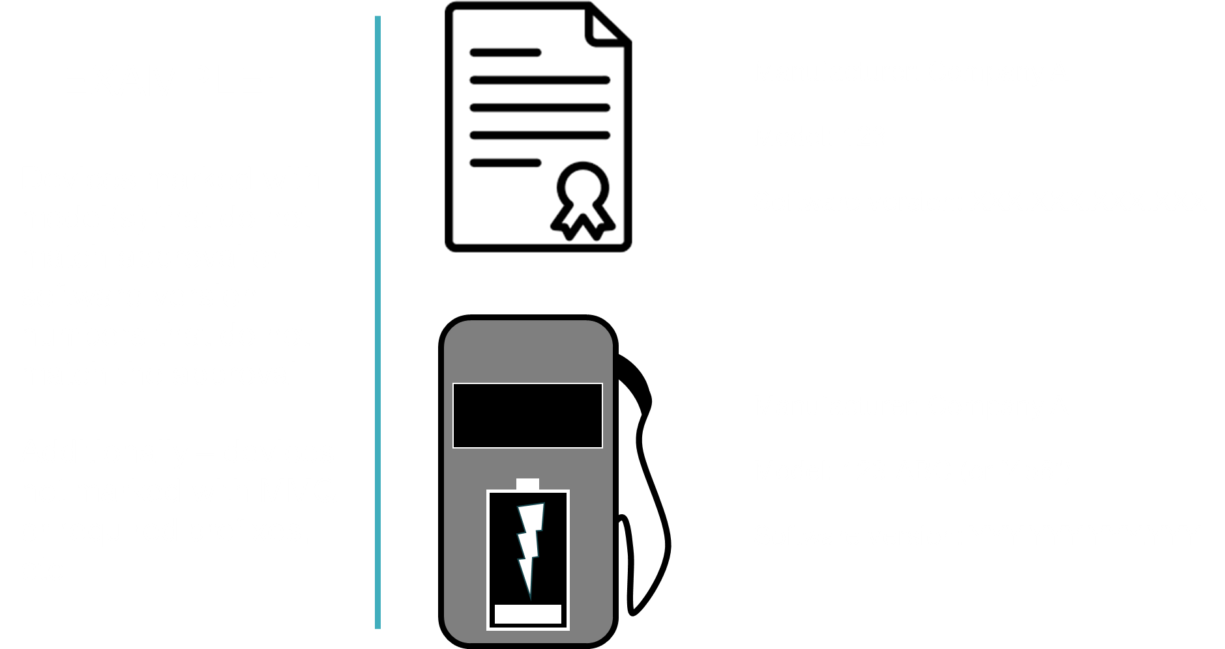

Slide 37
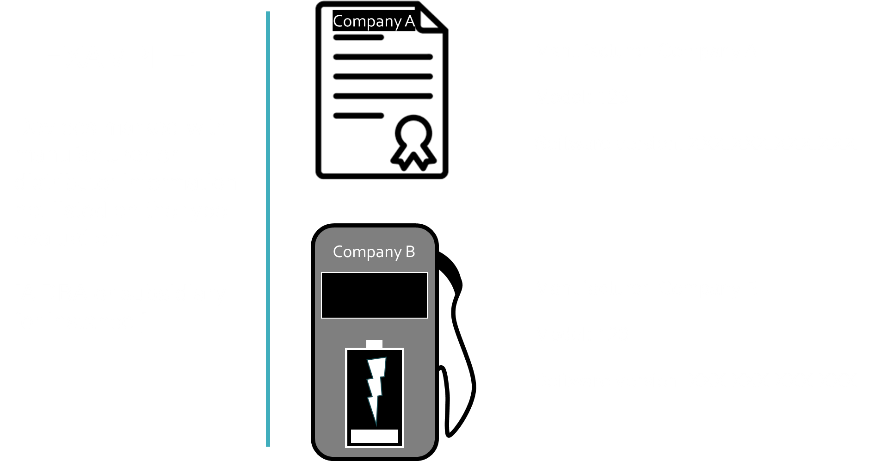

Slide 38
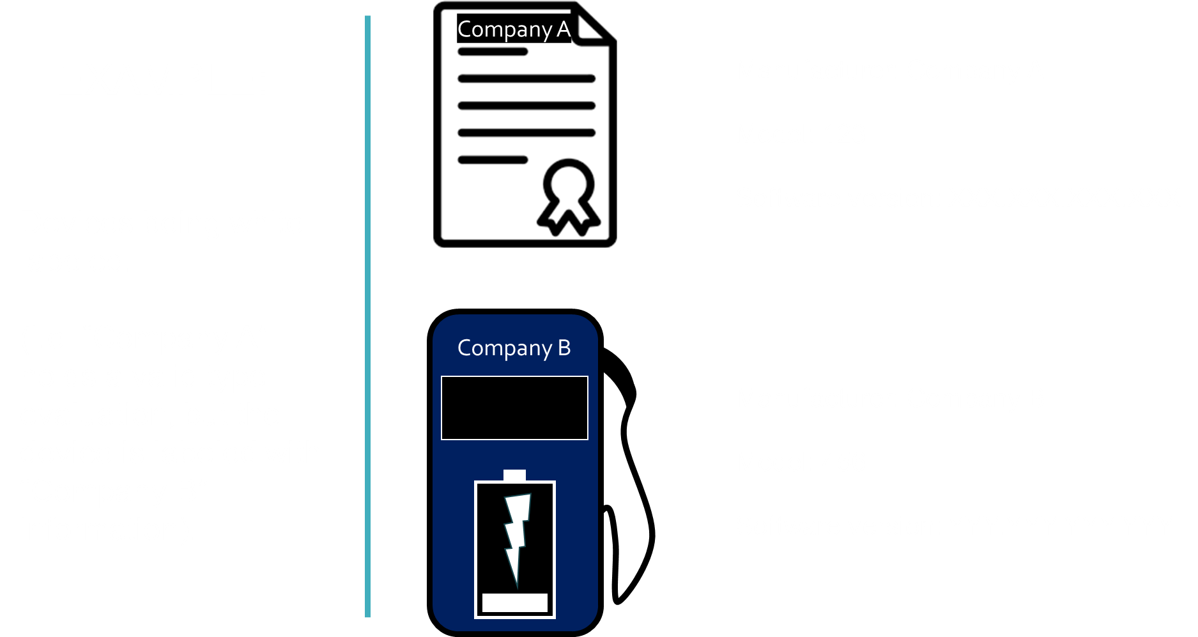

Slide 39
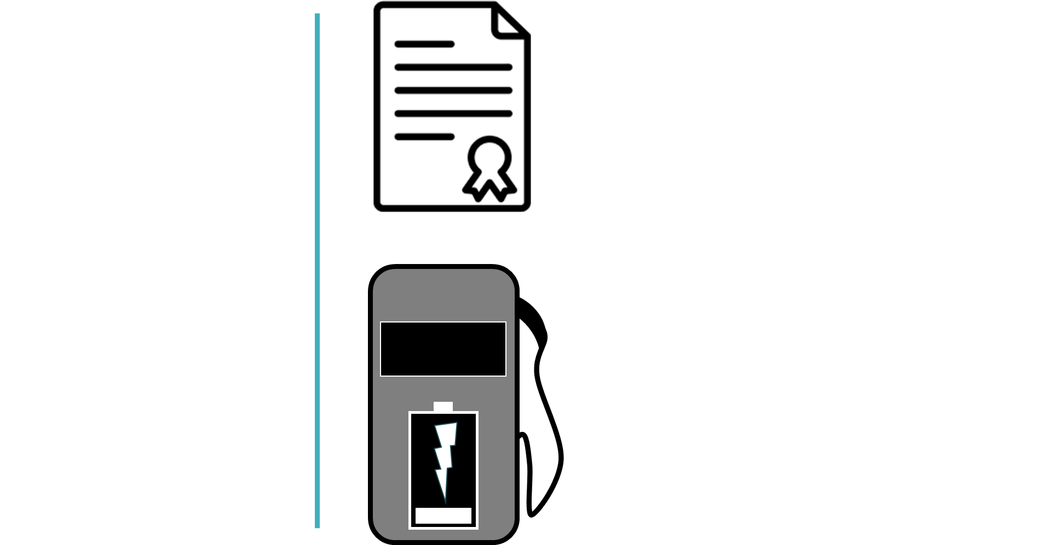

Slide 40
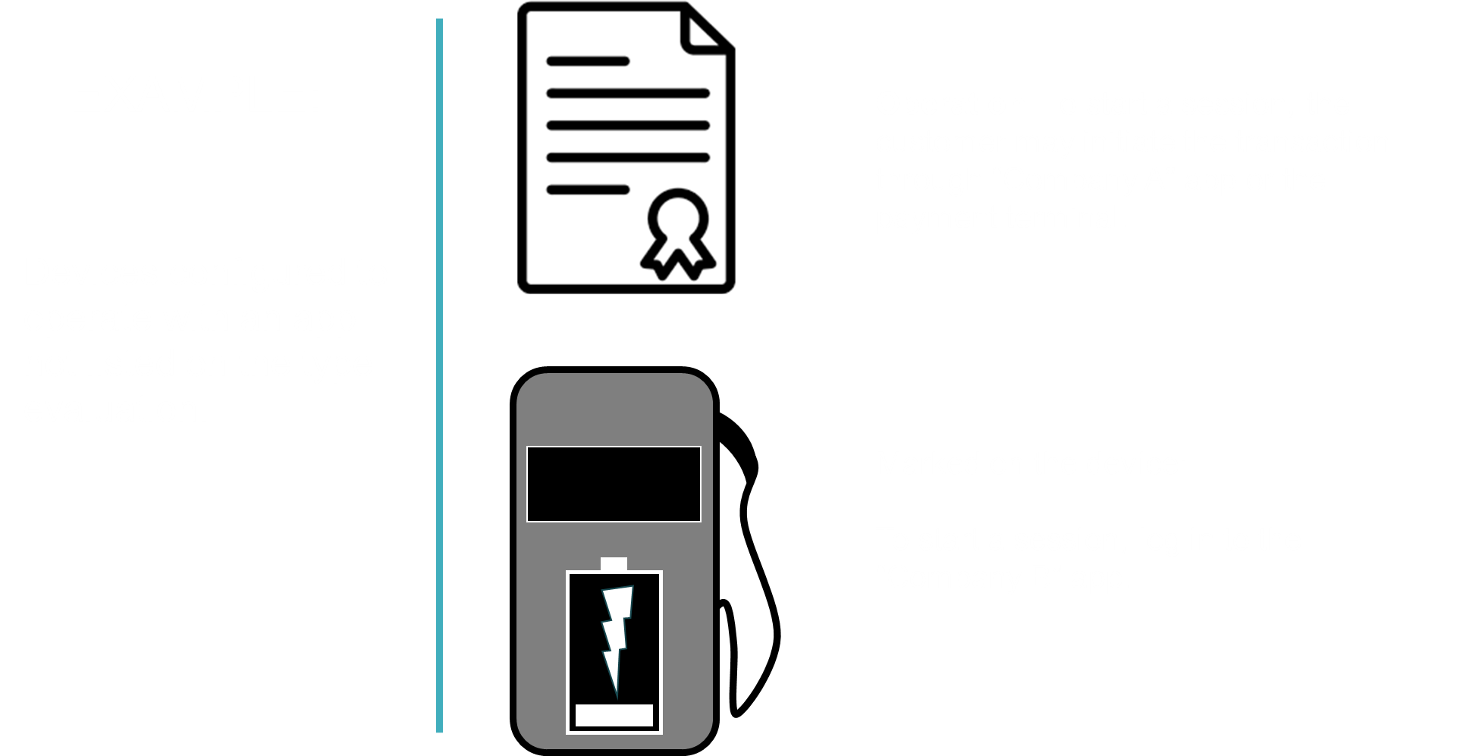

Slide 41
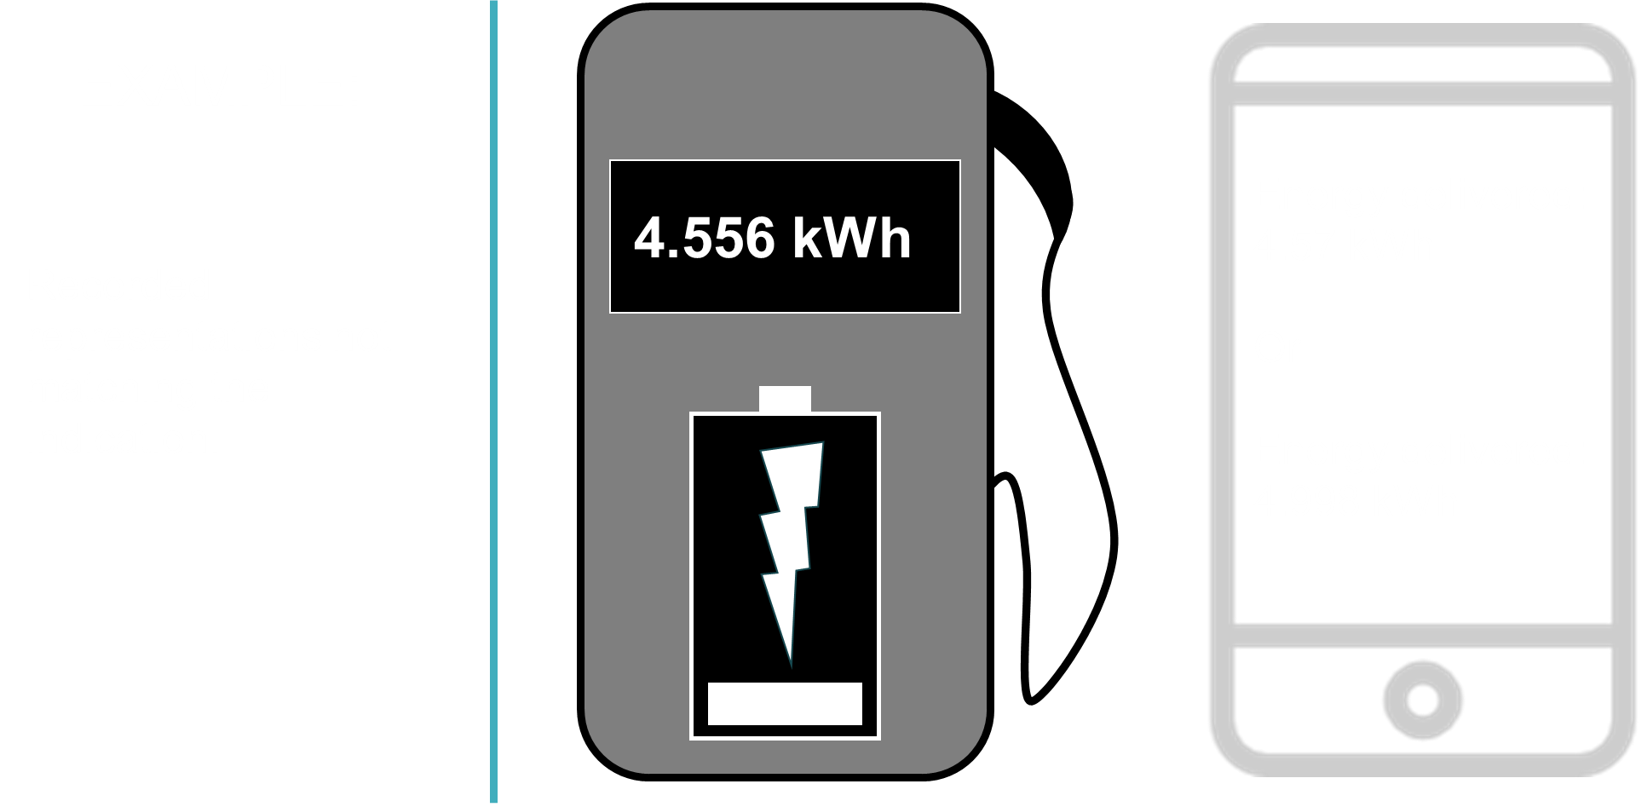

Slide 42
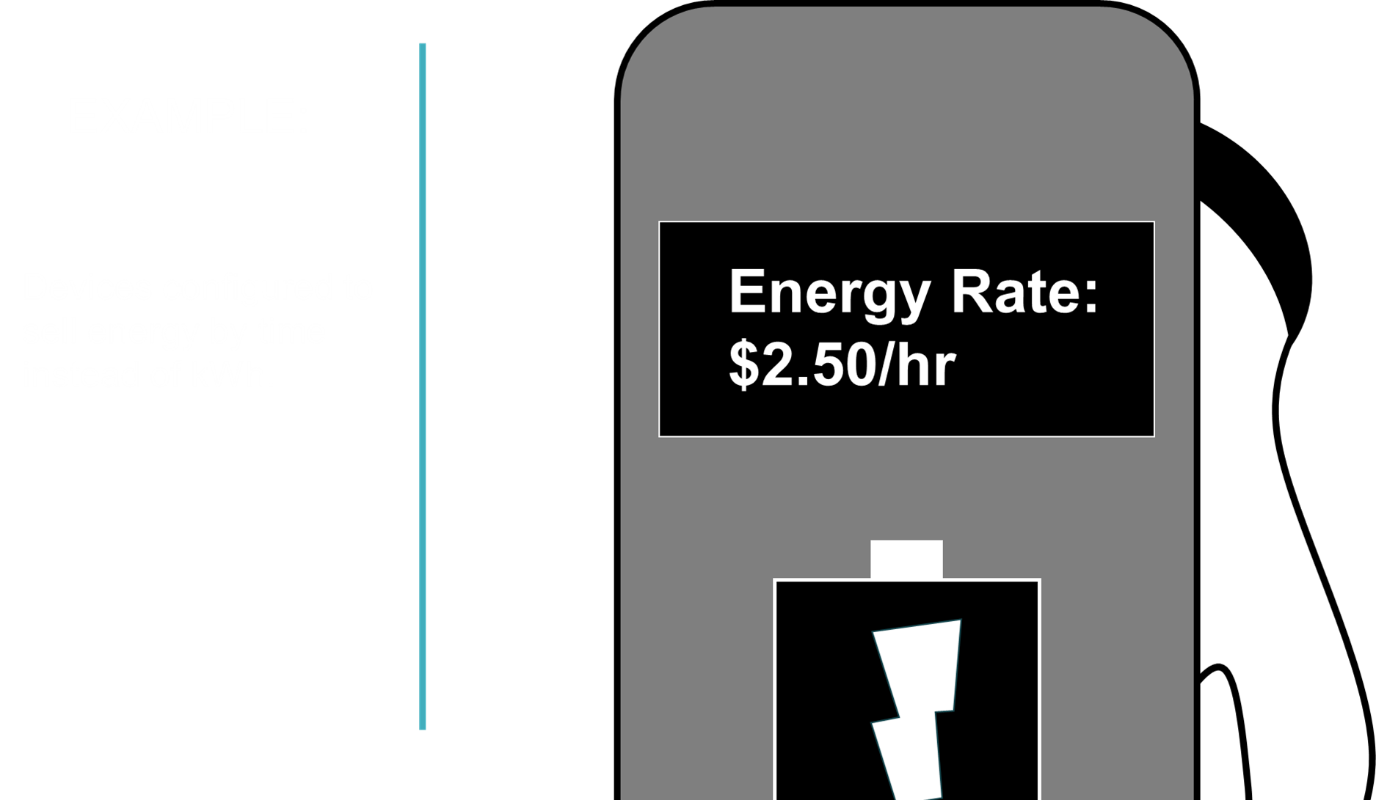

Slide 43


Slide 44


Slide 45
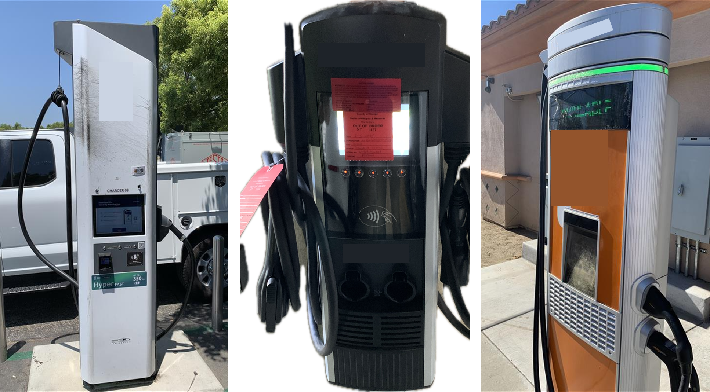

Slide 46
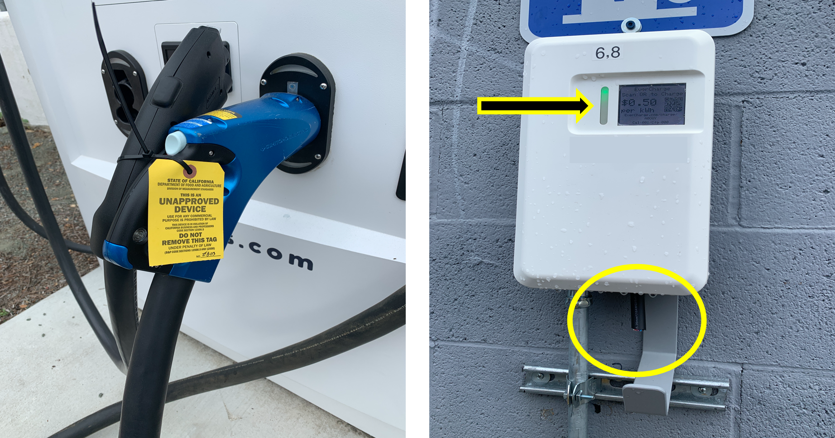

Slide 47
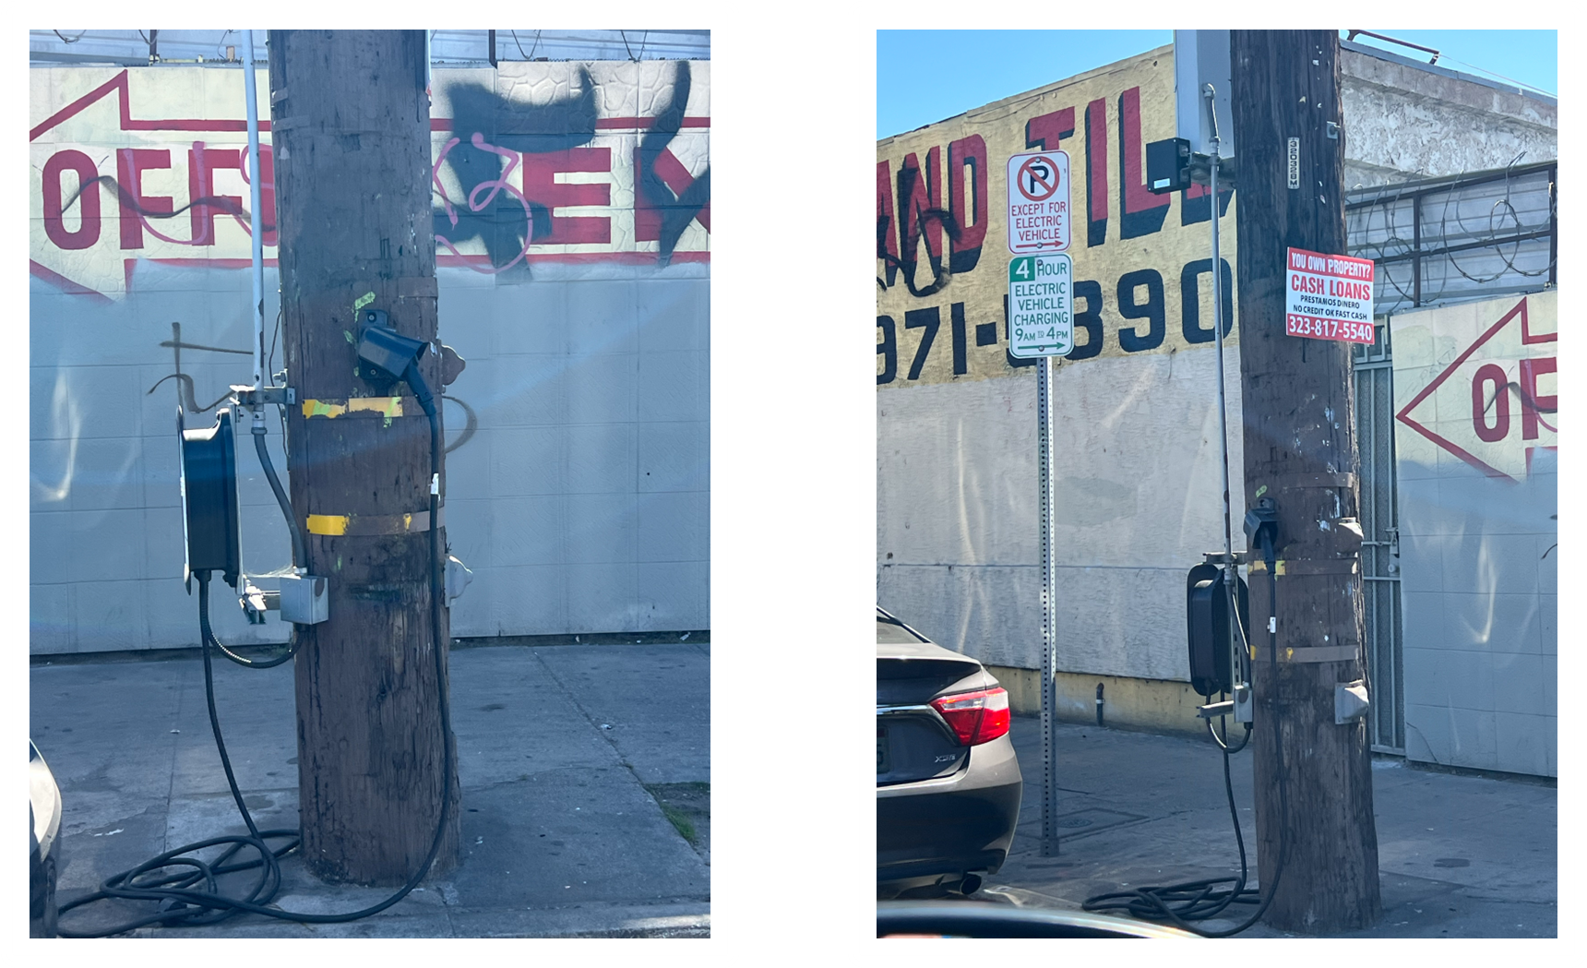

Slide 48
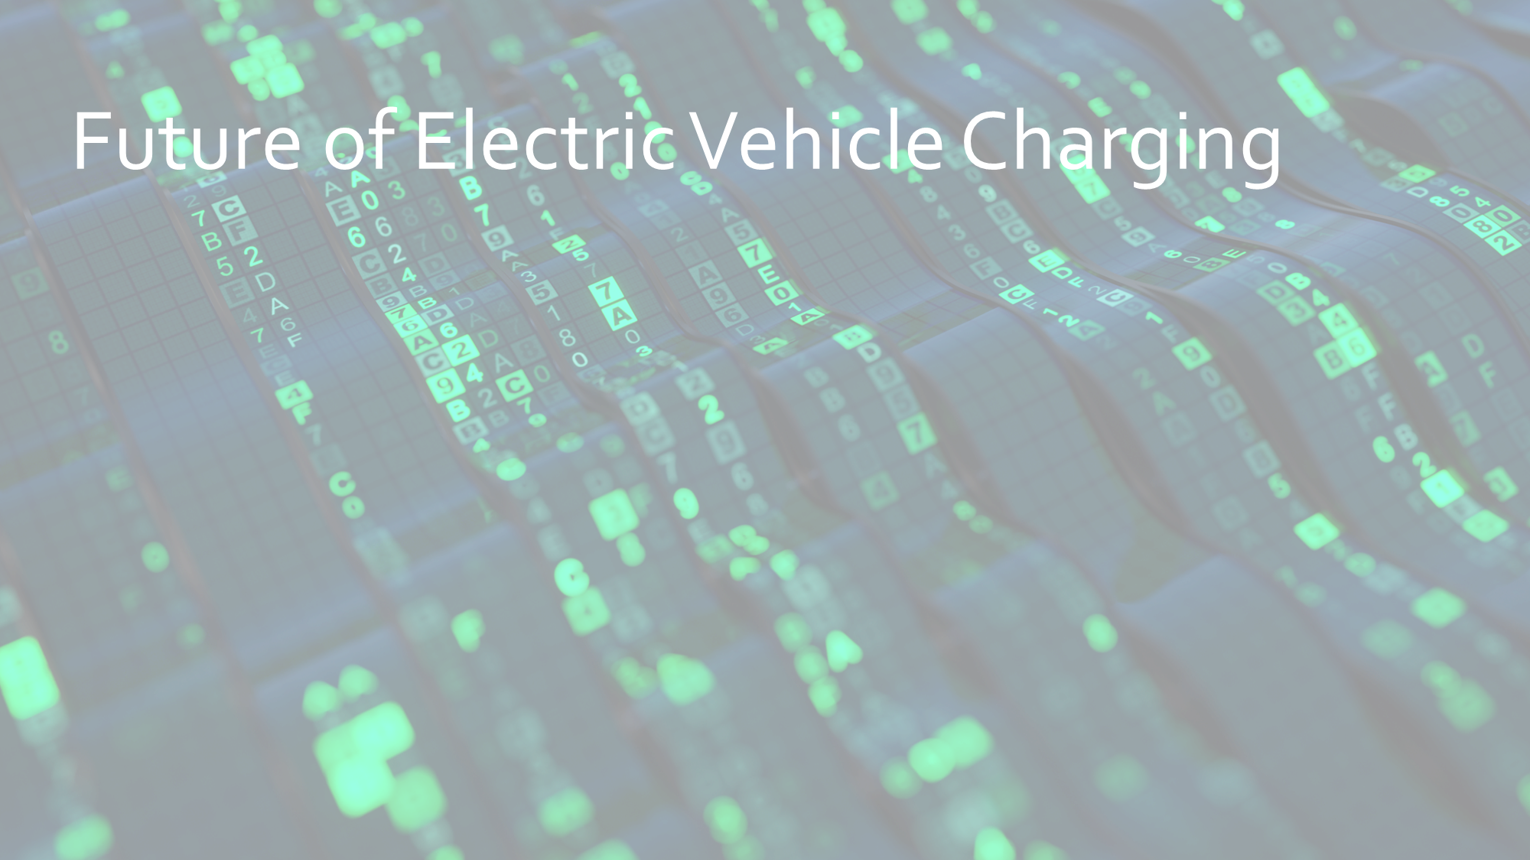

Slide 49
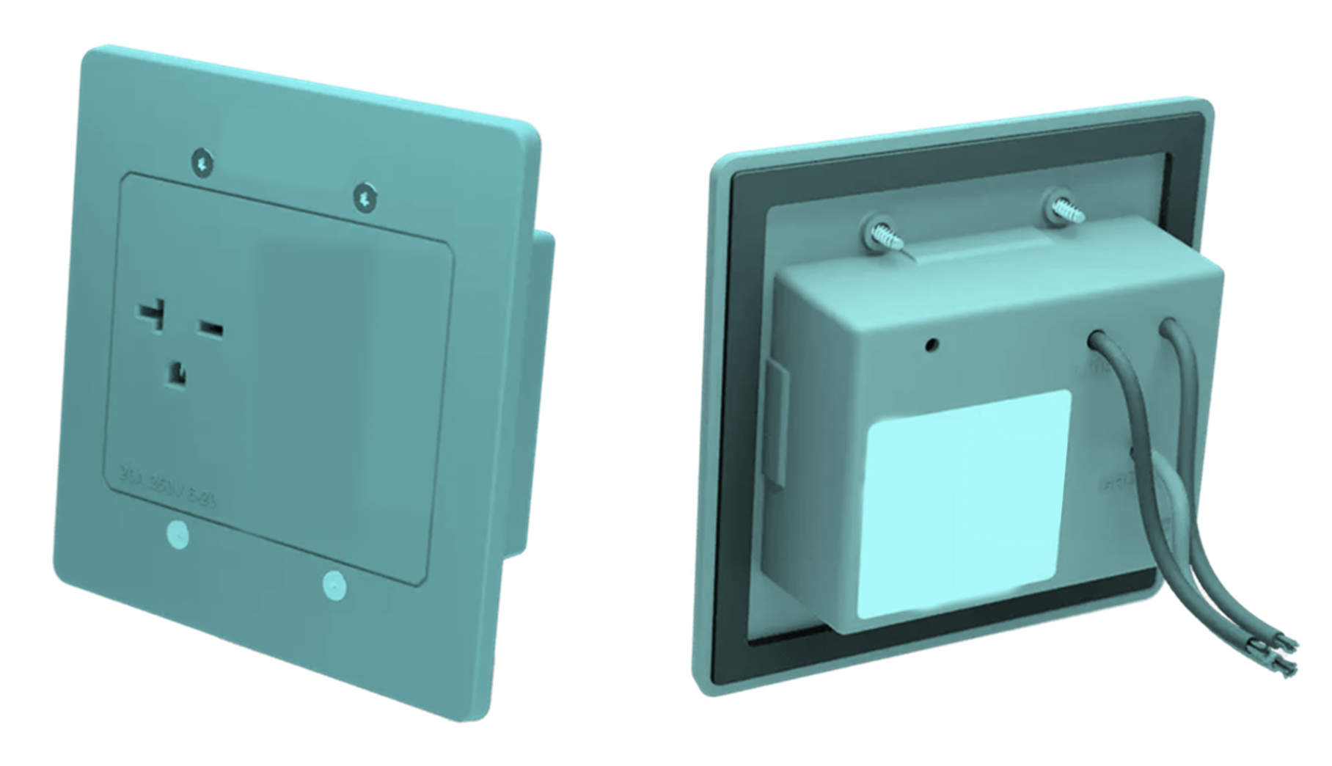

Slide 50
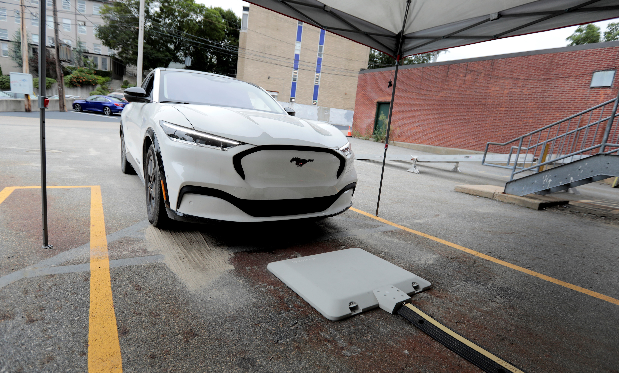

Slide 51
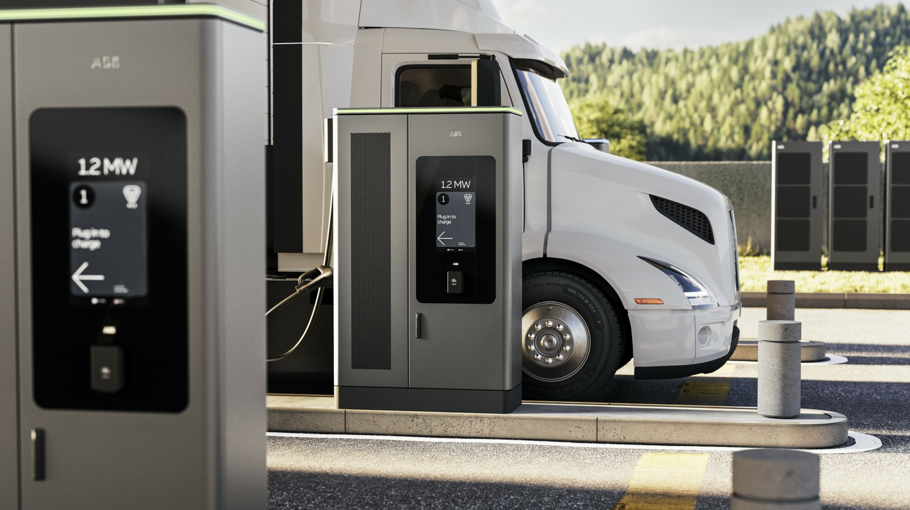

Slide 52
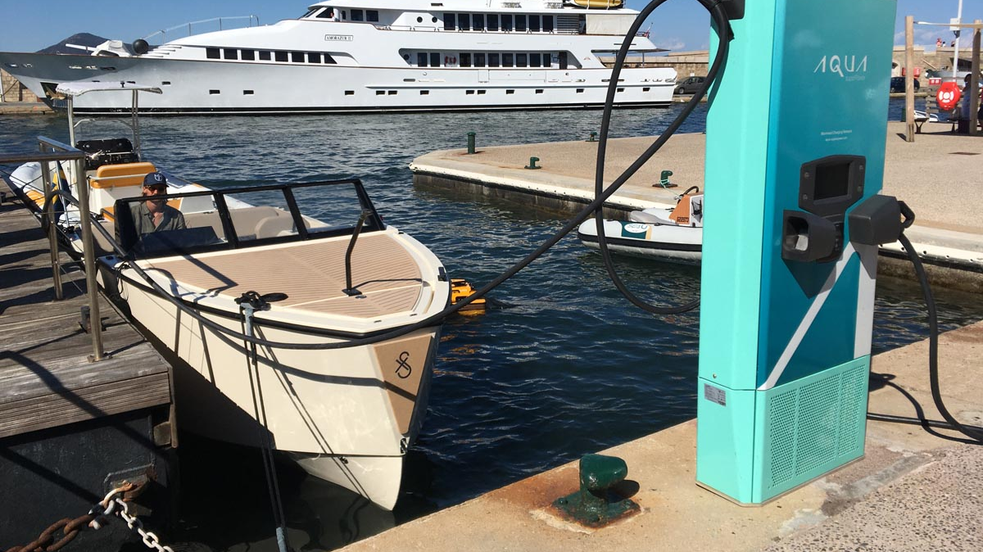

Slide 53


Slide 54


Slide 55
