Slide 1
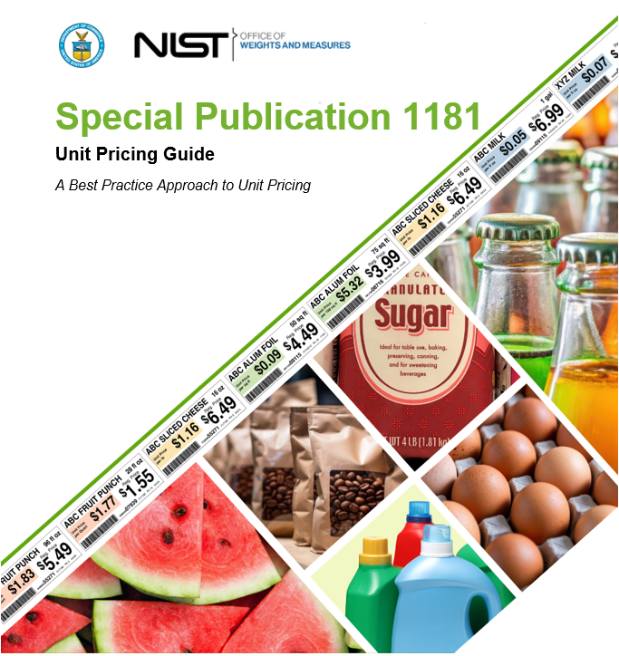
Notes:
This guide, developed by the National Institute of Standards and Technology (NIST), provides standardized best practices and recommendations for implementing unit pricing in retail environments. Unit pricing—the practice of displaying the cost of a product per standard unit of measure (e.g., per ounce, liter, or count)—is a vital tool for promoting price transparency, enabling consumers to make informed value comparisons across products. NIST Special Publication 1181 aims to assist state and local jurisdictions, retailers, and labeling system developers in designing and maintaining clear, consistent, and consumer-friendly unit pricing systems that align with regulatory standards and support fair commerce.

Slide 2
Special Publication 1181 Unit Pricing Guide: A Best Practice Approach to Unit Pricing
Purpose: Guide retailers on best practices for clear and consistent unit pricing.
Applies To: Food & non-food retail, e-commerce, drugstores, convenience stores, and more.
Value to Consumers: Helps compare prices accurately, especially amid shrinkflation.
Notes:
This guide, developed by the National Institute of Standards and Technology (NIST), provides standardized best practices and recommendations for implementing unit pricing in retail environments. Unit pricing—the practice of displaying the cost of a product per standard unit of measure (e.g., per ounce, liter, or count)—is a vital tool for promoting price transparency, enabling consumers to make informed value comparisons across products. NIST Special Publication 1181 aims to assist state and local jurisdictions, retailers, and labeling system developers in designing and maintaining clear, consistent, and consumer-friendly unit pricing systems that align with regulatory standards and support fair commerce.
Unit pricing is a standardized tool for helping consumers evaluate product value across different brands and sizes. This tool is relevant to nearly all retail sectors and plays an especially important role in today’s economic climate, where downsizing—also known as “shrinkflation”—is common.

Slide 3
Acknowledgements
Trade Associations
FMI, The Food Industry Association (FMI)
Consumers Groups
Consumer Reports
Consumer World
National Consumers League (NCL)
Queensland Consumers Association (Australia)
Weights and Measures Officials
California, Division of Measurement Standards
Connecticut Department of Consumer Protection
Hawaii Quality Assurance Division – Measurement Standards Branch
Massachusetts Division of Standards
New Jersey Office of Weights and Measures
Vermont Agency of Agriculture, Food & Markets
Academia
Queensland University of Technology (QUT) Business School
Independent
CGGT Resources (Chris Guay, Guay Technologies)
Manufacturers
Vision Group Inc.
Retailers
Wakefern Food Corporation
Walmart
Notes:
I would like to thank the participants in this endeavor. I deeply appreciated their expertise and dedication to the project.
But I would like to highlight one individual who really went above and beyond to ensure this document was the best that it could be and that is Scott Dolan from Vermont.

Slide 4
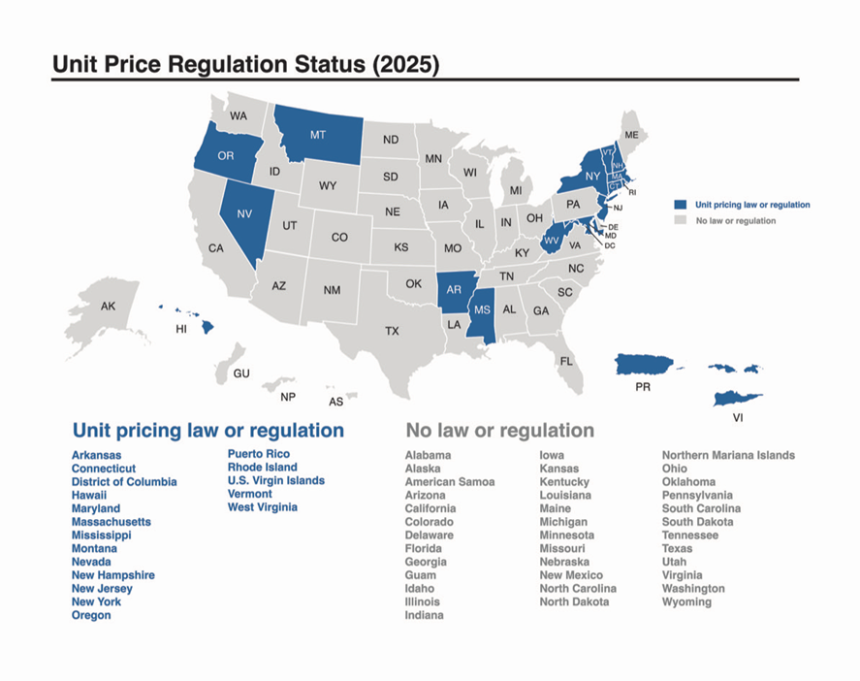
Legal and Regulatory Context
Federal Level: No mandate; voluntary unless required by state.
UUPR: Adopted by many states as a model regulation.
Compliance: Retailers must check with their state’s Weights & Measures office.
Notes:
Unit pricing is not federally mandated, but over a dozen states require it. If you’re implementing unit pricing, you must align with local law first—then use this guide’s best practices to elevate the experience.

Slide 5
Why Unit Pricing Matters
Consumers: Make value-based decisions, save money, and identify shrinkflation.
Retailers: Improve pricing transparency, inventory control, and customer trust.
Studies Show: 74% of shoppers use unit pricing when available (FMI, The Food Industry Association, 2023).
Play UP Video
Notes:
Unit pricing is more than just a display—it empowers smarter purchasing. Consumers trust retailers who display unit pricing because it signals fairness, clarity, provides them the ability to make value-based decisions, and identifies shrinkflation. Retailers benefit from improved inventory and shopper satisfaction.
Play UP Video
Play UP Video! https://www.nist.gov/pml/owm/unit-pricing-national-legal-metrology-working-group

Slide 6
Design Principles for Unit Price Labels
Legibility: Large fonts, color contrast, and clear layout.
Clarity: Simple terms, avoid jargon, consistent placement.
Prominence: Use bold fonts for required info, minimize retailer-specific details.
Layout: Use the “Blocked Approach” with 4 clearly defined information blocks.
Notes:
Read: The four principles of designing a Unit Price Label are Legibility, Clarity, Prominence, and Layout.
The goal is ease of use. Large fonts and good color contrast make unit pricing readable. Required consumer information should stand out, while retailer-use codes are de-emphasized. Labels should be clean and not overloaded.

Slide 7
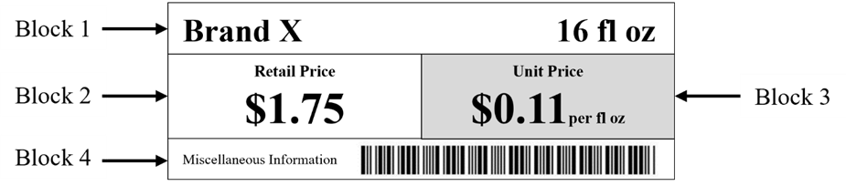
The “Blocked Approach” Layout
Block 1: Product Identity & Size (e.g., Brand X “Apple Juice, 16 fl oz”).
Block 2: Retail Price (e.g., “$1.75”).
Block 3: Unit Price (e.g., “$0.11 per fl oz”, bold with colored background).
Block 4: Retailer Info (UPC, QR code, etc., non-bold, small).
Notes:
This layout is recommended because it structures information for quick comprehension. Unit price should stand out with a colored background and be easy to locate. Consistency across all labels matters just as much as design. Show and discuss each Block.

Slide 8
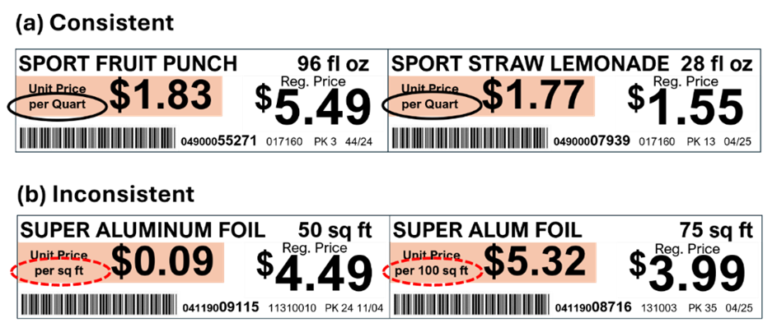
Units of Measure – Consistency is Key
Uniform Units: Same unit across all brands in a category (e.g., per ounce).
Allowed Units: Weight, volume, area, length, and count (U.S. or metric).
Best Practice: Choose the most common unit familiar to consumers.
Notes:
Nothing is more confusing than seeing one brand listed by ounce and another by pound. Uniformity simplifies comparisons. Use commonly understood units, and metric where it makes sense—like with wine or spices

Slide 9
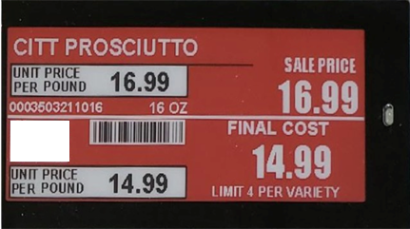
Enhancing Visibility and Readability
Font Size: Minimum 6 mm (0.24 in); at least 50% of retail price font.
Color: High contrast (≥ 7:1 ratio) between text and background.
Placement: Adjust angles for top/bottom shelves; ensure visibility on ESLs
Notes:
Here we have an example of an ESL.
Older consumers, the visually impaired, and low shelves present readability challenges. Follow minimum size and contrast guidelines. Angling labels, especially on lower shelves, improve visibility. Choose ESLs with wide viewing angles.

Slide 10
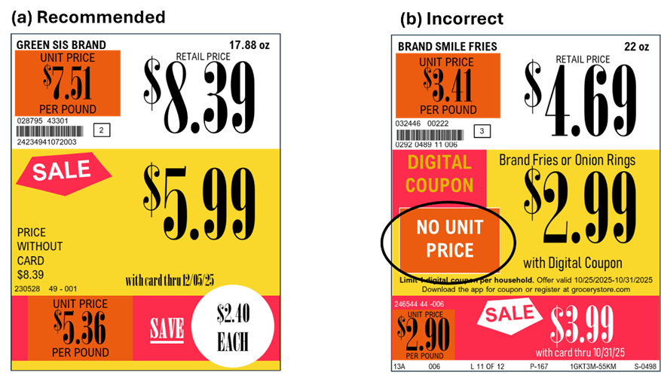
Sale Signs & E-Commerce Guidelines
Sale Tags: Must show unit price alongside sale price.
Tier Pricing: Each deal (e.g., “3 for $5”) must have unit pricing.
E-Commerce: Display unit price near total price; follow the same design principles.
Notes:
Consumers shouldn’t lose access to unit pricing just because an item is on sale or online. Display unit prices consistently, even during promotions or digital campaigns. That means every sale tier should be unit-priced.

Slide 11
Audit, Maintenance & Consumer Education
• Retailer Audits: Ensure unit pricing accuracy, consistency, and label compliance.
• Education: Periodic outreach to inform shoppers about unit pricing.
• Digital Tools: ESLs and e-commerce features (e.g., sorting by unit price).
Notes:
Use internal audits like you do for price accuracy. Educate consumers periodically—even a small reminder boosts usage. Digital tools, like filter-by-unit-price features, help online shoppers just as much as shelf labels help in-store.

Slide 12
Final Recommendations
• Adopt Consistent Formats: Uniform presentation across all platforms.
• Prioritize Clarity: Make price comparison easy for everyone.
• Review & Update Labels: Use design checklists and consumer feedback.
• Promote Unit Pricing Use: It benefits both consumers and retailers.
Notes:
To wrap up, unit pricing is a low-cost, high-impact feature that builds shopper trust. Follow this guide’s design and consistency principles, and you’ll enhance the retail experience—both online and in-store.

Slide 13
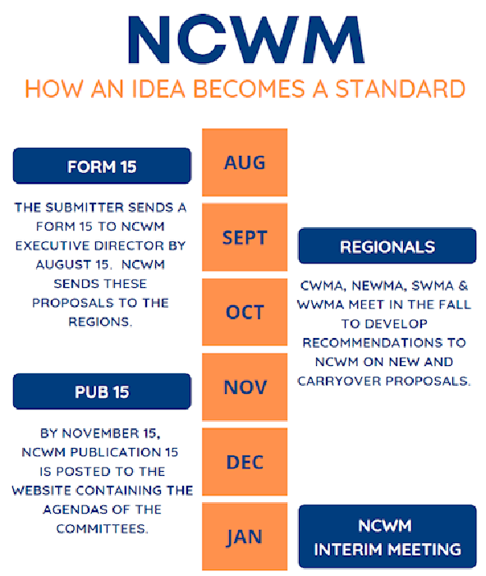
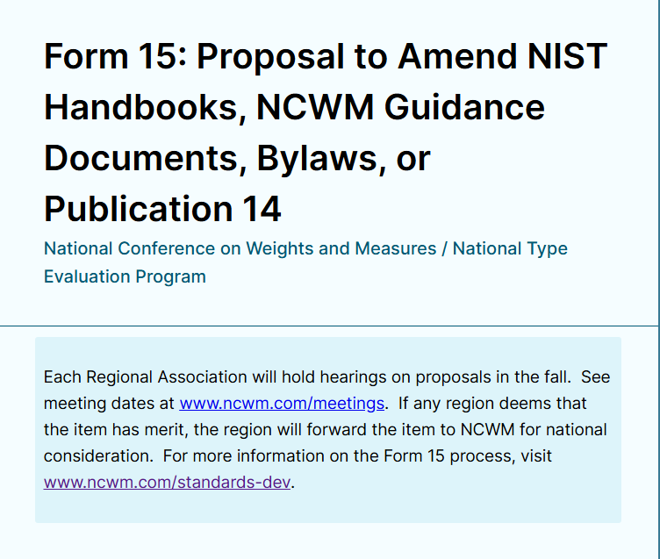

Next
Steps
In
Process
Notes:
With the additional items and information within the NIST Unit Price SP 1181, we are working on harmonizing NIST Handbook 130 Section C. Uniform Unit Pricing Regulations to ensure continuity, uniformity, and the availability for State jurisdictions to adopt this regulation.

