Slide 1
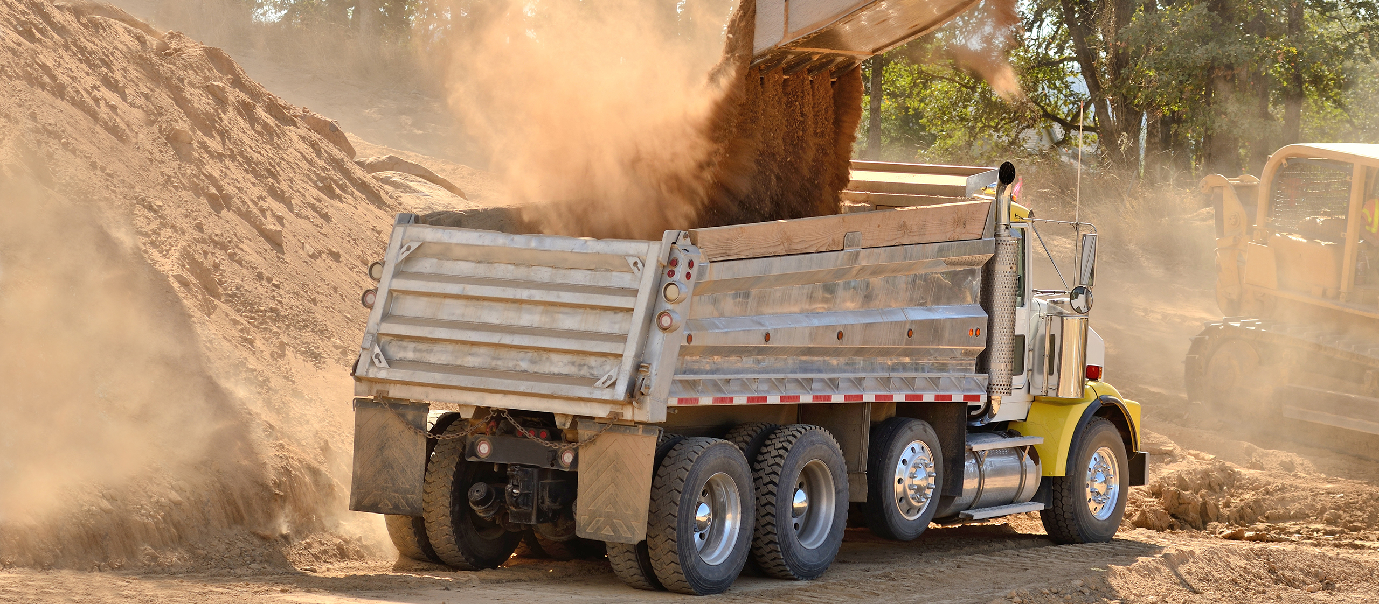
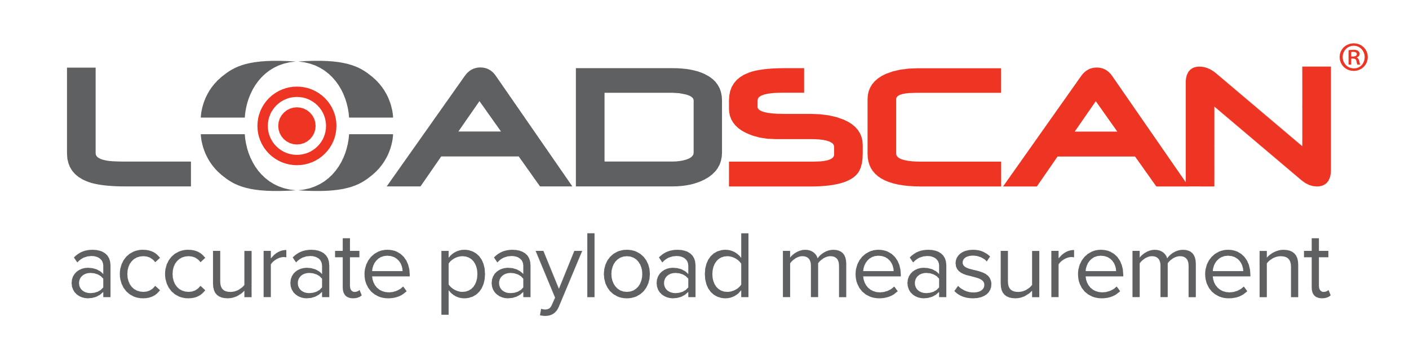
MDM 25-1
Load Volume Scanners
Meeting Measurement Needs
of the Civil Construction Industry
Prepared for:
110th NCWM July Annual Meeting
Prepared by:
Adrian Ruthe, Carey West
Loadscan Ltd, NZ
Notes:
Introduction
Self-introduction - representing Loadscan from New Zealand.
Foreign associate NCWM member and part of Volume Dimensioning MDMD focus group that has been developing the proposed HB44 language for VMD.
Loadscan is the original developer of the type of Volume Measurement Device (VMD) using lidar scanning technology covered by the MDM 25-1 proposals.
I would like to demonstrate the real-world need for this kind of measurement technology to be incorporated into the US legal metrology framework.
I will focus on the needs of the civil construction industry for the volumetric measurement of sand, gravel and other construction aggregates.
Note that I actually gave a presentation at the January 2014 NCWM meeting – but were unable to get enough traction to progress at the time.
But things have moved on, the technology has been embraced by industry and there are now multiple manufacturers of similar measurement devices.

Slide 2
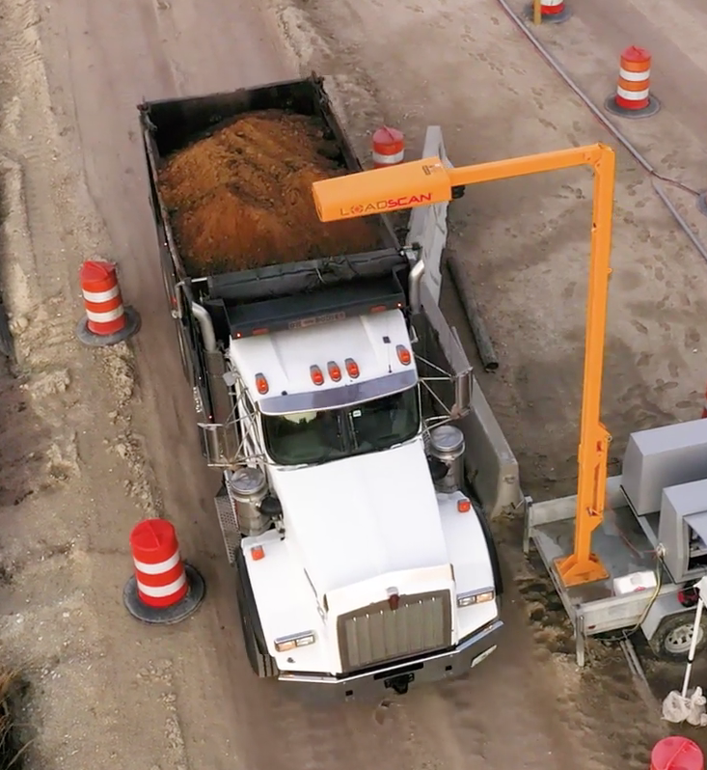

Why load volume scanning?
Measuring truck loads of construction aggregates by weight has always been an incomplete solution for an industry that operates in volumetric quantities.
Determining volume by converting from weight, counting loader buckets, or counting trucks, is inaccurate and contributes to supply disputes.
In 1998 the Load Volume Scanner (LVS) was developed in New Zealand to solve these issues for a local civil construction company.
The LVS provides direct non-contact volume measurement.
Independent of moisture content and assumed material density.
Notes:
Background – meeting a need
Cubic yards of rock, sand, gravel are required for roading, earthworks etc., not tons.
Traditional methods of determining volumetric quantities of construction aggregates on trucks are not reliable.
The Load Volume Scanner (LVS) was developed in 1998 in New Zealand.
It was a response to a long-standing issue: buyers consistently receiving underloaded trucks from sand pits and quarries.
The goal was to create a reliable way to verify the actual volume of material being delivered on construction sites.

Slide 3
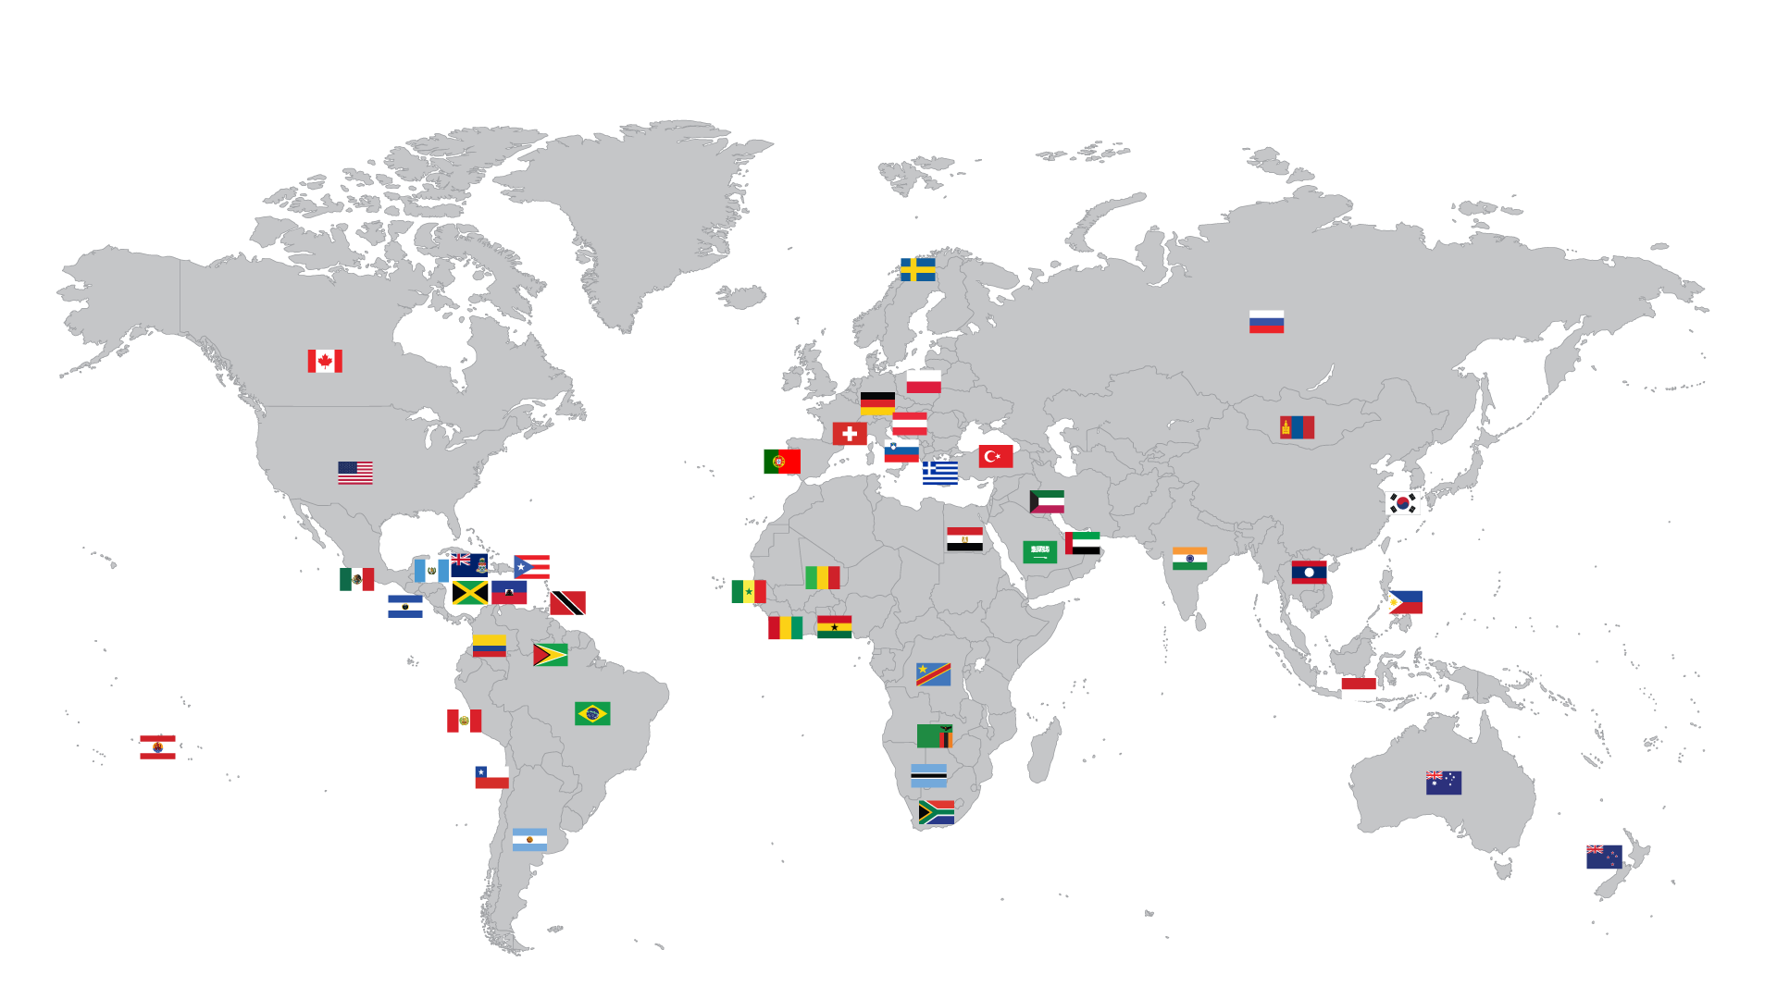
Loadscan Load Volume Scanners are now operating in over 47 countries
Notes:
A clear demand
Loadscan LVS systems are now used all over the world, mainly in:
civil construction
mining
bark and mulch
This demonstrates a clear need for this kind of volume measurement technology.

Slide 4
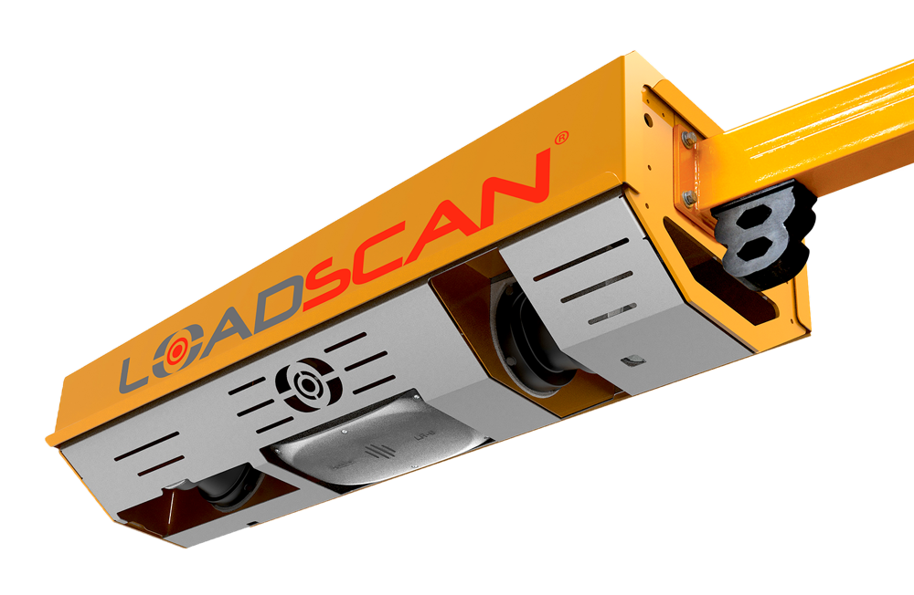
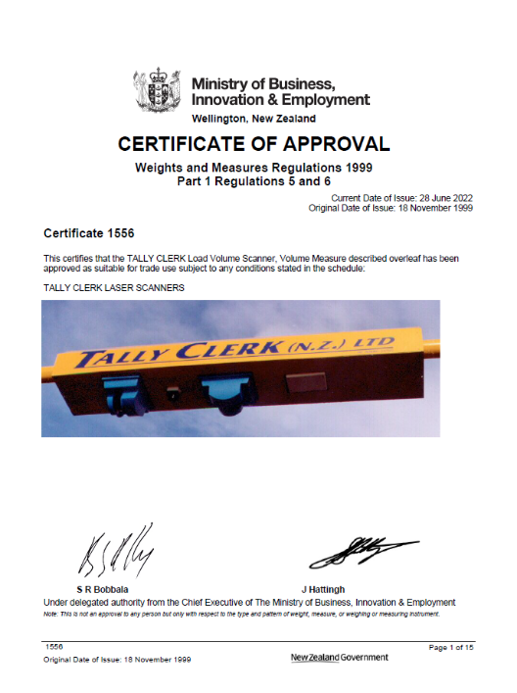
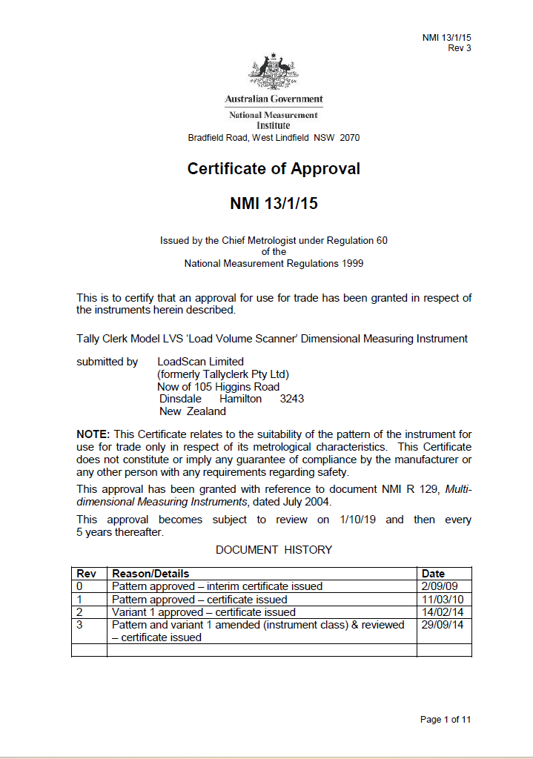
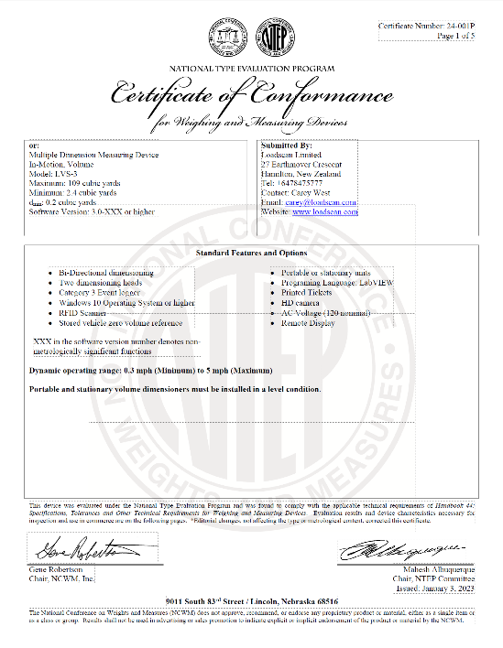
Proven accuracy and suitability for use
1999 - New Zealand type approval
2010 – Australian type approval
2024 – Provisional NTEP type approval for USA
Notes:
Commitment to Accuracy
Accuracy and suitability for use have always been at the heart of our system.
First achieved trade approval in NZ in 1999 (Certificate 1556.0).
Followed by approval in Australia in 2010 (Certificate 13/1/15 rev3).
In Australia and New Zealand, the LVS has been widely adopted and used in trade measurement applications.
Provisional NTEP type approval in 2024 (CC 24-001P).
Our LVS systems meet the requirements of proposed language for HB 44 and associated test method.

Slide 5
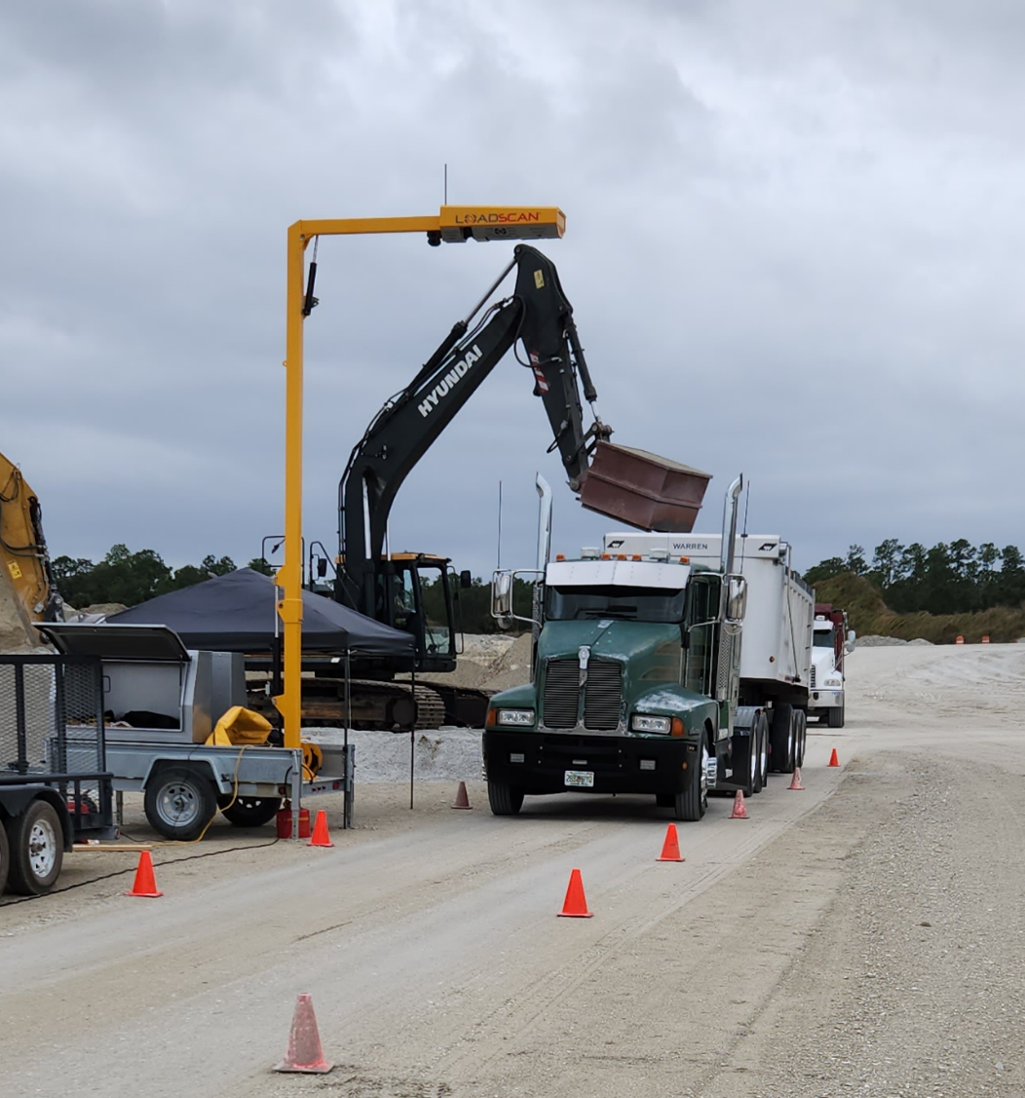
The USA (status quo)
Over 200 LVS systems (all industries).
Used in business-to-business (B2B) bulk transfer transactions.
Material is sold by the ‘truck load’, with a agreed quantity assigned to each truck type.
The LVS confirms that the agreed volumetric quantity is loaded and delivered (monitoring only).
For incoming loads, the LVS is used to confirm that expected quantities are received.
This gives confidence to both sellers and buyers - and reduces disputes.
But… our customers are demanding ‘trade-legal’ status for their Load Volume Scanners.
Loadscan, on behalf of its customers, supports the MDM 25-1 proposal in its current form.
Notes:
The USA
Loadscan has been in the U.S. since 2009.
This is how the LVS is currently used in quarrying and construction, outside the scope of legal metrology.
Our customers are demanding to be able to base transactions on actual measured load volumes and use LVS systems for direct trade.
Sand pits, gravel suppliers and civil construction companies in particular, want to see this kind of technology recognized in the legal metrology framework… with urgency.

Slide 6
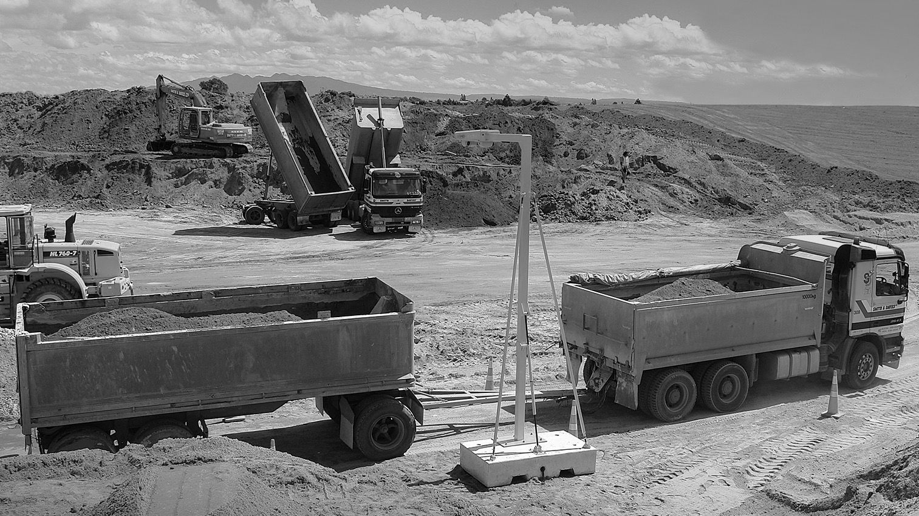
MDM 25-1
Supporting Testimonial
J McKinnon
Notes:
Supporting Testimonial
J McKinnon, Florida
Speaker transition:
Handover to Lawson Lamaar from J McKinnon, one of Loadscan’s longstanding U.S. customers who operate a fleet of Load Volume Scanners and supports the MDM 25-1 proposals.
Lawson will speak to how Loadscan has improved transparency and trust in their daily operations and why they want to use LVS systems for direct trade.

Slide 7
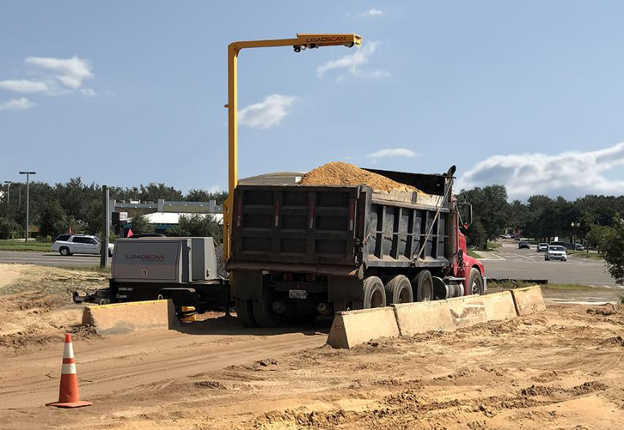
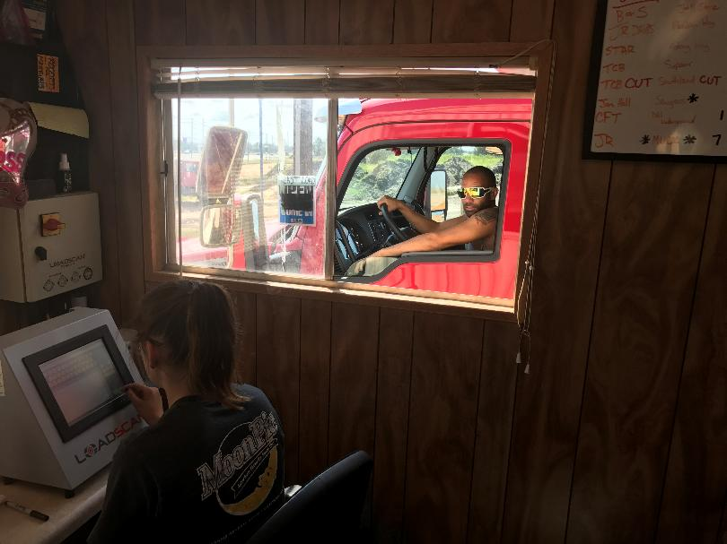
J.McKinnon, Florida, USA
Notes:
Speaker: Lawson Lamaar
1. Brief Introduction (~30 seconds)
Good morning/afternoon, everyone.
I’m Lawson Lamaar, Operations Manager at J McKinnon, based in Florida.
We’ve been using Loadscan’s Load Volume Scanner in our operation for over [X] years now, and I’d like to briefly share what it’s done for our business.
2. The Challenge Before Loadscan (~45 seconds)
Before we adopted Loadscan, we relied on visual estimates or weight-based measurements, which caused frequent disputes with our customers.
Variations in material density, especially with mulch and sand, made it hard to guarantee consistent truck loads.
And when there were discrepancies, it came down to trust - something you don’t want to risk in high-volume, contract-based supply.
3. Why We Chose Loadscan (~30 seconds)
We needed a solution that could give us confidence that each truck leaving our yard carried the right volume.
Loadscan offered a system that was accurate, repeatable, and didn’t rely on material weight—which was ideal for our needs.
It also provided reports we could use for record-keeping and accountability.

Slide 8
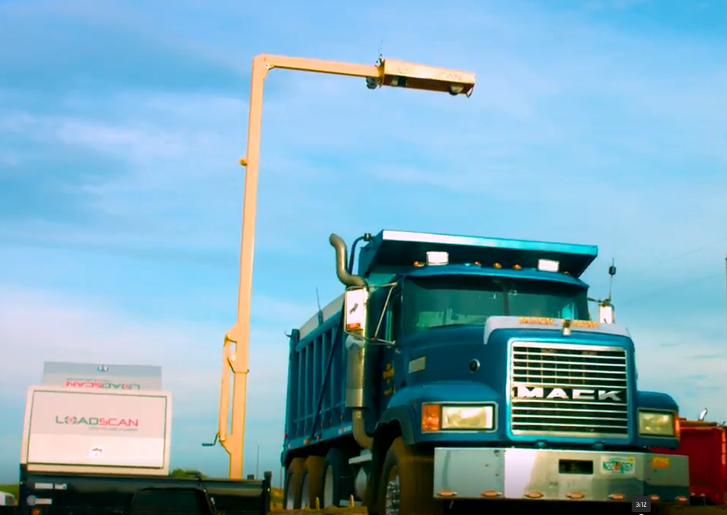
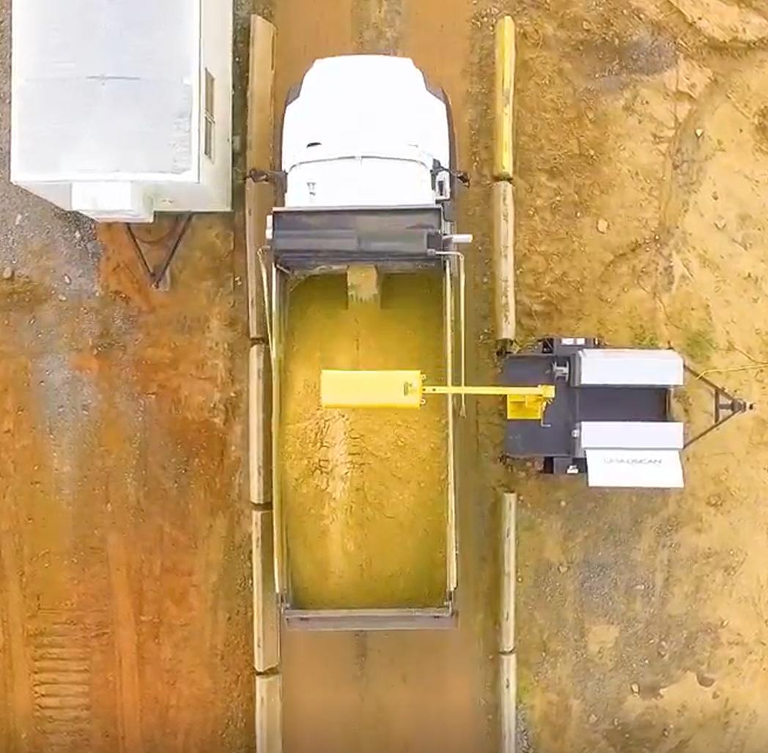
J.McKinnon, Florida, USA
Notes:
4. Day-to-Day Use and Benefits (~1.5 minutes)
Today, every truck we load passes through a Load Volume Scanner.
It gives us a real-time measurement of the actual volume on the truck—based on a 3D scan.
That volume is automatically matched to our invoice system, so our customers know exactly what they’re getting.
We’ve seen a huge reduction in disputes, and our delivery staff are more confident knowing every load is compliant with what’s on the invoice.
The system also helps us detect overloaded or underloaded trucks before they leave the yard, which has improved safety and compliance.
5. Support for Trade Approval (~45 seconds)
From a user’s perspective, I can say the LVS technology works.
It’s consistent, it’s transparent, and it’s auditable.
For industries like ours—sand, mulch, construction materials - where product is sold by volume, this kind of measurement standard would be a game-changer.
I fully support the MDM 25-1 proposals with voting status
approval, because I’ve seen first-hand how much volume measuring technology improves fairness and trust in these transactions.
6. Closing (~15 seconds)
Thanks for letting me share our experience.
I’m happy to answer any questions later in the session.

Slide 9
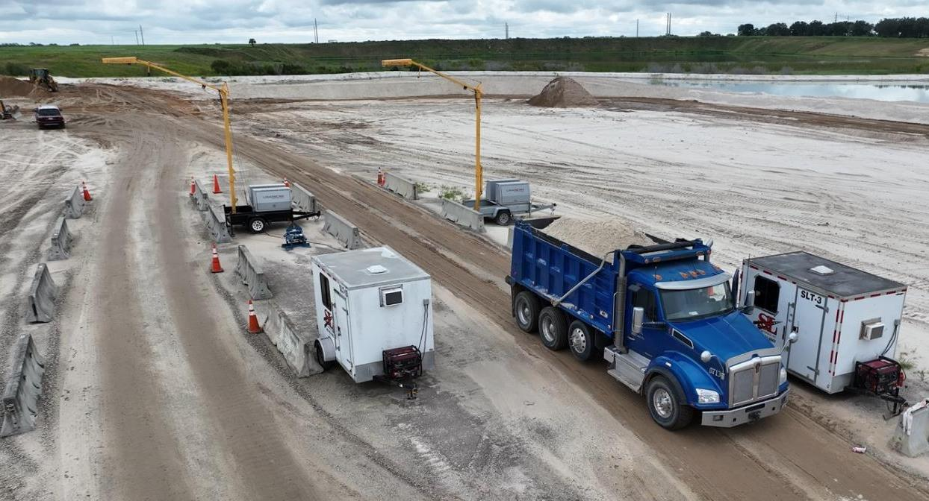
S&L Materials Inc, Florida, USA
(in and out measurements)
Notes:
Summary
Speaker: Adrian Ruthe
LVS was designed to solve a real-world issue in material delivery accuracy.
It is supported by decades of proven trade approvals and real-world use.
Our customers across the U.S. are already using LVS in transactional settings with great success.
We believe it is time for this type of volumetric measurement device to be formally recognized in Handbook 44 and that proposed language is ready for adoption.

Slide 10


Questions

Slide 11
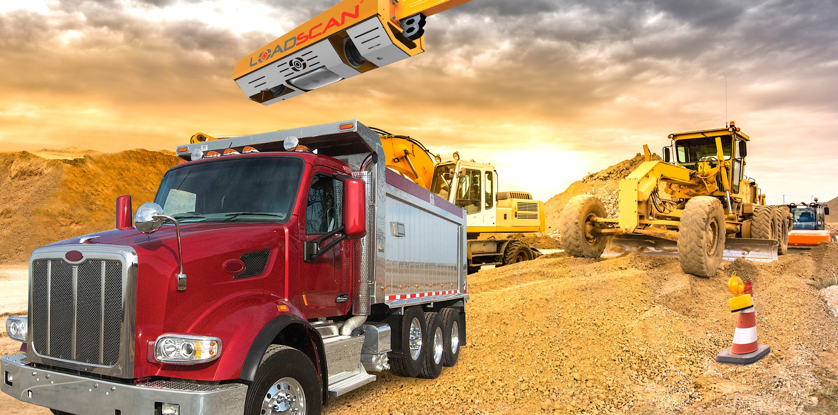
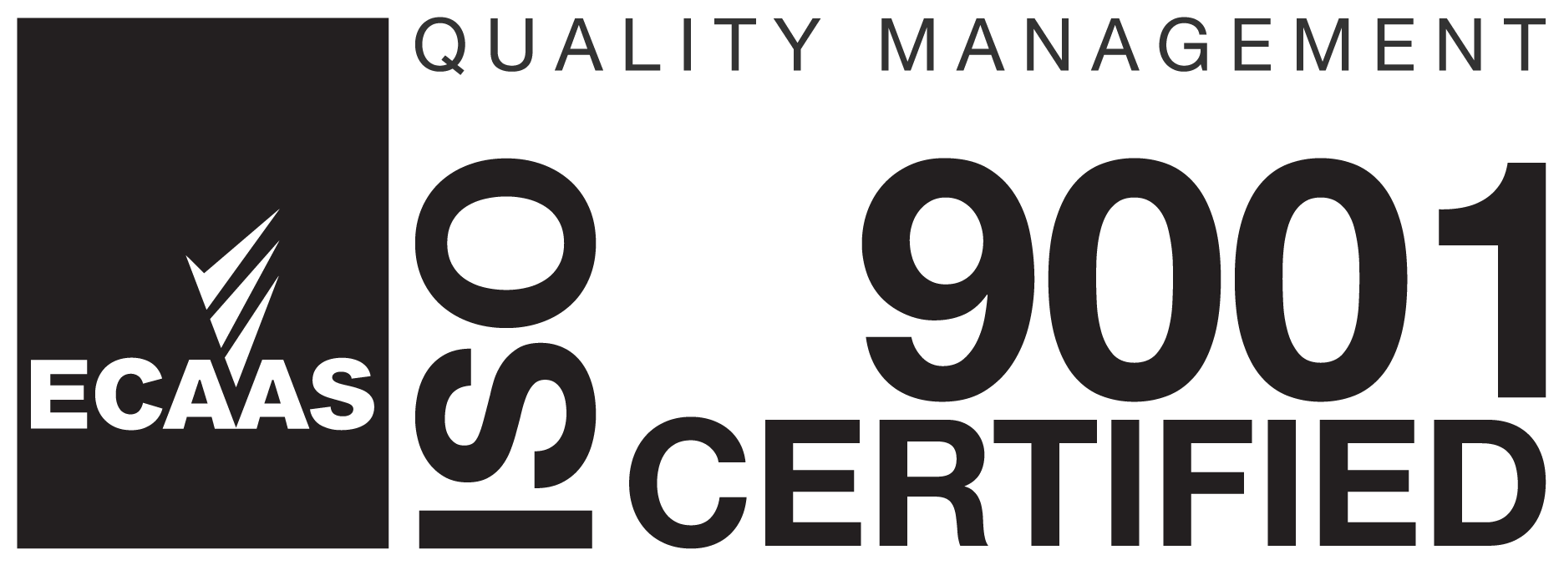

loadscan.com

