Slide 1
MOS 25.1
2.21.2. Metered Sales by Volume
NIST- OWM / NPGA Proposed Joint Amendment

Slide 2
Proposed Amendment
(c) Effective January 1, 2030 2036 2034, all metered sales (through all capacities of metering devices, regardless of installation and service date) shall be accomplished by use of a metering system that automatically compensates for temperature.

Slide 3
Justification

Slide 4
Original Proposal
2019 SWMA Meeting Proposal-
  For equipment placed in service on or after January 1, 2023, all metered sales using a meter with a maximum rated capacity of 20 gal/min or less shall be accomplished by use of a meter and device that automatically compensates for temperature.
  Effective January 1, 2030, all metered sales shall be accomplished by use of a meter and device that automatically compensates for temperature.

Slide 5
Functionality of Equipment
“Mechanical compensators require from 3 to 6 minutes to stabilize their thermal systems” ~ TEMPERATURE COMPENSATION IN LIQUID MEASUREMENT, Bob Petty, Linco-Electromatic, Inc.
Average fill times by container size:
  20 lb. – 19-20 Seconds
  30 lb. – 28-29 seconds
  33.5 lb. – 31-32 seconds
  40 lb. – 37-38 seconds
  100 lb. – 1 minute 34 seconds to 1 minute 35 seconds

Slide 6
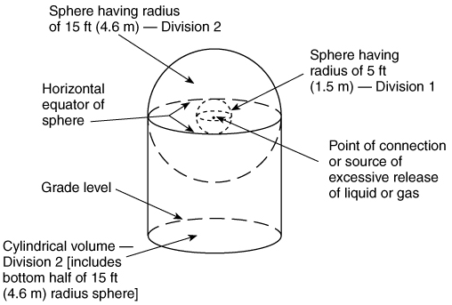
Technology Development
Electrical Temperature Compensator
  Electrical Classification Sought
    Class I Division 1
  Electrical Classification Achieved
    Class I Division 2

Slide 7
Market Landscape
85% of all propane is sold in the U.S. between October – March.
  Volumes dispensed largely favor consumer
Propane Industry in decline
  Continual domestic industry declines
    11.1 ↓ 9.1 billion gallons
    26.7 Billion Gallons produced annually
  Ultra low margin business
  Vast majority of industry identified as Small Business Interest
Retroactive requirements estimated to cost $91-199 million
  Figures based on current average list price of available equipment and 2025 labor rates
No tangible ROI exists for either the consumer or marketer.
Current new /replacement equipment sales are estimated at roughly 10% of the existing dispenser population.
New equipment (effective 2026) will include electronic meters allowing for more responsive (instantaneous) compensation

Slide 8
Substantiation
A 10-Year phase in period was intended through the initial proposal but never updated with the 2024 Adoption
Current functional bolt-on retrofit technology – Still does not exist
Proposed retroactivity window will lead to a significant reduction in distribution points

Slide 9
2025 Form 15 Submittal - Planned
  (b) Sales using metering systems with a maximum rated capacity equal to or less than 20 gal/min that were placed into service after January 1, 20267, shall be accomplished by use of a metering system that automatically electronically compensates for the effects of temperature
  (c) Effective January 1, 2034, all metered sales (through all capacities of metering devices, regardless of installation and service date) shall be accomplished by use of a metering system that automatically electronically compensates for temperature.

Slide 10
Questions?
Christopher J Wagner
cwagner@npga.org
C: 610-308-3822

