Slide 1
Voluntary Quantity-Related
Expressions
Chris Guay
NCWM PALS
July, 2025

Slide 2
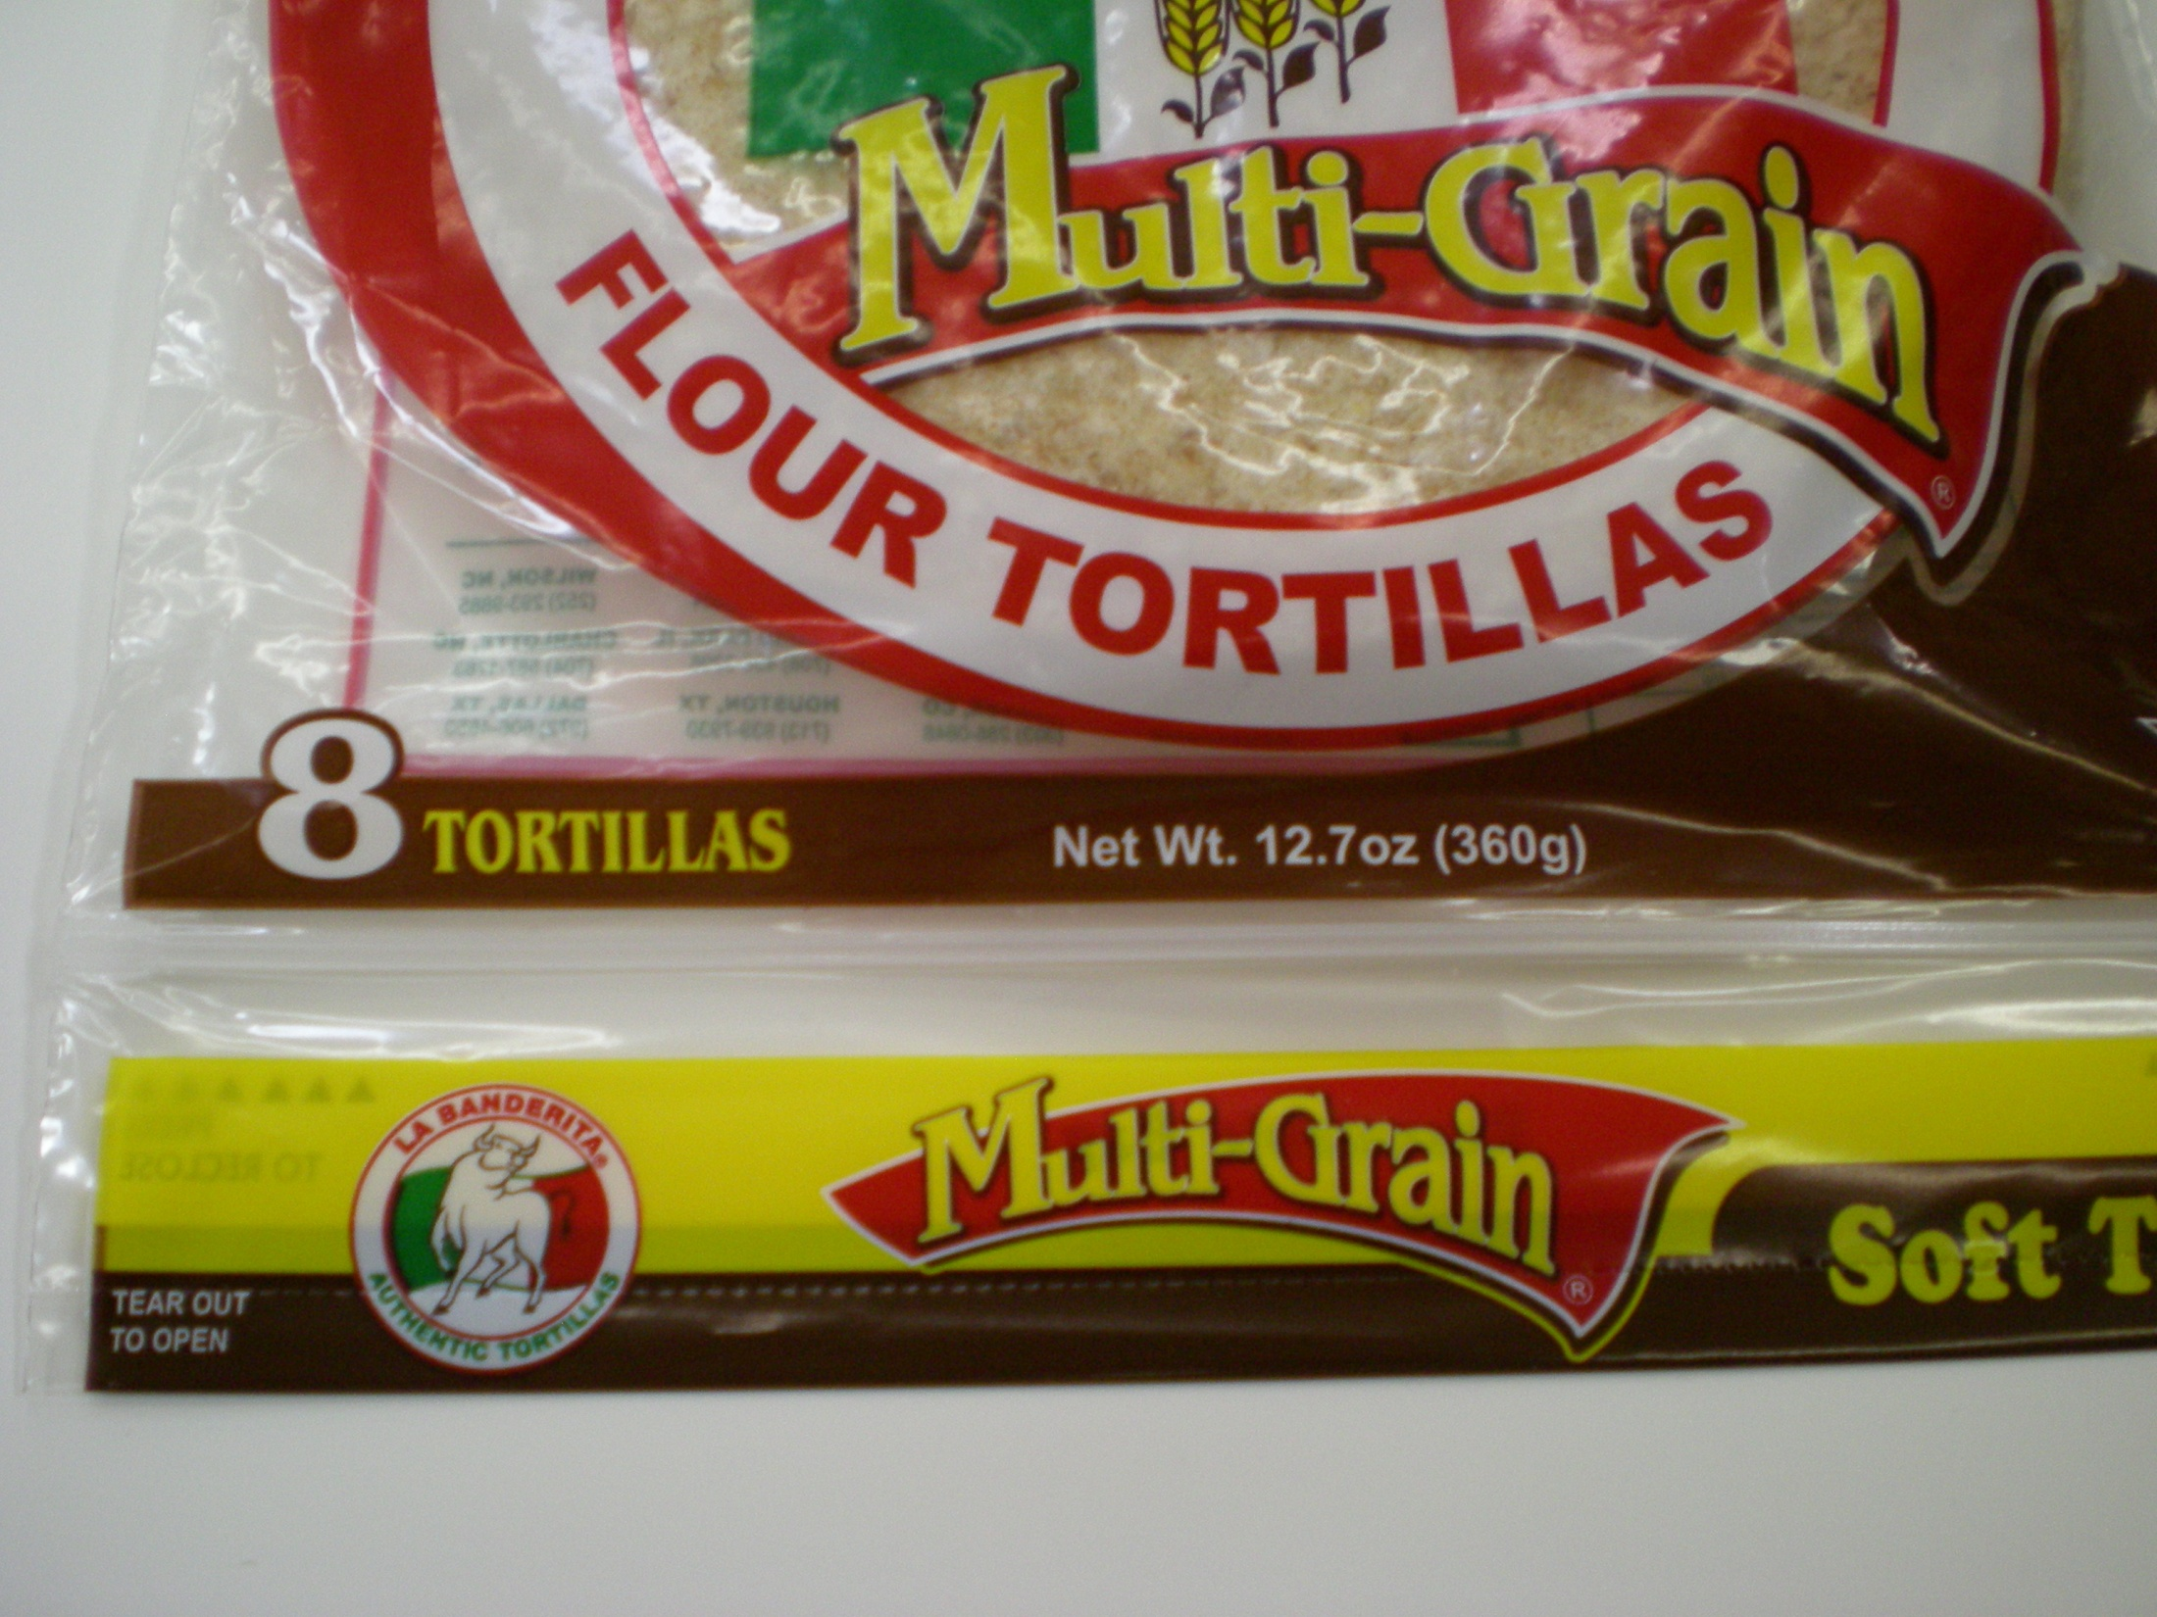

Slide 3
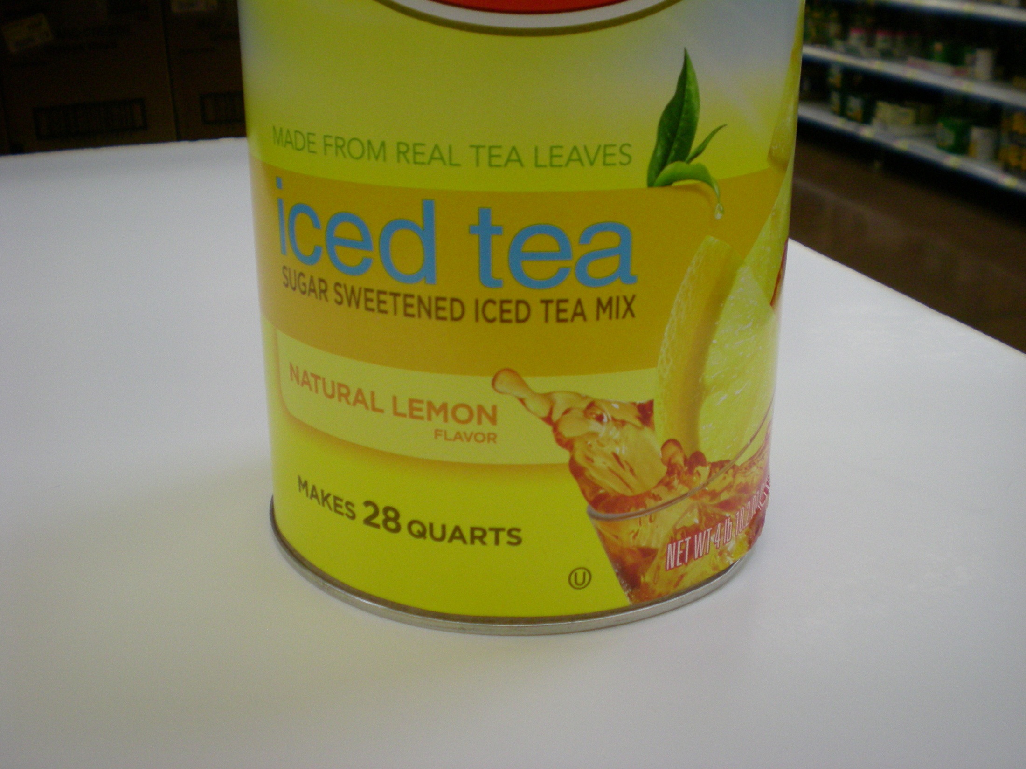

Slide 4
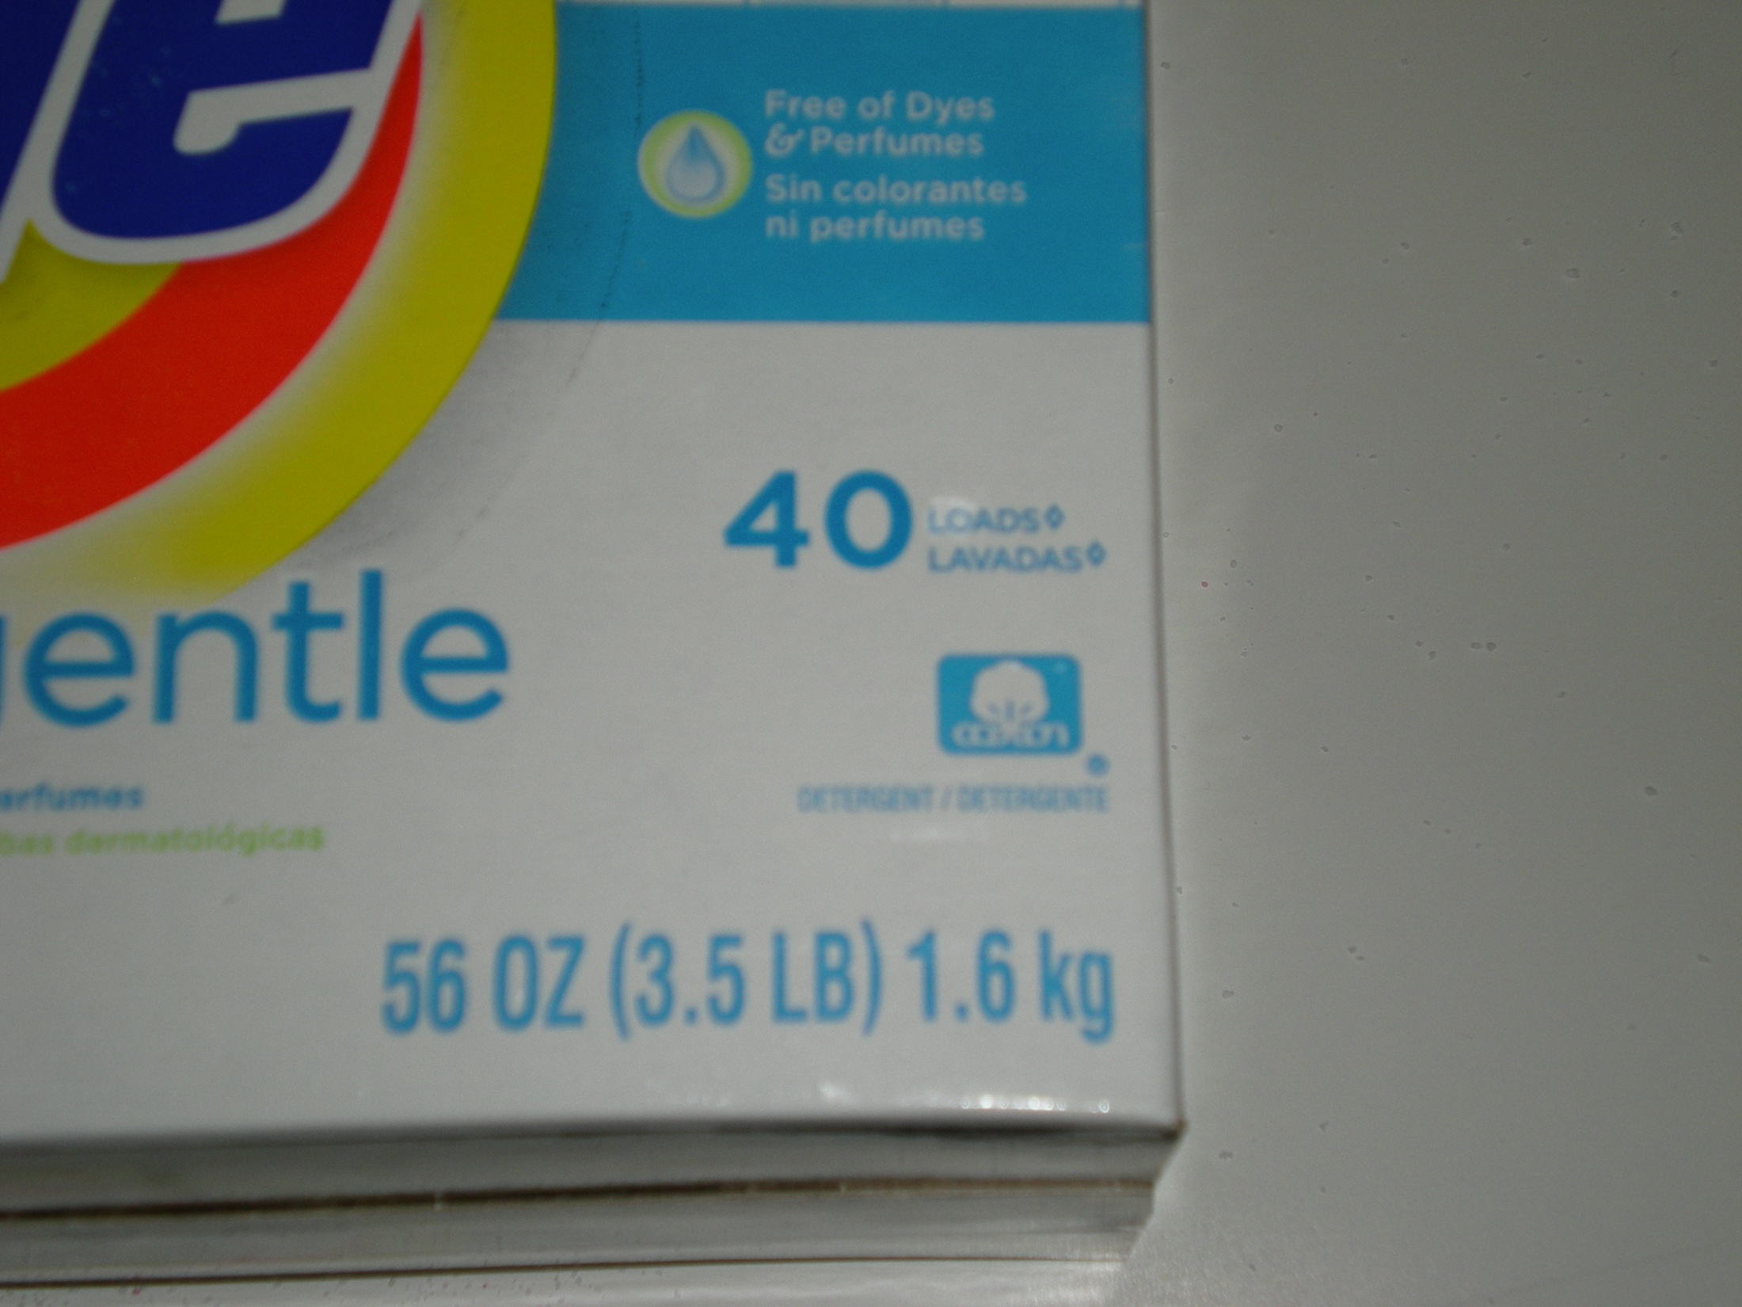

Slide 5
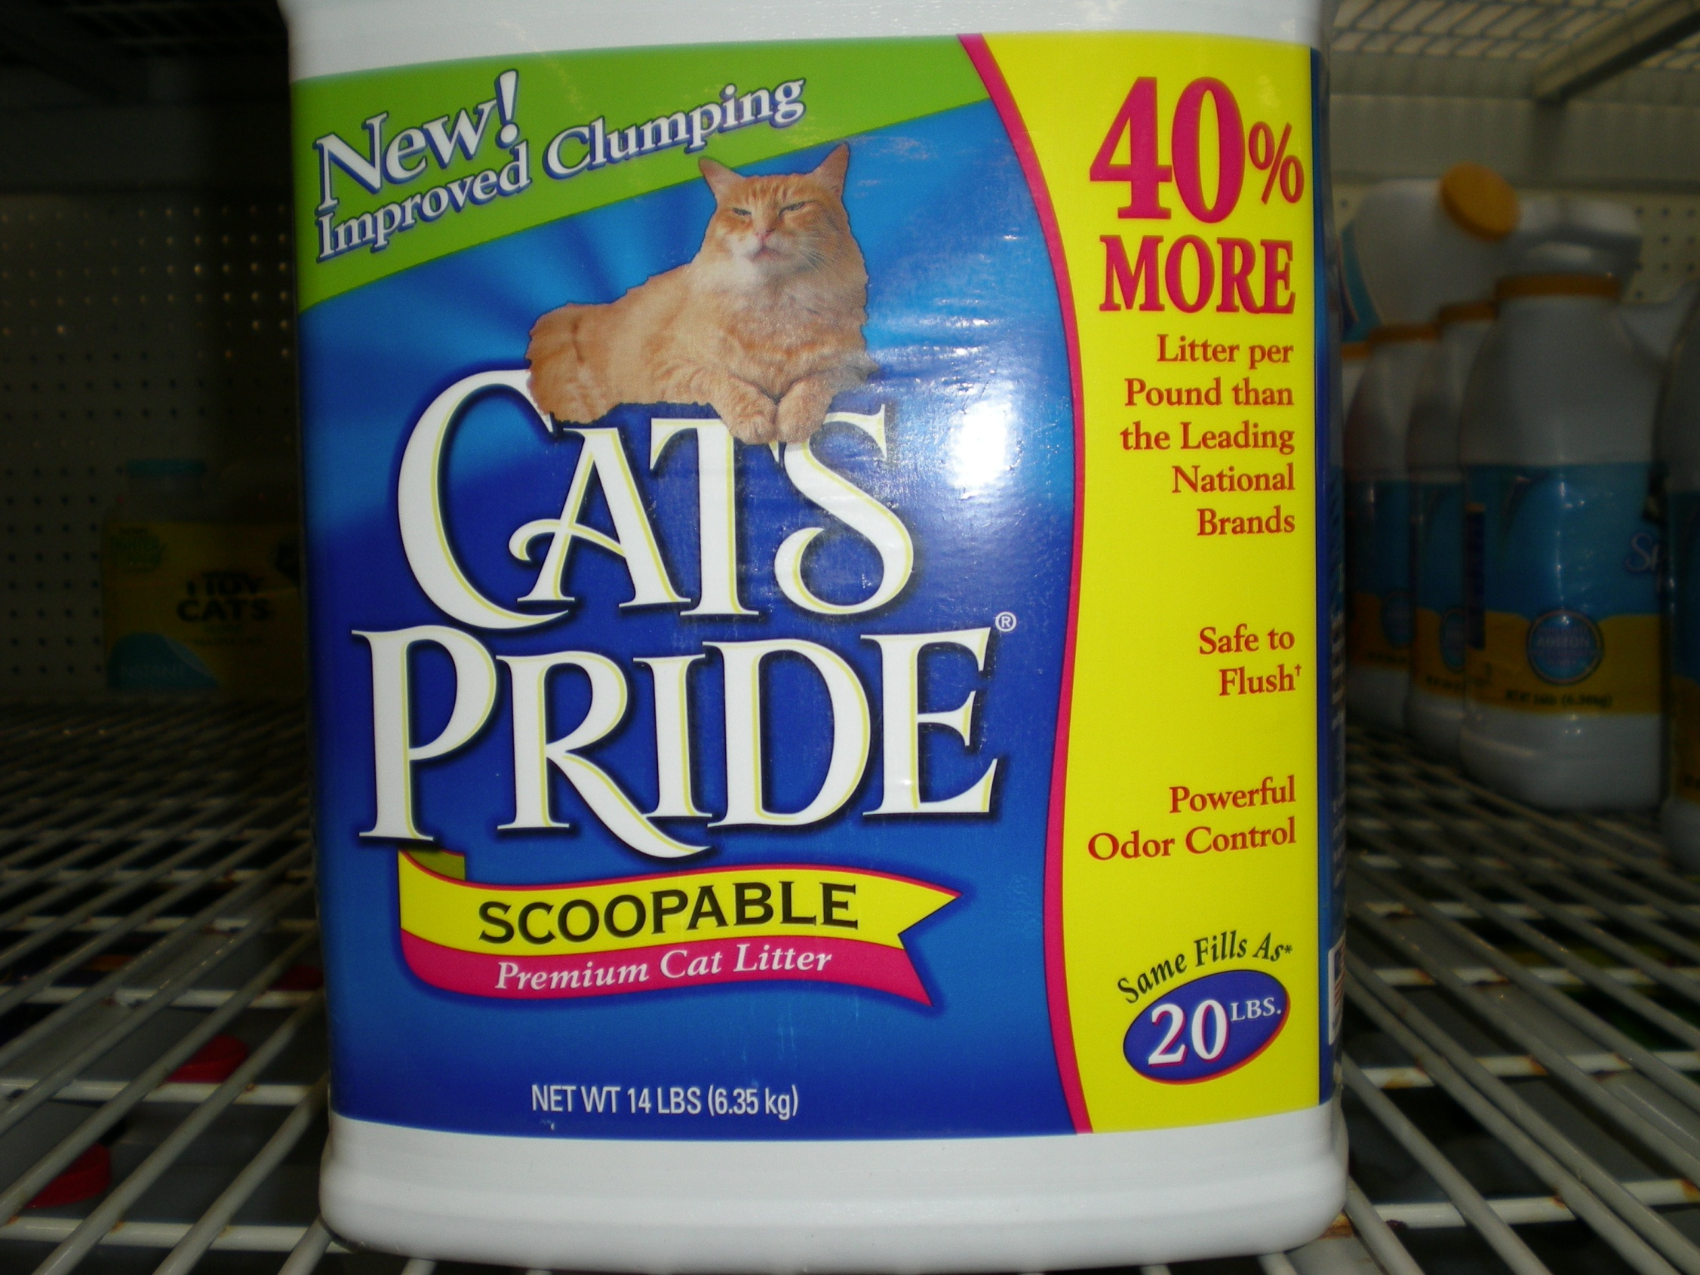

Slide 6
Background
Use of Voluntarily Added Information is Increasing
  Consumers want and use this information
  New technology and product forms make traditional product comparisons more difficult
A Net Quantity Statement and/or Unit Pricing may not be sufficient for consumers to make purchase decisions or accurate value comparisons
L&R item in 2011 proposed to restrict certain statements
L&R delegated item to PALS
PALS believed issue should be evaluated holistically and is working through this complex area.

Slide 7
Background (cont.)
PALS examined products on store shelves
No formal guidance for manufacturers or regulator viewpoints are often very subjective.
PALS has categorized the different kinds of Expressions
PALS drafting Principles (and accompanying detailed information) for each Category
PALS is compiling these Principles into a Recommended Best Practice document
Goal today is share some details of this developing DRAFT.

Slide 8
Expression Categories
Category | Example
1. Additional Expression of Quantity | “24 Tea Bags”
2. Quantity-Related Expression | “Contains More than a Quart”
3. Reconstituted Expression of Quantity | “Makes 2 Liters”
4. Reconstituted Quantity-Related Expression | “Makes Over 20 Gallons”

Slide 9
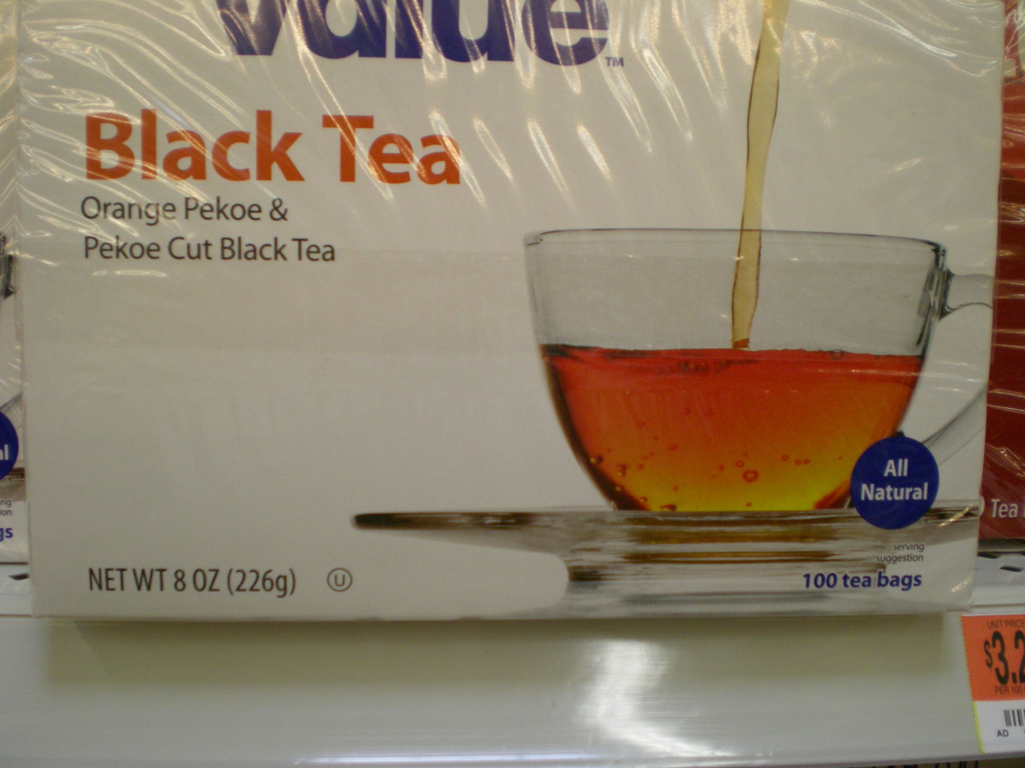
Additional Expression of Quantity

Slide 10
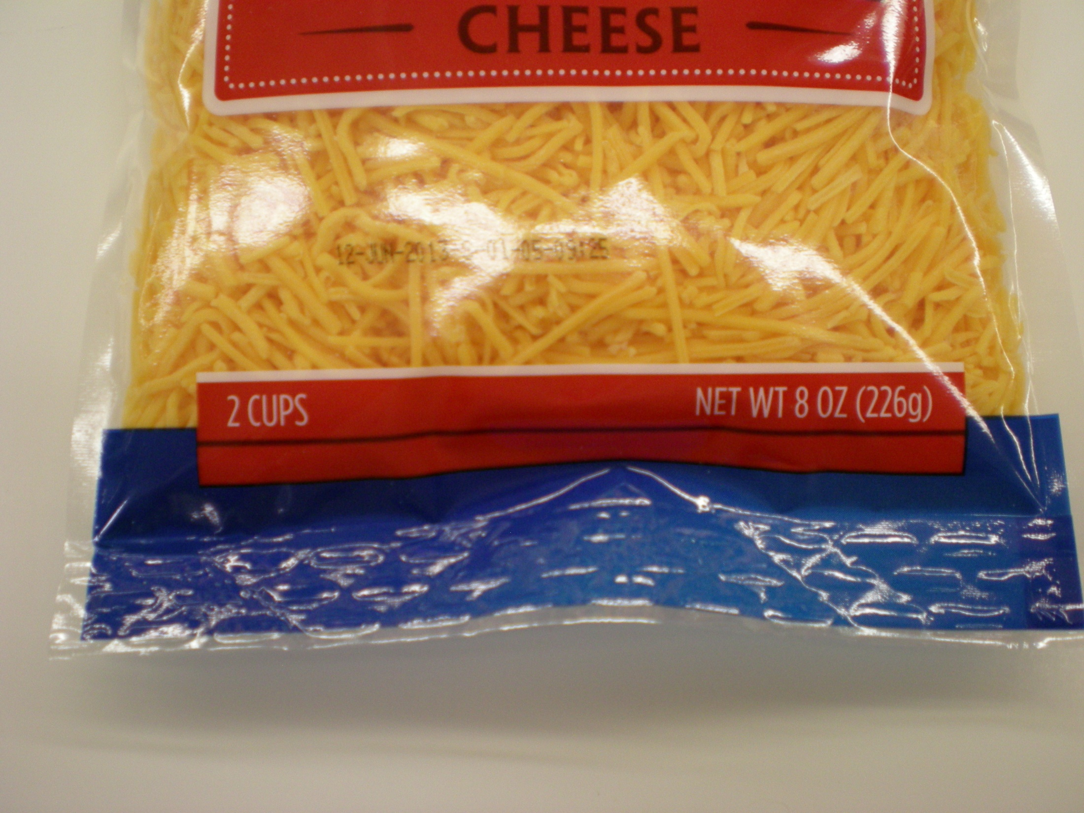
Additional Expression of Quantity

Slide 11
Reconstituted Expression of Quantity

Slide 12
Expression Categories (cont.)
Category | Example
5. Derived Unit Expression | “20 Loads”
6. Derived Unit Representation | “Over100 Uses”
7. Comparative Quantity Representation | “40% More Product Per Pound”
8. Comparative Performance Representation | “Does 25% More Loads”

Slide 13
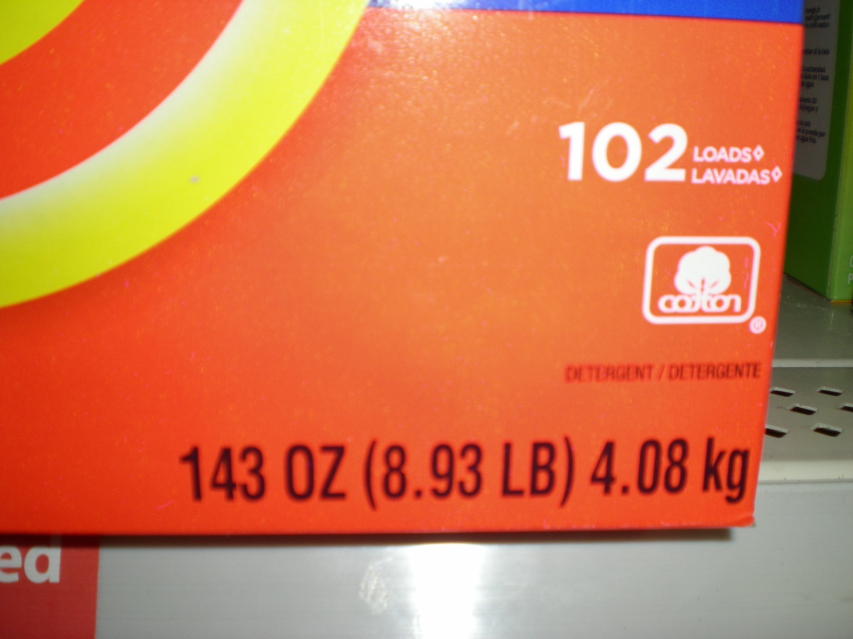
Derived Unit Expression

Slide 14
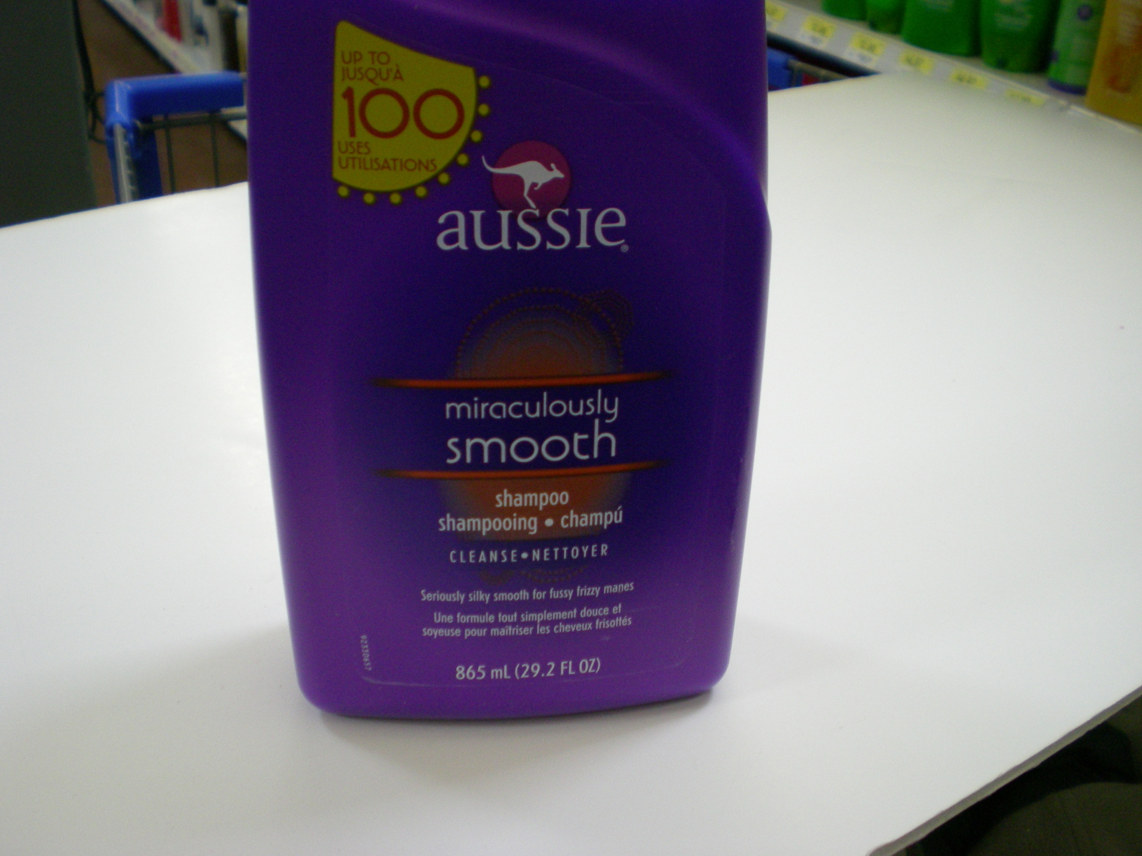
Derived Unit Representation

Slide 15
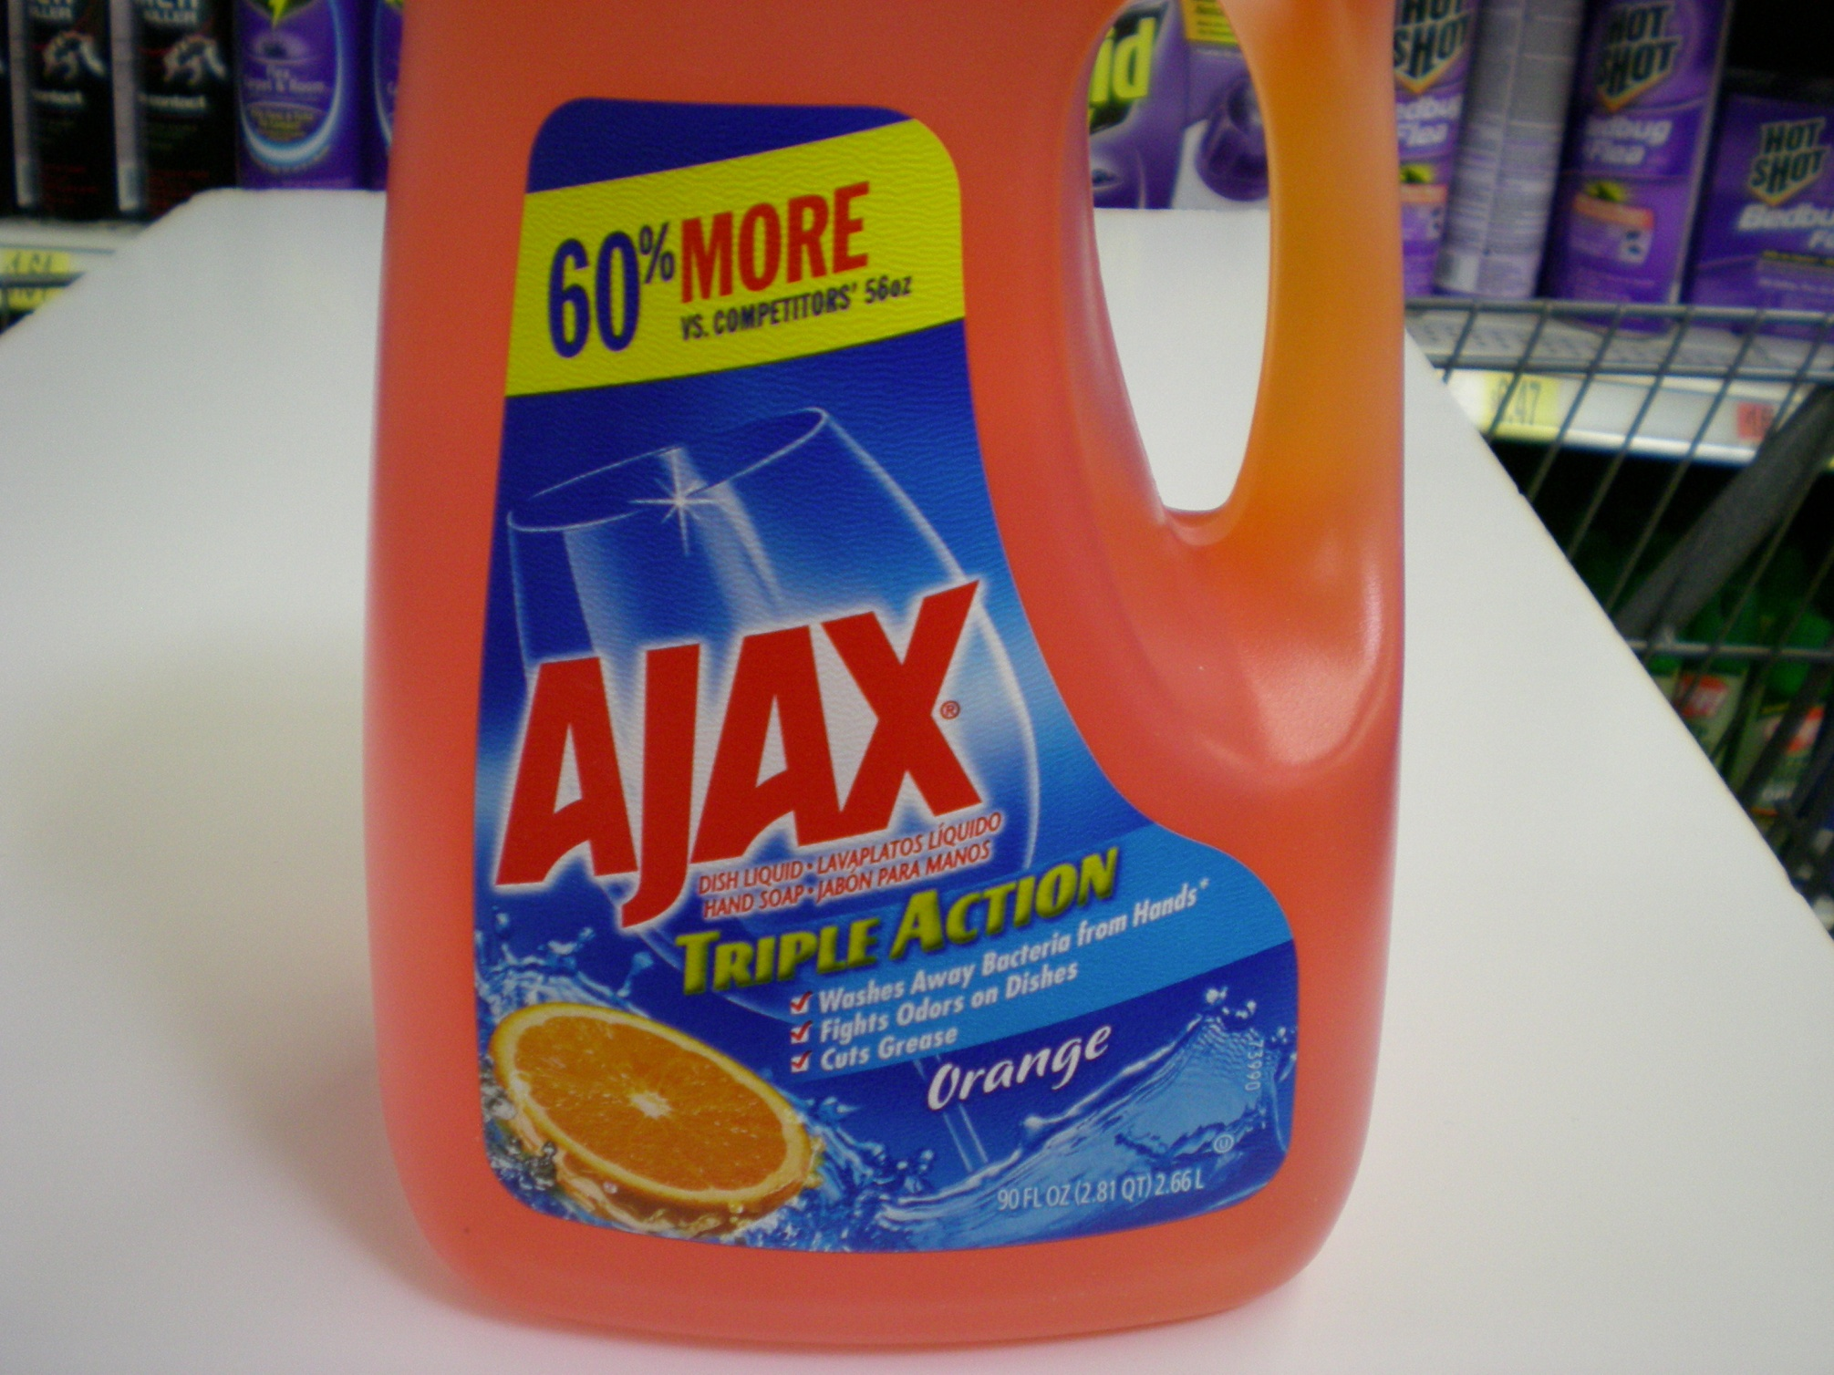
Comparative Quantity Representation

Slide 16
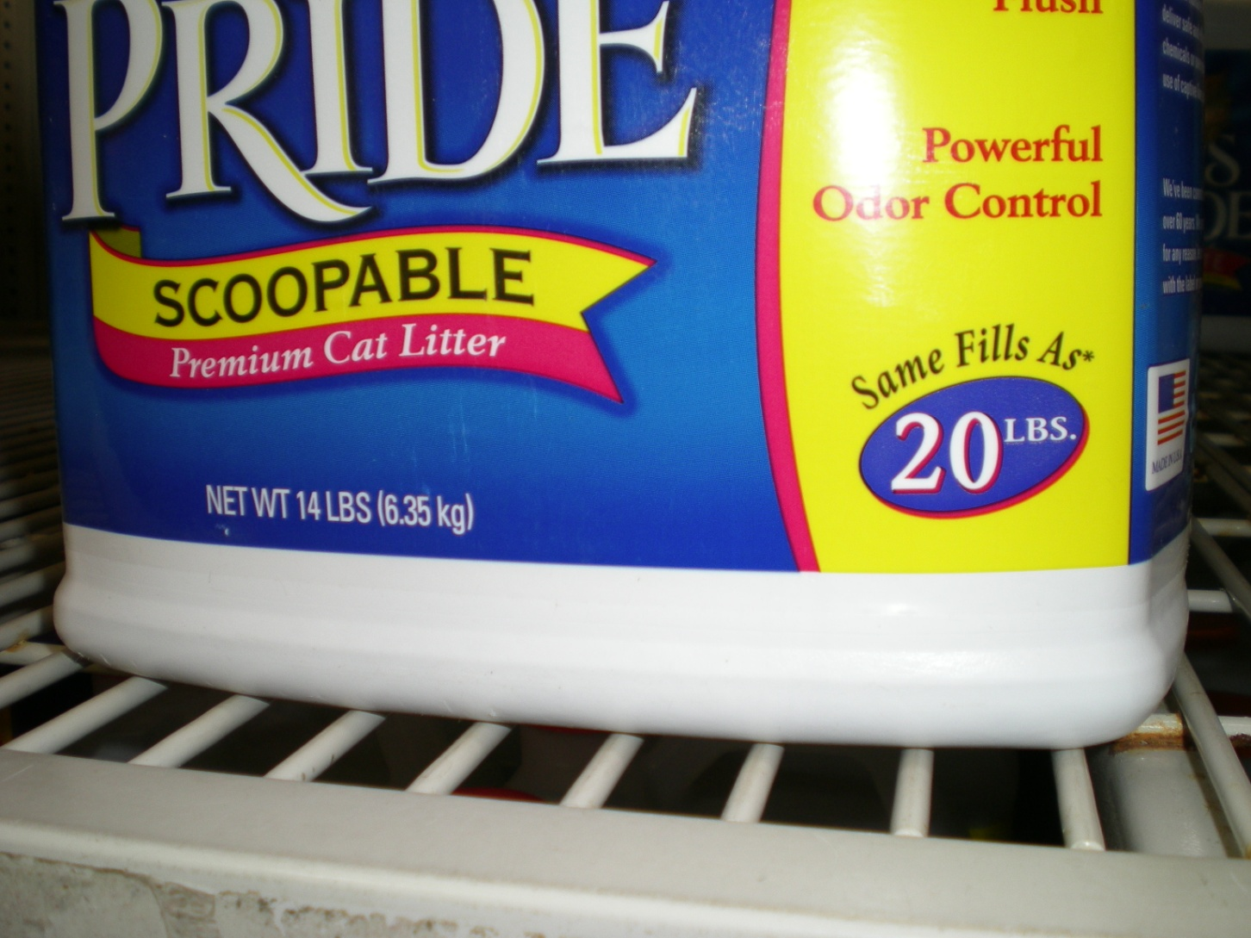
Comparative Performance Representation

Slide 17
Expression Principles
1. Expression should be useful for consumers.
2. Expression must be accurate and verifiable on the basis of a individual package.
3. Expression must be clear and unambiguous
4. Expression must not conflict with the information in the Declaration of Net Quantity
5. Expression location and prominence (size, font, and contrast) must be considered in relation to Net Quantity Statement prominence to ensure balance.
6. Expression should be relevant and in consumer meaningful units

Slide 18
Expression Principles (cont.)
7. Expressions should not conflict with units of Legal Metrology
8. When reconstituted expressions are used, directions for how to reconstitute product must be on package label
9. Expressions containing derived units must provide unit definition on the package label.
10. Derived unit definitions must be consistent between similar products.
11. A Comparative Quantity Representation should be located outside the lower 30% of the PDP in its entirety, and provide equal prominence quantities being compared.

Slide 19
What do these Principles Accomplish?
Increased Consistency and Transparency
Verifiable Statements
Clearer, More Complete and More Balanced Declarations
Decreased Confusion

Slide 20


Slide 21


Slide 22
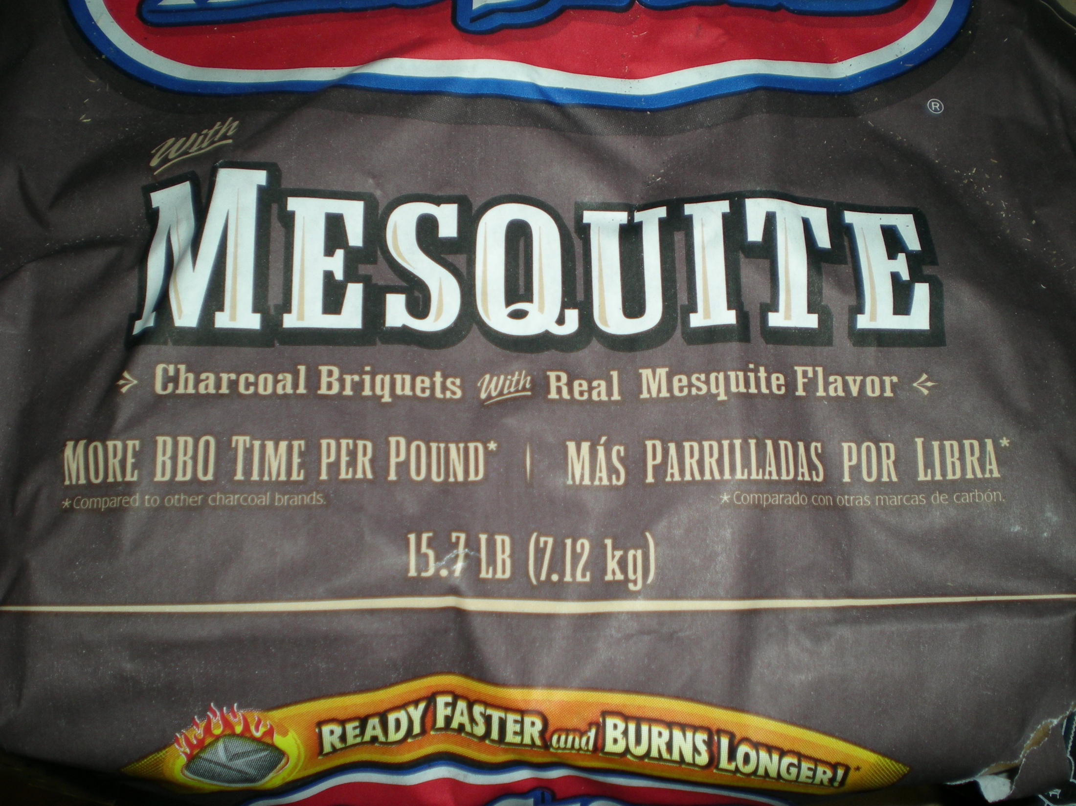

Slide 23
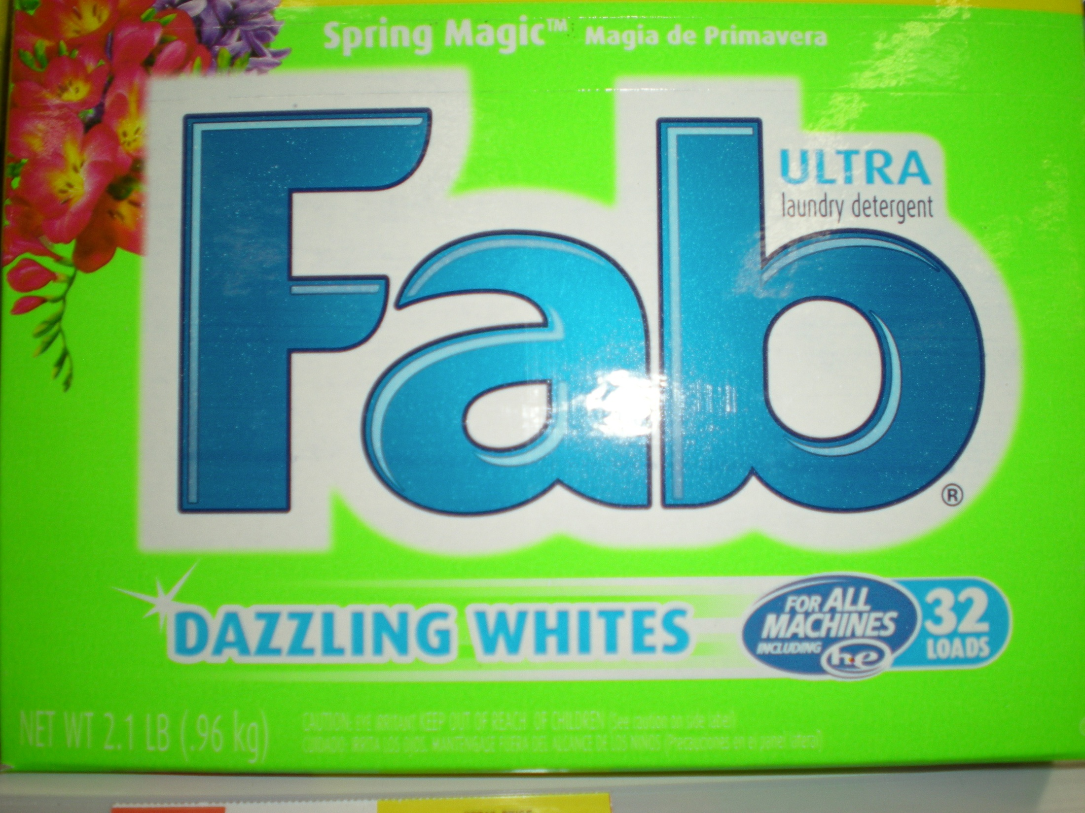

Slide 24


Slide 25
Recommended Practice Planned Document Format
Introduction and Background
Categories
Principles and Scope
Details on Principals
Enforcement
Appendix

Slide 26
Principles and Scope
 | Expression Category (Name, Abbreviation, Example)
Principal | Additional Expression of Quantity AEQ “24 buns” | Quantity-Related Expression QRE “Contains More than a Quart” | Reconstituted Expression of Quantity REQ “Makes 2 gallons” | Reconstituted Quantity-Related Expression RQRE “Makes over a gallon” | Derived Unit Expression DUE “20 Loads” | Derived Unit Representation DUR “Up to 100 Uses” | Comparative Quantity Representation CQR “40% More Litter Per Pound” | Comparative Performance Representation CPR “Lasts about 25% Longer”
Expression provides useful information to help consumers | X | X | X | X | X | X | X | X
Expression must be Accurate, Verifiable. | X | X | X | X | X | X | X | X
Expression must be Clear and Unambiguous | X | X | X | X | X | X | X | X

Slide 27
Principle and Scope | Detailed Guidance
2. Expression must be Accurate and Verifiable. Is the statement true? Can statement accuracy be verified? Applies to all categories | Voluntary expressions which contain quantity-related statements must be accurate and verifiable using appropriate evaluative procedures and are subject to external evaluation and confirmation. For expressions using defined units of measure or count, accuracy should be based on test methodologies recognized by appropriate authorities such as a Federal, State or International agency or standards organization. For expressions relating to product reconstitution, accuracy should be based upon the directions for product preparation appearing on the product label and test methodologies recognized by appropriate authorities such as a Federal, State, or International agency or standards organization. For Derived Unit Expressions (DUEs), Derived Unit Representations (DURs) and Comparative Performance Representations (CURs), accuracy should be based upon the unit definitions (which must be present on the product label) and verified using objective testing procedures. For example, since a Derived Unit Declaration (DUE) does not use a unit of legal metrology, a manufacturer must define that unit on the package label, ensure an appropriate test method or validation process for quantifying the unit has been established, and ensure the expression appearing on the PDP is accurate and verifiable. Where possible, the accuracy of the declaration should be based on test methodologies recognized by appropriate authorities such as a Federal, State or International agency of authority. Statement accuracy must be supportable by manufacturer data and is subject to external evaluation and confirmation.

Slide 28
Benefits to Manufacturers
There is now a reference for how to add this information.
Reference information provides more certainty for manufacturers wanting to add a statement.
Reference information provides more uniformity and consistency across packages

Slide 29
Benefits to Regulators
Regulators can direct manufacturers to Recommended Best Practice when asked for assistance
Regulators can direct manufacturers to Recommended Best Practice when concerns or questions are identified concerning a certain package.
Regulators will have a basis for asking questions about a particular package.
Package labels will be more complete and uniform.
Fewer issues/complaints/concerns exist regarding these statements on package labels.

Slide 30
Benefits to Consumers
Label information provided to consumers is more useful and helpful.
Label information provided to consumers is less likely to be confusing or misleading.
Label information is more complete, uniform and consistent.
Consumers are able to make better value comparisons at the point of purchase.

Slide 31
Why Recommended
Best Practice?
Wide variety of instances where information may be useful
1st Amendment Rights
FTC recognizes information is important to consumers
FPLA Record recognizes these statements as allowable
No guidance exists for manufacturers or regulators
Result is each manufacturer is “on their own”.
Recommended Best Practice provides, for the first time, a reference source for manufacturers and regulators to use to improve label quality and consistency for consumers.
Regulation, if deemed necessary in the future, always remains an option.

Slide 32
Current Status
PALS is working to finalize the first draft of the document.
PALS working to build awareness of this document, recognizing that it is both complex and outside normal scope of NCWM items.

Slide 33
Thank you!

