Slide 1
International Standards Activities Update
David Sefcik
Leader, National Legal Metrology Program
Office of Weights and Measures (OWM)
NCWM 110th Annual Meeting
15 July 2025

Slide 2








International Legal Metrology Program
Chuck Ehrlich
Served as U.S. International Committee of Legal Metrology (CIML) Member, on the OIML Presidential Council and as ILM Program Leader. Chuck recently retired from NIST after 38 years of service in national and international standards.
Ralph Richter
Served in OIML committees as an expert in gas and liquid flow measurement systems, including fuels. Ralph recently retired from NIST after 40 years of federal service, including a decade with the U.S. Navy.
Katya Delak
New Program Leader
Expertise is in electrical metering, and digitalization, with a focus on supply chain
Michael Nelson
Research Chemist/Physical Scientist
Expertise in chemical analyzers, electric vehicle supply equipment, and medical instruments
Jan Konijnenburg
General Engineer
Expertise in weighing instruments, digitalization,
and software security

Slide 3


OIML Electricity Metering Projects
Results from the March 2025 Technical Committee (TC) Meetings:
R46:2012 “Electrical Energy Meters”
  Updated test procedures, bidirectional measurement, remote displays, changing net configuration (electrical disturbances from wind turbines, etc.)
OIML G22 “Electric Vehicle Supply Equipment (EVSE)”
  U.S. has proposed to add a section on field verification procedures based on NIST Handbook 44 (3.40)
  Guide 22 to a full OIML Recommendation in 2026
New project in 2024: “DC Electricity Meters”
  DC applications are growing (solar panels, DC EVSE,
  battery units in grid storage)
  Project initiated and led by the U.S. (NIST OWM)

Slide 4
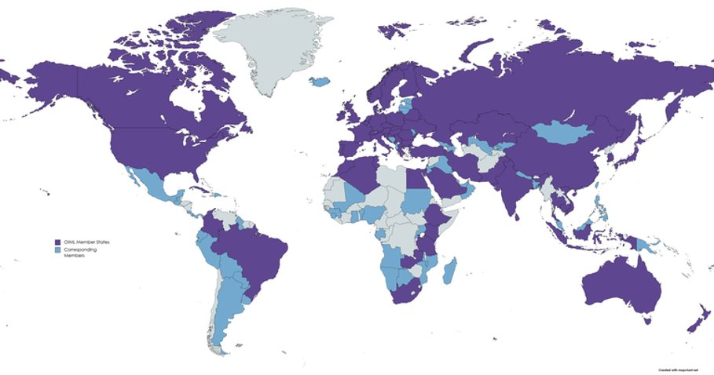


Promoting U.S. Manufacturers in International Markets
Electric Vehicle
Supply Equipment
Technical Issues currently NOT
considered by U.S. Weights and Measures:
Separately certified meters
Bidirectional: charging and vehicle-to-grid energy transfers
Software requirements: protection and updates
OIML Member States (64)
Corresponding Members (63)
Notes:
G 22 borne from OIML R 46 Active energy electricity meters but is not a generally applicable metering document. The meters embedded in EVSE can gain type approval separate from the EVSE device. Explanatory note within G22: “Whether the metrology in the EVSE is accomplished using a separately type approved meter, or integrated into the electronics of the EVSE, does not affect the requirements for testing, or the performance of the EVSE.”
NIST OWM activities in these spaces enable global reach for U.S. Industry

Slide 5

Measurements of Fuel and Other Liquids
OIML Recommendation revisions underway
R 71 Fixed Storage Tanks
R 85 Automatic Level Gauges
OWM is shifting staff resources
to maintain R 71/R 85 convenorship
OWM and the Netherlands on R 117 “Dynamic measuring systems for liquids other than water”
Notes:
With the recent retirement of Ralph Richter, OWM is seeking to close out some outstanding items. Els Koncki and Isabel Chavez-Baucom from the Laboratory Metrology and National LM programs have agreed to take over convenorship of the projects devoted to the revisions of R71 and R85. These haven’t seen a lot of progress in years, but we are anticipating that this will be a reasonably straightforward revision to complete.

Slide 6
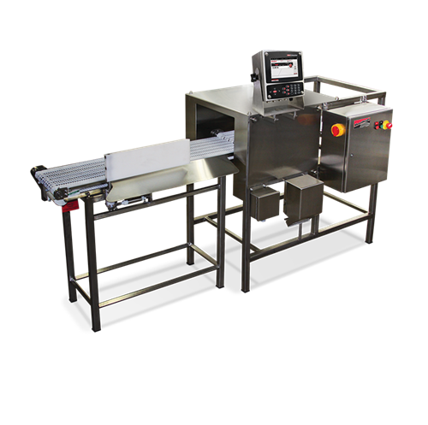

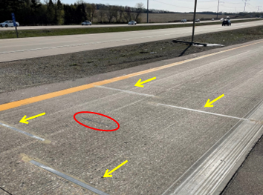
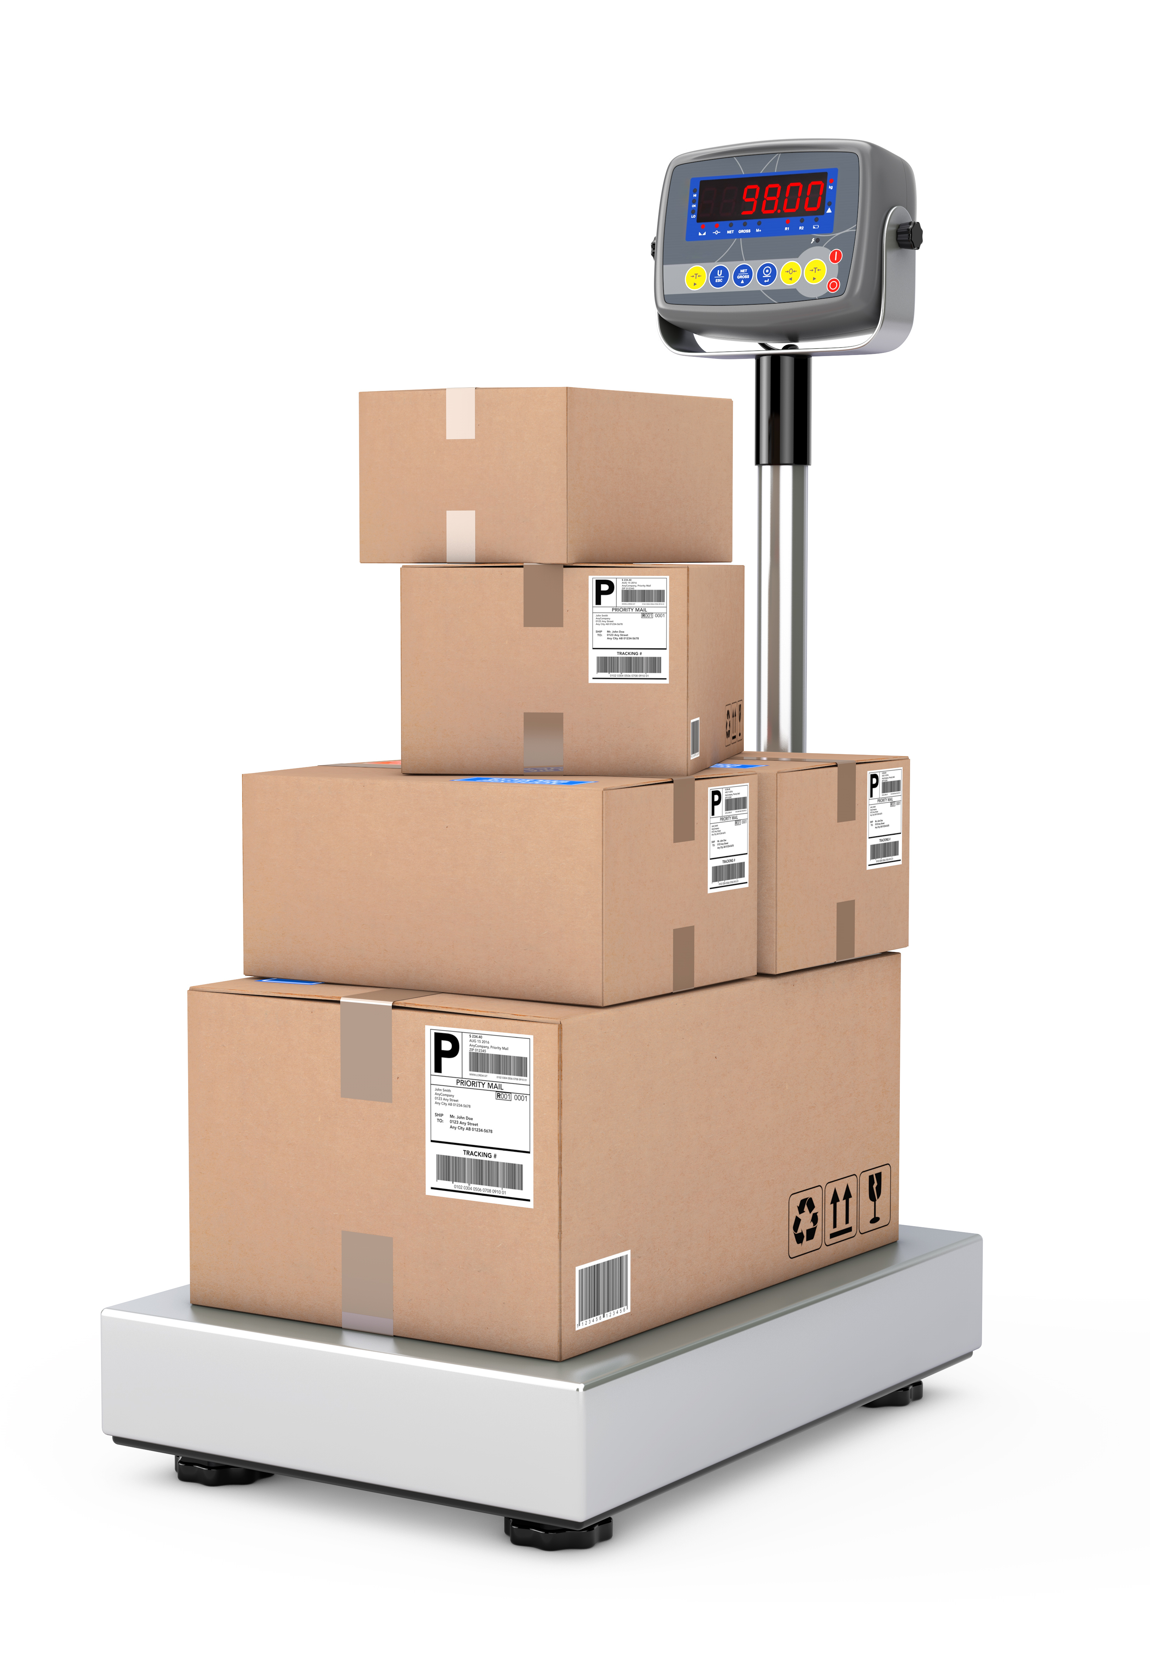
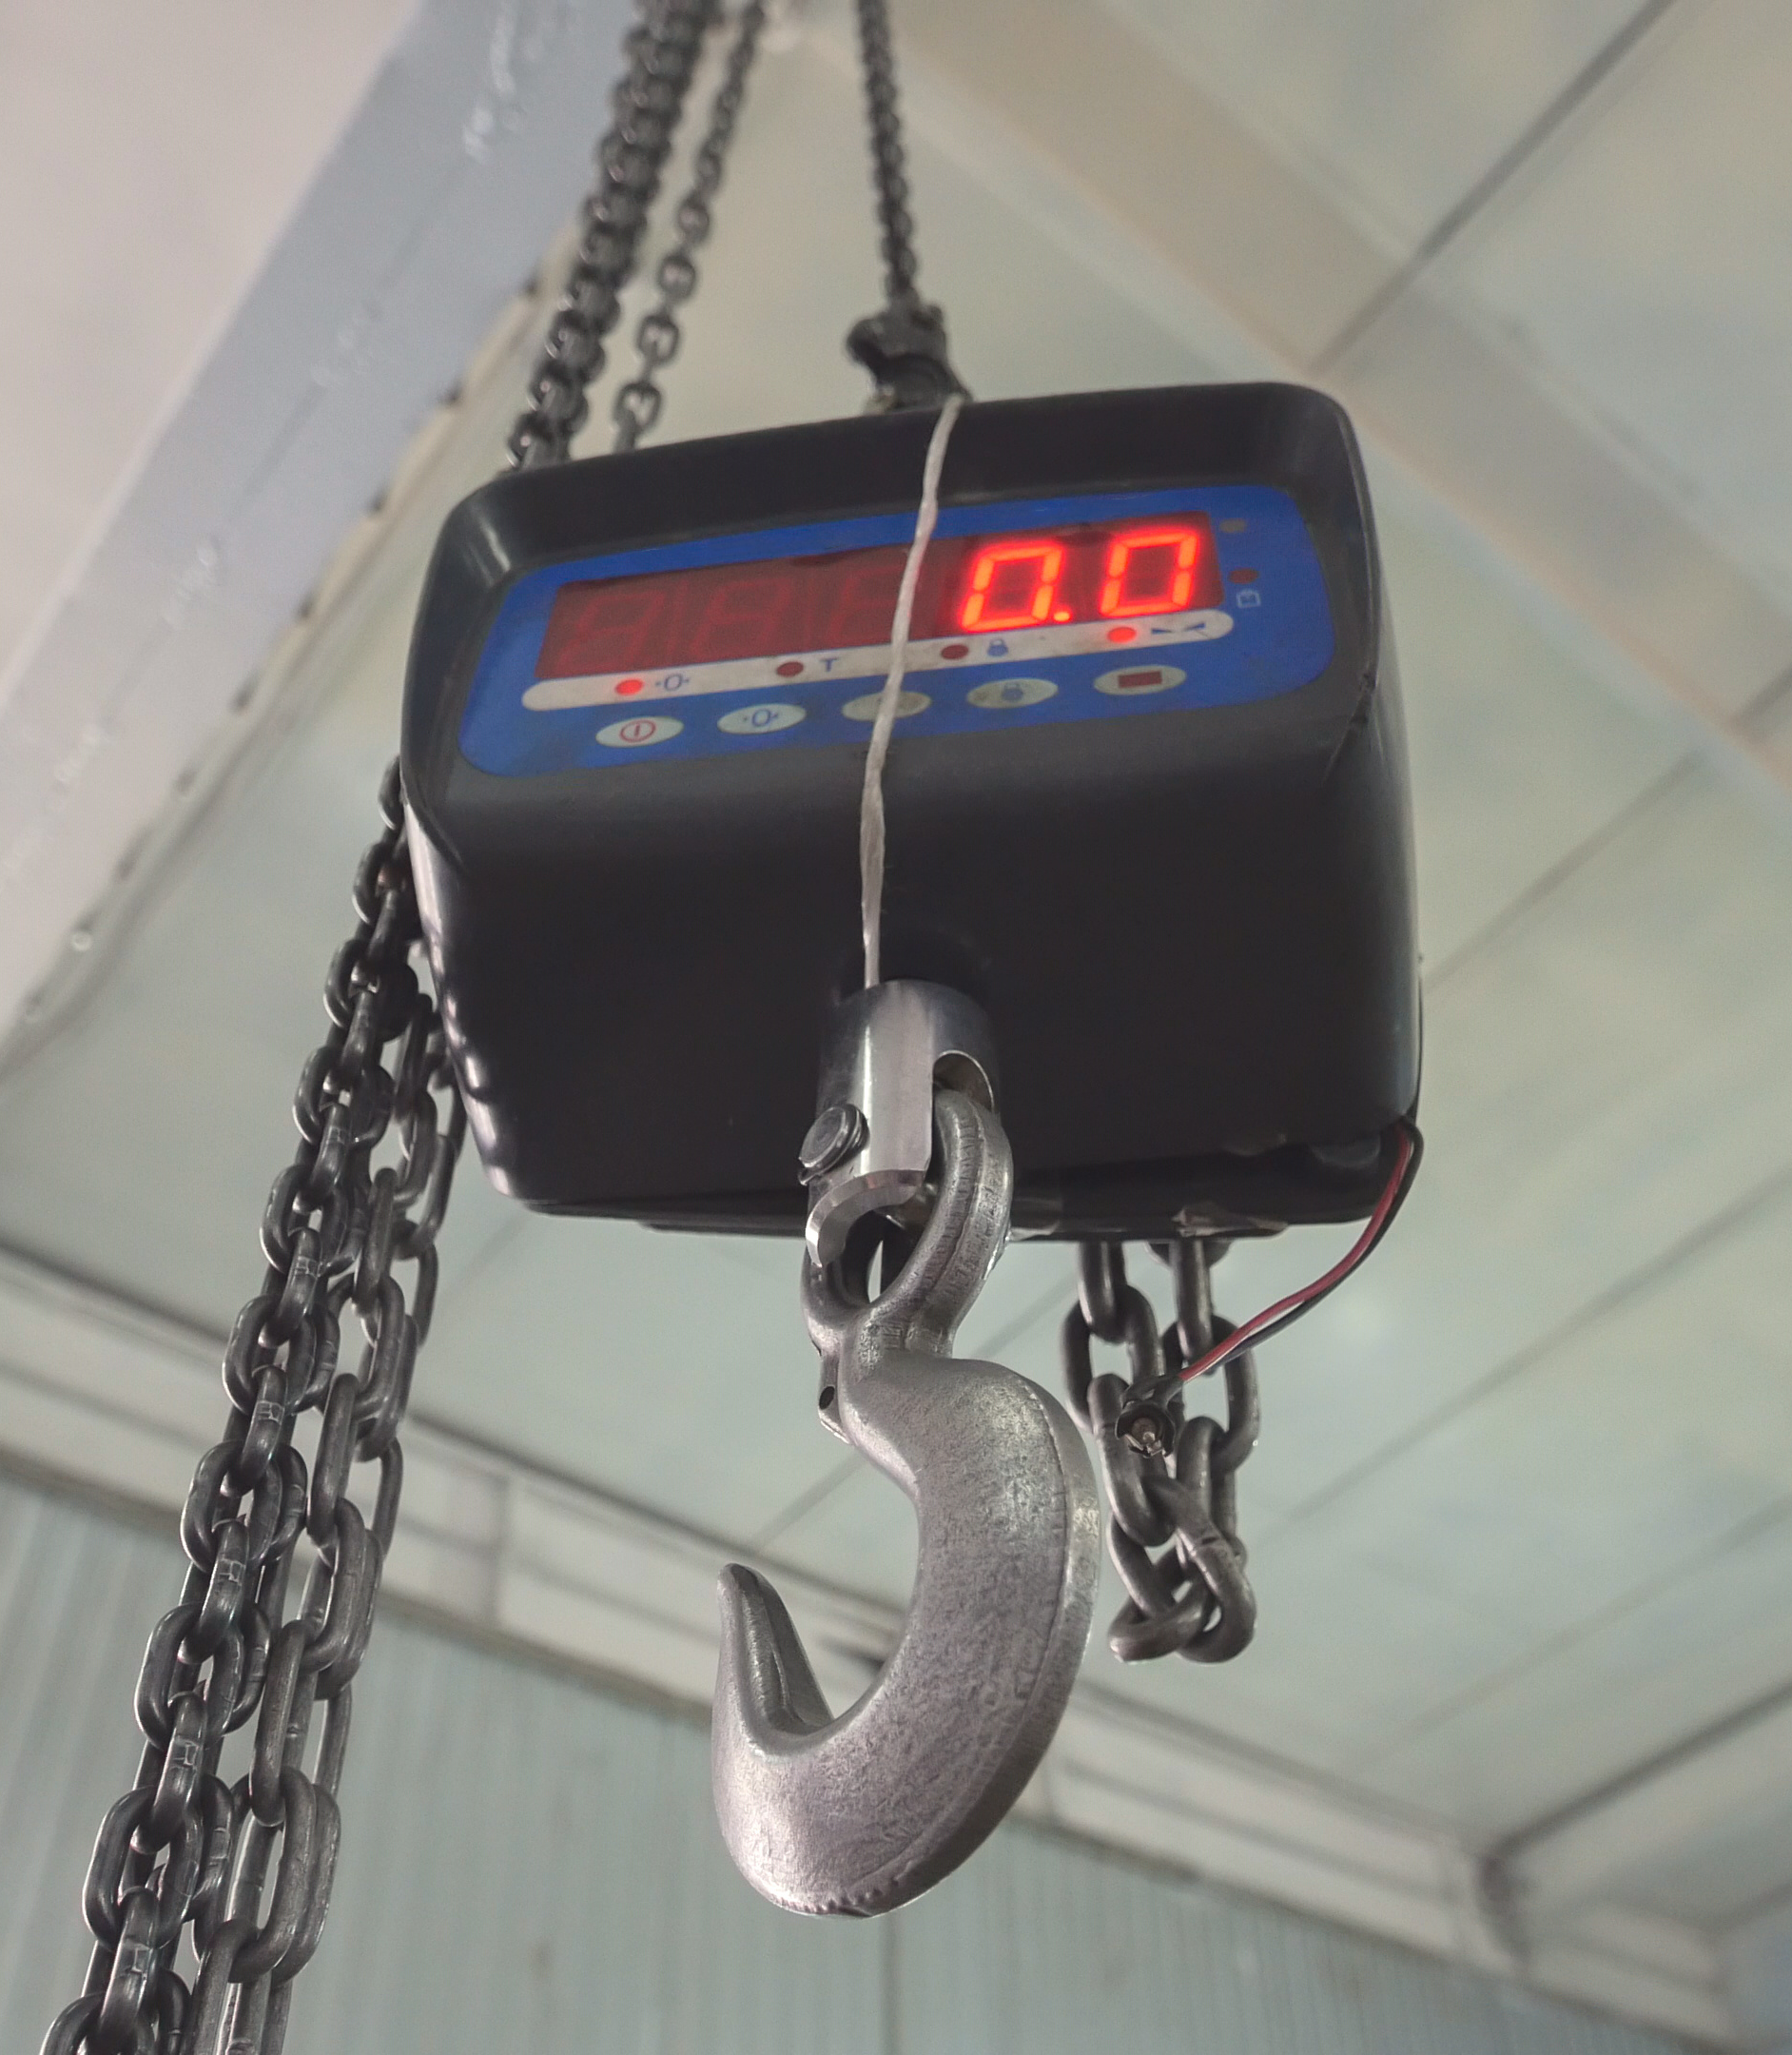

Weighing Systems in OIML TC9
OIML Recommendations in “active” revision status:
R 51 Catchweighers
R 134 Weigh-in-Motion (WIM) Systems
R 76 Non-automatic weighing Instruments (NAWI)
Source: Rice Lake Weighing Systems
Installed Weigh-in-Motion (WIM) System
NAWI Focus Areas: electronic scales (vs mechanical), remote verification, and software security
Notes:
There are a number of ongoing projects with regard to weighing systems
R 51:
The update has been focused on the update of software and EMC requirements.
Variable test size based on the performance of the instrument.
Expected end of 2026
R 76:
Update of software requirements.
Includes remote verification possibilities.
Aim for publication end of 2026.
R134:
New convenor after being on hold for 2 years.
Traceability of axle load measurement.
Differentiation between high-speed and low-speed WIM.
Update of software requirements.

Slide 7







OIML Digitalization Efforts
Smart Standards (OIML Digital Task Group)
  Migrating OIML Recommendations to digitalized forms (XML format) that are machine-readable and eventually machine-interpretable
  Supports interoperable regulations and conformity assessments
Digital Quality Infrastructure
  Digital Calibration Certificates (DCCs) for Scales/NAWIs
  All-Inclusive Digital Product Passports (EU-driven)
  More efficient, reliable data available to support measuring instrument/device inspections
NIST OWM’s goal is to include U.S. Weights and Measures Community in this effort…
Notes:
The “Why” for Digitalization in Legal Metrology = XXXXXX
Lessen errors that come with manual data entry of the test results, for example.

Slide 8

Feel free to contact any of us for more information:
      katrice.lippa@nist.gov
      katya.delak@nist.gov
      jan.konijnenburg @nist.gov
      michael.nelson@nist.gov
General/Technical Inquiries: owm@nist.gov

