Slide 1
International Legal Metrology Update for the 2025 NCWM Interim Meeting in Charleston
David Sefcik
NIST Office of Weights and Measures

Slide 2
OWM serves as a liaison for international standards activities and regulatory activities; A more detailed summary of international activities is found in the Pub 15 BOD Report (Appendix A) ; OWM provides service to the entire legal metrology community as an “Information Hub”
Presentation Summary/Take-aways:

Slide 3
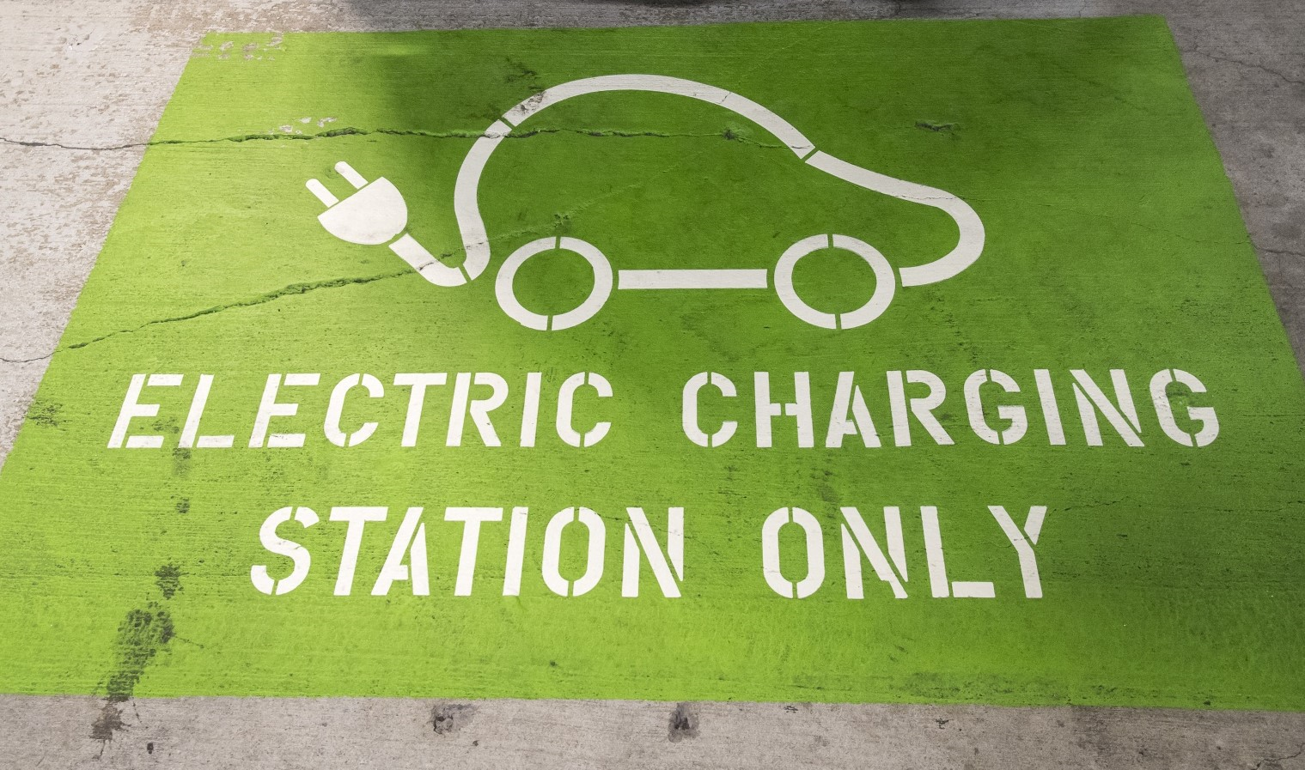
Electricity Meters in OIML TC-12 OIML Guide 22: “EVSE” Guide published; Being made into a Recommendation R46: “Energy Meters” Project Group distributed the 2CD of R46 in Nov 2024 New project: “DC Electricity Charging” 1WD distributed in 2024; US is Convener

Slide 4
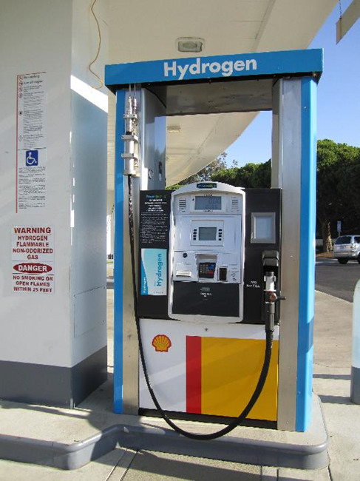
Alternative Fuels for Vehicles Hydrogen and CNG OIML R139 - “Compressed Gaseous Fuel Measuring Systems for Vehicles” Liquefied Natural Gas (LNG) OIML R117 - “Dynamic Measuring Systems for Liquids Other Than Water”

Slide 5
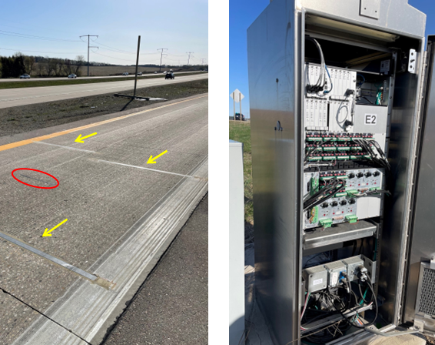
Weighing Systems in OIML TC9 All of the following OIML Recommendations are currently in active revision: R51 “Catchweighers” R76 “Non-Automatic Weighing Instruments (NAWI)” R134 “Weigh-in-Motion (WIM) Systems”

Slide 6
OIML Certification System (OIML-CS) 37 OIML Recommendations are now in OIML-CS; Digitalization (OIML DTG, NIST efforts) Annual CIML Meeting Held in October 2024; The OIML Medal was awarded to Dr. Charles Ehrlich (this is the highest level of recognition in the organization).

Slide 7
Discussion/Questions?
Charles Ehrlich
charles.ehrlich@nist.gov
Katya Delak
Katya.delak@nist.gov
Ralph Richter
ralph.richter@nist.gov

