Slide 1
Software in Weights and Measures applications
September 2026

Slide 2
Introduction
The National Council on Weights and Measures (NCWM) is a professional nonprofit association of state and local weights and measures officials, federal agencies, manufacturers, retailers and consumers.
  NCWM has been developing national weights and measures standards since 1905
  NCWM manages the content of NIST Handbook 44 and Handbook 130
The National Type Evaluation Program (NTEP) is operated by NCWM. NCWM/NTEP maintain multiple NTEP Publication 14 documents to standardize the type evaluation procedure and expectations.
The NTEP Committee is a standing NCWM committee that manages the program, with multiple technical subcommittees called ‘Sectors’ that each manage one of the separate Publication 14 documents.
The NTEP Software Sector maintains the Software Technical Policy and Supplemental Checklist section of Publication 14 and makes recommendations related to software and software-based devices to the NTEP Committee.
Software in W&M Certification and Inspection
Notes:
Publication 14 consists of multiple sections, including an Administrative Policy section(overall program expectations), and separate technical policies / checklists for Measuring instruments, Weighing instruments, and other device types. It also now includes a Software Technical Policy and Supplemental Checklist document.

Slide 3
Software Sector Role and Goals
Develop NCWM Pub 14 guidance and supplemental checklist criteria for type evaluation of software / software-based devices.
Advise S&T committee on items for HB44 related to software
Support the NTEP committee, NTEP evaluation process and NTEP laboratories
Provide or assist with Training
  Assist in the development of training materials and guidelines for Weights and Measures inspectors
  Promote a clear understanding of the use of software in weighing and measuring devices in NCWM
  Consider the development of guidelines and training aides to educate manufacturers, designers, service technicians and end users
Software in W&M Certification and Inspection
Notes:
The ‘Charter’ for the Sector is to accomplish all the items on the list shown here, roughly in priority order. Some other considerations include maintaining some semblance of alignment with international standards (at least don’t conflict) and

Slide 4
Agenda
Describe concepts related to software in general
Provide examples of how to identify software versions/revisions on several types of devices, such as retail scales, WIM installations, retail motor fuel dispensers, and LMDs
Explore how software can impact the field inspection process
Software in W&M Certification and Inspection

Slide 5
State of the Art - Review
With the ubiquitousness of PCs and mobile devices, the idea of a software application is becoming more widely understood/used
Many consumer software applications are now acquired or accessed online (for example Apple Store, Google Play Store, Xbox Live)
Applications may be built-in, e.g., your cable TV receiver or Roomba comes with pre-installed software designed for a specific purpose
Software applications might even be ‘pushed’ to a device by the developer of the software, or by a company’s IT department
  ‘State of the Art’ is a moving target
Software in W&M Certification and Inspection

Slide 6
State of the Art Review (cont.)
Parts of a computer system and how they are organized
  The computer - a collection of electronic hardware (processor, network card, memory, hard drive, display…)
  The operating system software, which contains modules that allow the user (or other software) to access the hardware and organize files
  End user applications that allow us to do meaningful things, like browse the web (Edge, Chrome), edit documents (Microsoft Word), or create and give presentations (MS PowerPoint)
  Software may be running locally or remotely (e.g. in the cloud).
Software in W&M Certification and Inspection

Slide 7
Software versus Firmware
The terms Software and Firmware are often used interchangeably
Firmware is typically used to describe software running on dedicated hardware or a chip
Software is a more generic term that is usually applied to programs run on a general-purpose computer and OS
Software in W&M Certification and Inspection

Slide 8
The Future Is Here
Since 2022, the indication of current software version is now required for all software-based devices.
The implication is that the Certificate of Conformance for all these software-based devices will have instructions explaining how to identify the relevant software version(s) and/or follow basic rules to make identification of revision straightforward.
Software in W&M Certification and Inspection

Slide 9
Metrologically Significant Software
Metrologically Significant Software - The set of software modules that impact the accuracy of the device or affect the representation of the measurement or transaction to the consumer or otherwise affects the compliance of the device to the specifications in Handbook 44.
Software in W&M Certification and Inspection
Notes:
Reducing the potential exposure to the manufacturer to have to have devices re-evalulated can be accomplished using a technique known as ‘software separation’
It was mentioned earlier that these systems have operating system updates that are not optional. Therefore to avoid recertification every time an operating system update is produced or a feature unrelated to the measurement function is added or modified, the NCWM has developed the concept of Metrologically Significant Software.
Section 3.1 of the NCWM/NTEP Pub 14: "The manufacturer must describe and possibly demonstrate how the version or revision identifier is directly and inseparably linked to the metrologically significant software. Where the version revision identifier is comprised of more than one part, the manufacturer shall describe which portion represents the metrological significant software and which does not."

Slide 10
Software Separation
Manufacturers may choose to separate metrologically significant software from non-metrologically significant software.
Separation would allow the revision of the non-metrological portion without the need for further evaluation. In addition, non-metrologically significant software may be updated on devices without breaking a seal, if so designed.
The metrologically significant software part of a measuring instrument (device or sub-assembly) includes all software modules (programs, subroutines, objects, etc.) that perform metrologically significant functions or contain metrologically significant data.
If the separation of the software is not possible or needed, then the software is considered metrologically significant as a whole.
Software in W&M Certification and Inspection
Notes:
Field inspectors will likely not have to worry about anything other than comparing the device’s version with the conforming versions; the Certificate of Conformance will indicate which revisions are in conformance.
It is beneficial for manufacturers to choose to separate the metrologically significant software for any device that requires frequent updates to modules that are not metrologically significant (e.g. the operating system).

Slide 11
The Necessity of Software Maintenance
Software is much more flexible than hardware
Easy and (relatively) cheap to modify/update
Ubiquitous networks (Ethernet, Wi-Fi, cellular) make it easy to deliver these revisions
Downside - these networked devices are now a potential gateway that can be used by ill-intentioned individuals or groups to do undesirable stuff
Bottom Line – Protection is required for mission critical systems
Software in W&M Certification and Inspection
Notes:
Undesirable stuff – e.g., gain access to confidential information, distribute viruses and other malware, delete data, platform for cyber-attacks on other devices in the network.
Typically 2 or more software updates per year are required to provide needed operating system updates and new features. The benefit to end users is significant for both reasons. Continuing to use outdated software poses security risks and denies the user access to the latest features.
The hacker community finds vulnerabilities in the operating systems that enable unauthorized access to information in the machine or access to information on computers connected to the machine.
The operating system makers and antivirus product developers are constantly developing software updates for their operating system to counteract these vulnerabilities. Hence regular operating system updates are important and need to be distributable to devices - sometimes very quickly if a major threat is in circulation.

Slide 12
Software Maintenance
Keeping track of all these updates requires that most software components have a version number, which is required by NTEP if they’re metrologically significant.
The operating system also has a version number, like Windows 11.
The Application has a version number, like PowerPoint Version 14.0.7214.5000.
Which are important to W&M?
  The software identifiers related to the metrologically significant components of the application are the only identifiers that an inspector needs to check
Software in W&M Certification and Inspection
Notes:
There are revision numbers for the Operating system and for the internal applications used by the operating system to access the hardware (also known as device driver software).
It would be very difficult to know which of potentially hundreds of revision numbers are relevant for weights and measures certification.
The NTEP evaluator will likely look at all the software ‘pieces’ that make up the device’s ecosystem – OS version, application version, library versions, etc.
The metrologically significant portion of the application is what is critical to inspectors in the field.

Slide 13
HB44 Guidelines on Software
The NCWM recognizes this and has added some requirements recommended by the Software Sector to the General Code in HB44. The HB44 document currently uses these terms:
  "built-for-purpose device" - any main device or element which was manufactured with the intent that it be used as, or part of, a weighing or measuring device or system. [1.10].
    This is the definition currently in Handbook 44, Appendix D. Definitions, though it is not used verbatim anywhere in Handbook 44.
  "not built-for-purpose, software-based device" – the term that is actually used in G-S.1. It is not defined separately beyond the definition above.
Software in W&M Certification and Inspection
Notes:
Add images?
"not built-for-purpose device" - not specifically defined in HB44. Therefore I consider it to be anything not classified as a "built-for-purpose device". Example, an application that runs on a PC that uses an array of simple analog load cells to weigh in and weigh out trucks at a landfill.
"software-based device" - not specifically defined in HB44. I consider this to be a device that uses software as part of its metrologically significant measuring process. This is basically anything that is not purely mechanical or analog electronic (think transistor based old-school) which uses a microprocessor to process the signal from the measurement transducer (e.g. load cell or strain gauge) and present it.
The lines are blurring between the first two categories… so that all metrological software will likely eventually (soon) be treated the same way.

Slide 14
HB44 Guidelines on Software
G-S.1. (d) (device shall be marked for identification with…) "the current software version or revision identifier for not built for purpose, software-based devices manufactured as of January 1, 2004 and all software-based devices (or equipment) manufactured as of Jan 1, 2022.“
G-S.1. (d) (1) ii. (the revision number shall be:) "continuously displayed or accessible via the display. Instructions for displaying the version or revision number shall be described in the CC (Certificate of Conformance).
G-S.1.1 Note specifies that the instructions for accessing the relevant software information shall be listed on the Certificate of Conformance.
Software in W&M Certification and Inspection
Notes:
The main purpose of these is to enable verification that the software in the device is the same type that was evaluated, i.e. meets type.

Slide 15
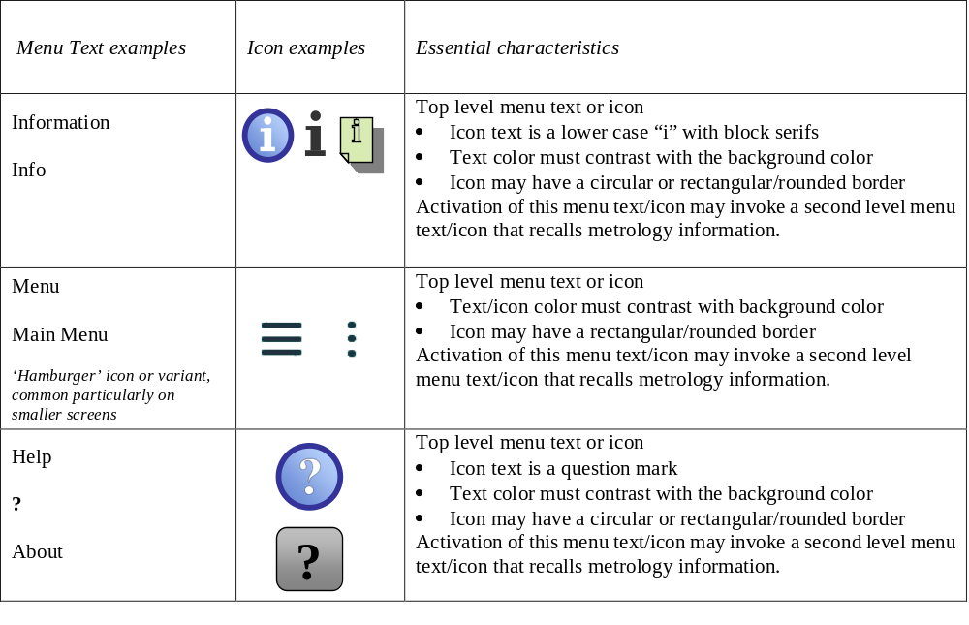
Acceptable Icons or Menu Items
Only a subset of examples shown here
See Publication 14, Software Technical Policy and Supplemental Checklist, for complete list
Software in W&M Certification and Inspection

Slide 16
Examples from the Field
Look up the Certificate of Conformance for the device
Examine instructions in the Certificate of Conformance on how to locate the software identifier and/or the audit trail in the software
Explore various implementations on specific types of devices and look at how each one indicates the software version
Software in W&M Certification and Inspection

Slide 17
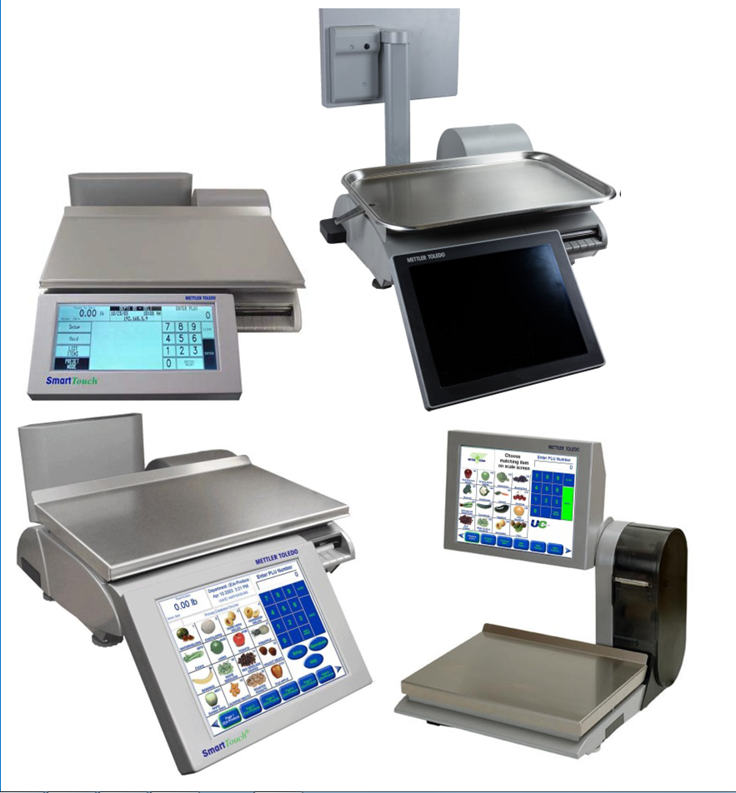
Example 1: Scales
Many digital scales are now made using the same pattern. For example, the scale shown is a collection of electronic hardware, practically the same as a PC, except is it purpose built.
Most of the hardware components are the same as in a standard PC, except for the instrument-specific components - the load cell and custom-made integrated housing to contain the hardware.
Devices are networkable, making it possible to update software
Software in W&M Certification and Inspection
Notes:
Why build a device from generic PC components?
PC parts are fairly inexpensive because they are made in high volumes and provide very good value for their cost.
To make this collection of electronic parts sort of useful, we add an operating system that allows the user and other applications to access the hardware. Operating systems are not economical to write from scratch anymore, because of how sophisticated even the basic equipment has become. Virtually everyone starts with an off-the shelf operating system and customizes it by adding support for their specialized hardware like the load cell, printer and custom displays. The big players are Microsoft and Linux derivatives. Upcoming are mobile operating systems like Android.
Software is plentiful and easy to develop on these platforms (Linux, Windows, iOS, Android)
To make it really useful we add the Scale Application. This software application loads at startup and never stops. It helps make the scale a built-for-purpose device. The User only interacts with the Scale application; they don't have access to the Operating system or other applications.

Slide 18
Example 1: Scales - Summary
Many digital weighing devices are made using PC hardware, an off-the-shelf operating system, and a Scale application.
Systems like this, using mobile handheld devices with operating systems like Android or Apple IOS with a scale interface or other NTEP approved application running on it, are becoming more prevalent.
Some mechanism to ensure valid software is in place (and to prevent invalid software from being installed) is important to the design of these devices.
Software in W&M Certification and Inspection
Notes:
Most digital scales can be connected to a computer network, thanks to low cost hardware and availability of a network in many businesses. This enables price updates, software maintenance, and troubleshooting to be accomplished without visiting the scale. This can provide big savings in maintenance and cost of ownership.
For example, most large grocers have the ability to download new software from their corporate IT department into their scale in the stores using their internal network.

Slide 19
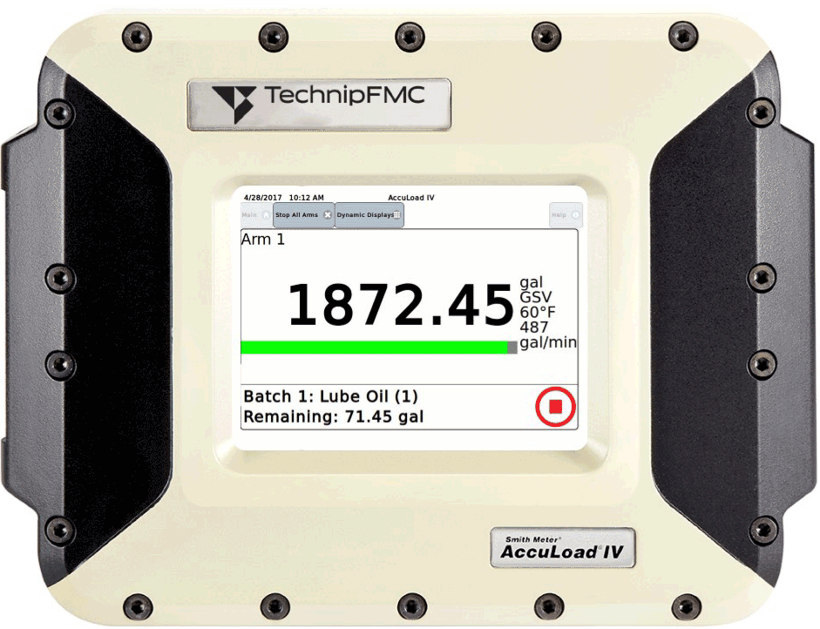

Example 2 – LMD
Wholesale Meter Register (Preset batch controller)
Like the scale example, utilizes an off-the-shelf OS
Software in W&M Certification and Inspection

Slide 20
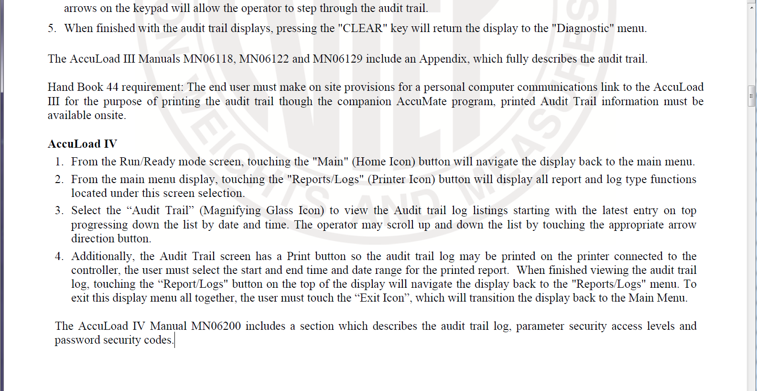
Example 2 – LMD – Information in CoC
Software in W&M Certification and Inspection
Notes:
Like with the audit trail instructions, eventually the requirement to find the software identifier will be important as well. (As previously mentioned, the requirement to provide the identifier becomes enforceable as of Jan 2022.)
AccuLoad IV
1. From the Run/Ready mode screen, touching the "Main" (Home Icon) button will navigate the display back to the main menu.
2. From the main menu display, touching the "Reports/Logs" (Printer Icon) button will display all report and log type functions
located under this screen selection.
3. Select the “Audit Trail” (Magnifying Glass Icon) to view the Audit trail log listings starting with the latest entry on top
progressing down the list by date and time. The operator may scroll up and down the list by touching the appropriate arrow
direction button.
4. Additionally, the Audit Trail screen has a Print button so the audit trail log may be printed on the printer connected to the
controller, the user must select the start and end time and date range for the printed report. When finished viewing the audit trail
log, touching the “Report/Logs" button on the top of the display will navigate the display back to the "Reports/Logs" menu. To
exit this display menu all together, the user must touch the “Exit Icon”, which will transition the display back to the Main Menu.
The AccuLoad IV Manual MN06200 includes a section which describes the audit trail log, parameter security access levels and
password security codes.

Slide 21
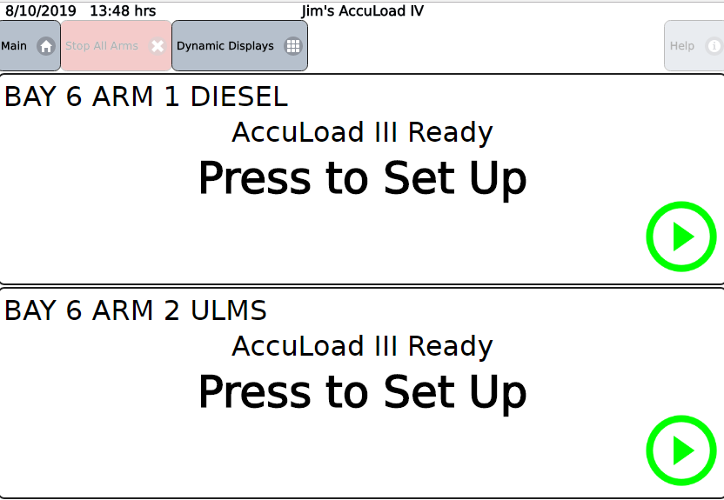
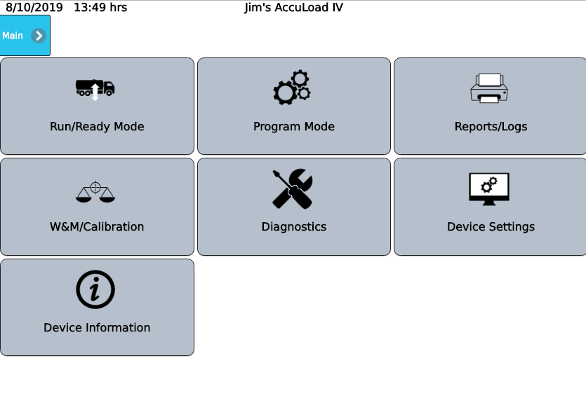
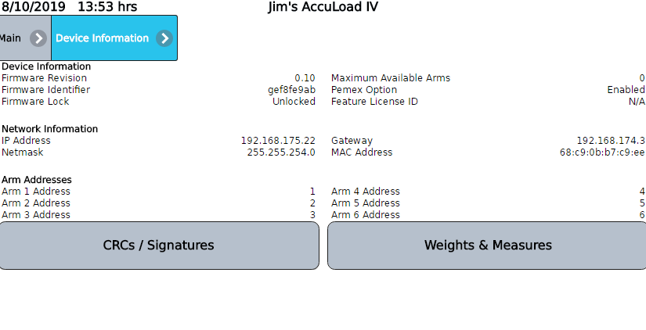
Example 2 – LMD (cont.)
Software in W&M Certification and Inspection
Notes:
Here is another example of a device that can be updated in the field. Any of the sealing philosophies defined by NTEP can be applied to this device, but for most installations it is configured to utilize a Category III audit trail for the maximum flexibility.

Slide 22
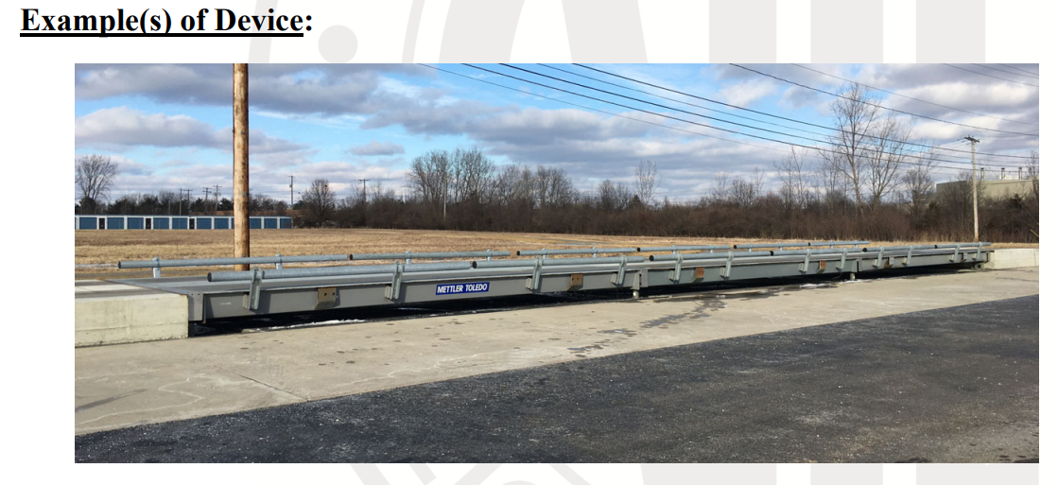
Example 3: Truck Weigh-in-Motion scale
Software in W&M Certification and Inspection

Slide 23
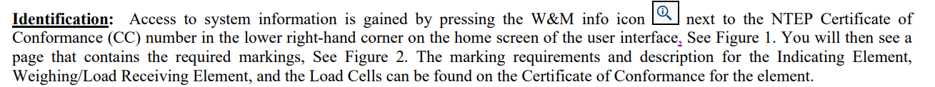
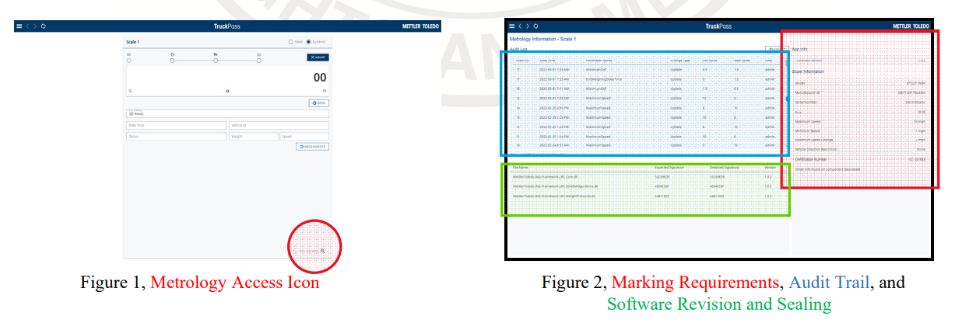
Example 3: Truck Weigh-in-Motion scale
Software in W&M Certification and Inspection

Slide 24
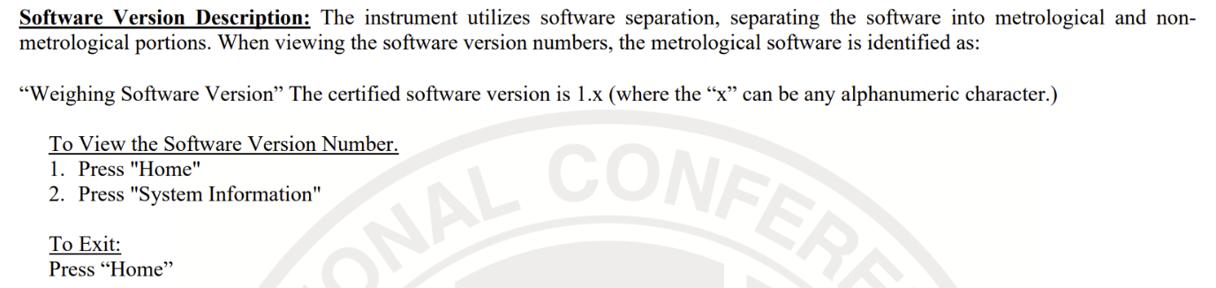
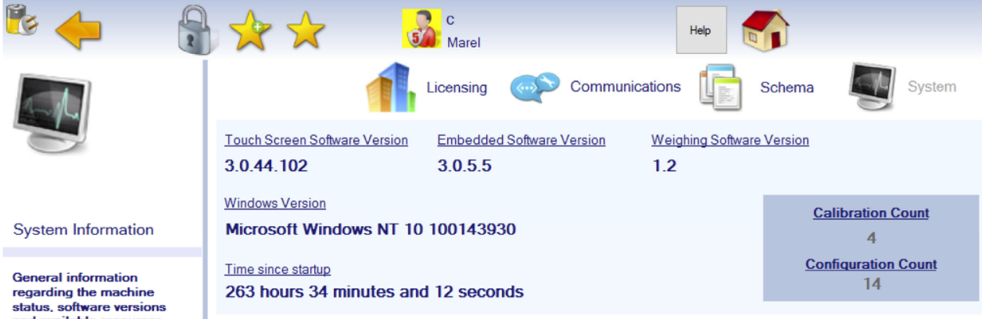
Example 4: Automatic Weighing System
Software in W&M Certification and Inspection

Slide 25
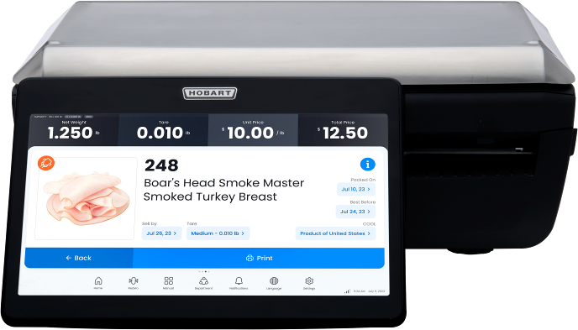
Example 5: Computing Scale
Identification: The data plate is located on the frame of the scale underneath the integrated printer located on the right side of the device. To view remove the printer cartridge from the device. Capacity by division is displayed on the operator and customer screen continuously when in weighing mode. The NTEP CC number and metrological software information is located on the Weights and Measures information page and can be accessed by selecting Menu icon, then “Weights and Measures” on the front panel touch screen. In the case of Self Service, Weights and Measures information page may be accessed by touching in the metrological area (lower left) of the screen.
Software in W&M Certification and Inspection

Slide 26
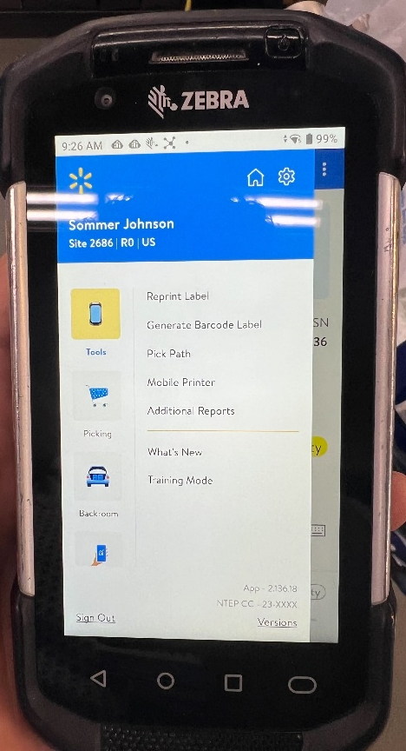
Example 6: Point of Sale Application
Identification: All applicable markings are accessed by tapping the “Tools” icon located in the main menu, then the “Additional Reports” button. The Application Software number and NTEP CC number will then be displayed in the lower right corner of the screen. The information for the handheld device can be found by the device information page.
Software in W&M Certification and Inspection

Slide 27
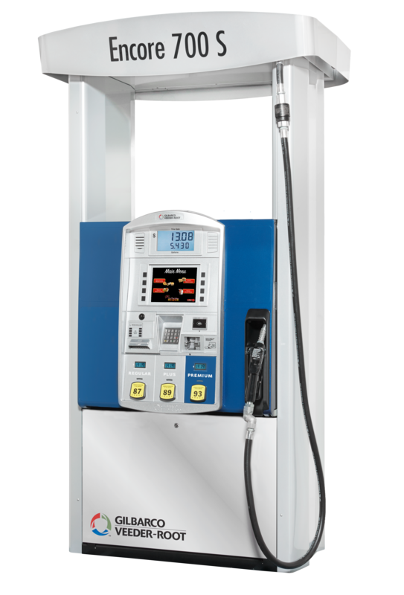
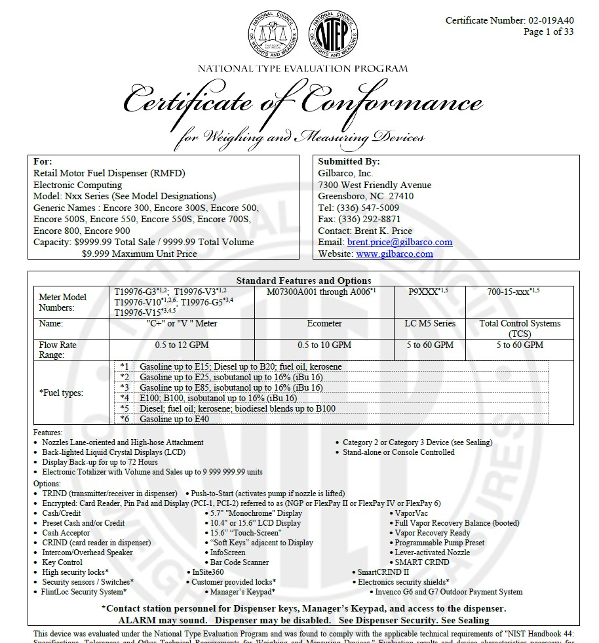
Example 7: Retail Motor Fuel Dispensers
Software in W&M Certification and Inspection

Slide 28
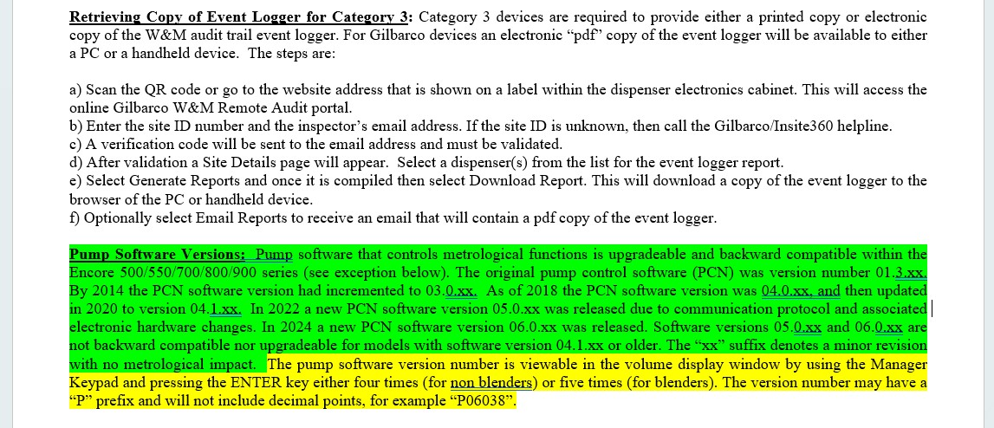
Example 7: Retail Motor Fuel Dispensers
Software in W&M Certification and Inspection

Slide 29
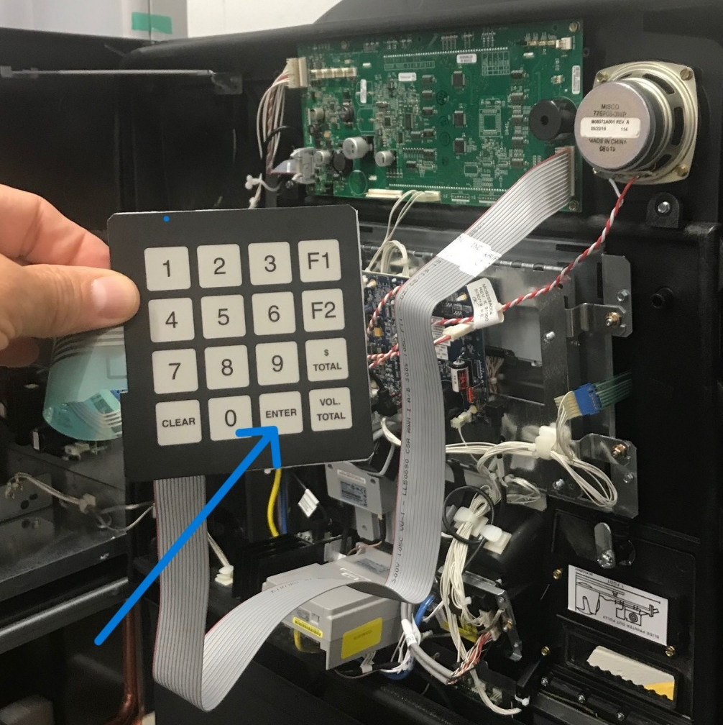
Example 7: Retail Motor Fuel Dispensers
Software in W&M Certification and Inspection

Slide 30
Difficult Situations
What can you do if you don’t have a Certificate of Conformance number?
  Is there a make and model number?
  Contact the manufacturer to obtain identification
  Try searching NTEP database based on just make, model, or manufacturer
If the device is in operation, how do you access what you need without interrupting measurement?
  Work with onsite facility personnel or service provider to get help
What do you do if the device doesn’t match what’s on the Certificate of Conformance?
  It depends on what’s different and why. The jurisdiction determines the appropriate action.
Software in W&M Certification and Inspection
Notes:
Certificate of Conformance ideally should be hard-marked on the nameplate for built-for-purpose devices and continuously displayed for not-built-for-purpose devices.

Slide 31
Conclusion
Weighing and measuring devices containing software typically have the same major components as a PC, including hardware, an operating system, and one or more software applications
The Certificate of Conformance should include explicit instructions on how to identify the software, particularly if it deviates from standard methods
Software in W&M Certification and Inspection
Notes:
As time progresses the line between ‘built-for-purpose’ devices and ‘not-built-for-purpose’ devices continues to blur. Many ‘built-for-purpose’ devices are just PCs in sheep’s clothing. They may have input/output devices that don’t look like a regular computer, or physical seals, etc. that provide features unavailable on an off-the-shelf PC, but inside they’re more similar than not. For these reasons, the regulations have moved toward treating these two classes of devices the same.

